Slide 1
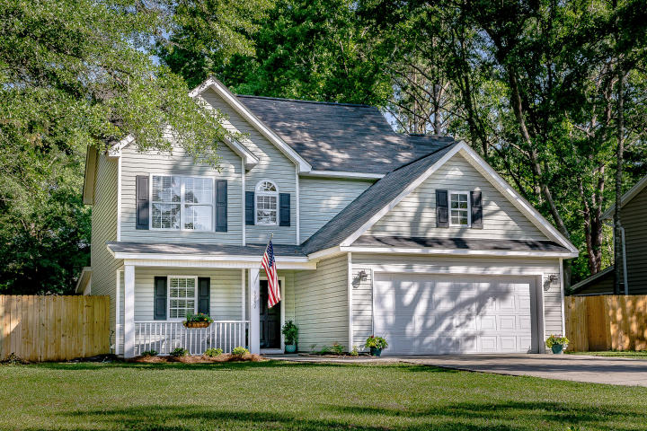
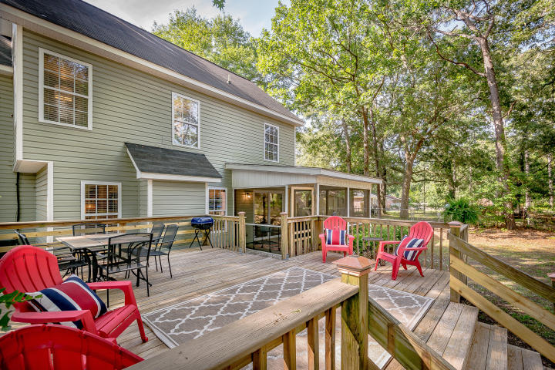
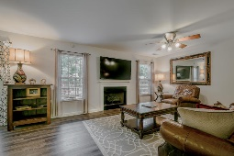
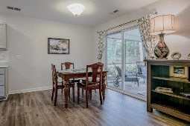
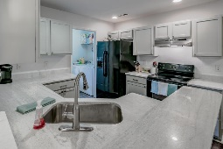
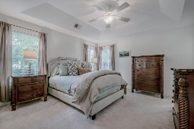
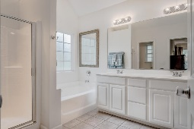
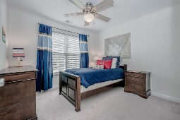
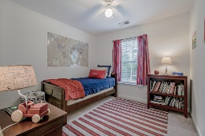
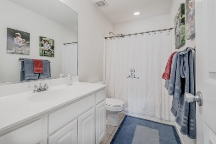
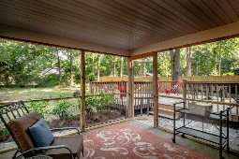
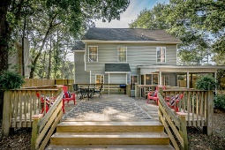
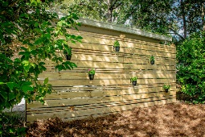
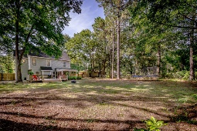


Open House Sunday (7/29) - 1-3pm
NEW PRICE ~ Over 1/3 Acre + No HOA
3292 Berryhill Road
Cedar Springs | Johns Island | MLS# 18018149 | $269,995
Don't miss this one! Bring your boat and get ready for some outdoor entertaining on this wonderfully large lot (over 1/3 an acre) with no HOA! Brand new Luxury Vinyl Plank (100% waterproof) floors downstairs, Quartz kitchen counters, new backsplash, new fencing, one year old stain resistant carpet, tile floors in upstairs bathrooms and freshly painted walls. Beautiful master suite with tray ceilings in bedroom and vaulted ceilings in bathroom. Large walk-in closet, garden tub, shower and separate water closet. Enjoy dining and relaxing outside on the screened porch and over-sized deck. Plenty of room for a pool, fire pit, etc. One year Home Warranty with Global Home Warranty Included! Owner/Agent
Whitley Boyd
(843) 324-4761
w.boyd@agentowned.com
www.PropertiesofCHS.com
AgentOwned Preferred Group | 824 Johnnie Dodds Blvd | Mt Pleasant, SC 29464

