Slide 1
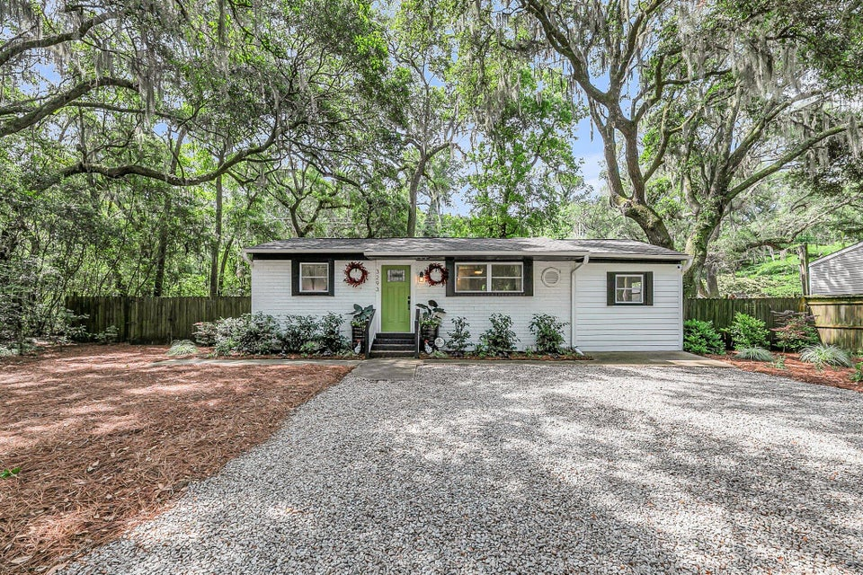
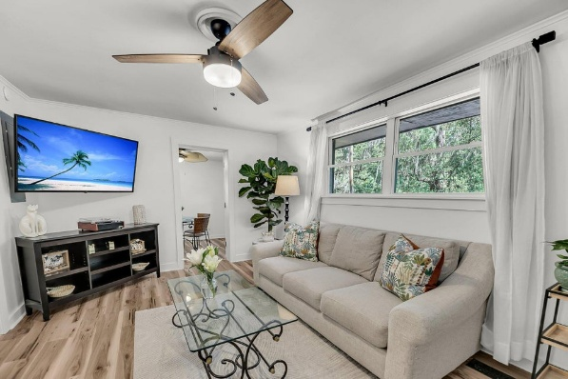
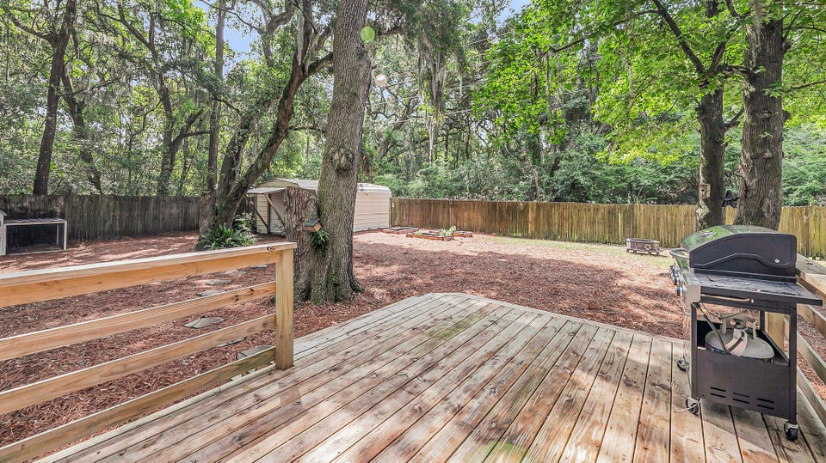
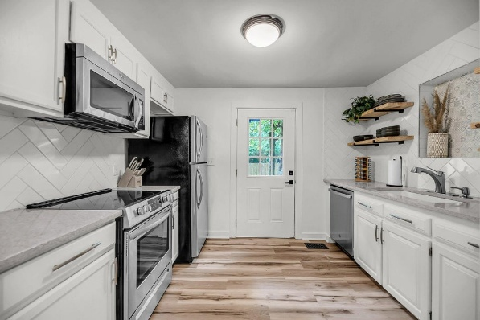



Open House
May 17th ~ 11am-1pm
4.2 Acres
3293 River Road
Walpole | Johns Island, SC 29455
MLS# 25012637 | $425,000
3 Bedrooms | 2 Bathrooms
1,070 SF | Year Built 1970
Stephanie Howard
REALTOR
843-224-5912
stephanie@stephanie-howard.com
www.findyourcharleston.com
Elaine Brabham and Associates
1890 Sam Rittenberg Blvd. #217 · Charleston, SC 29407

