Slide 1
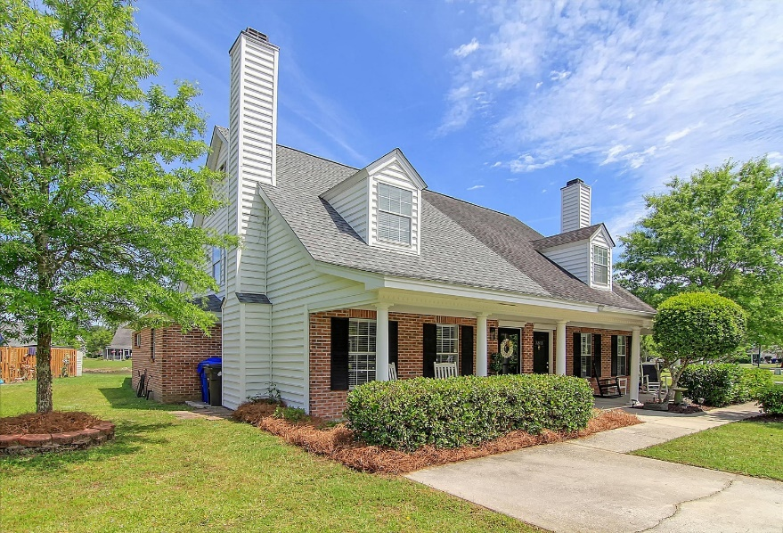
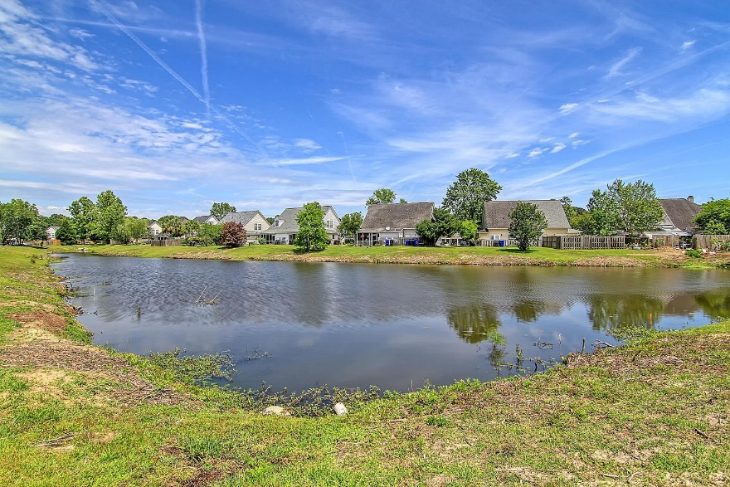
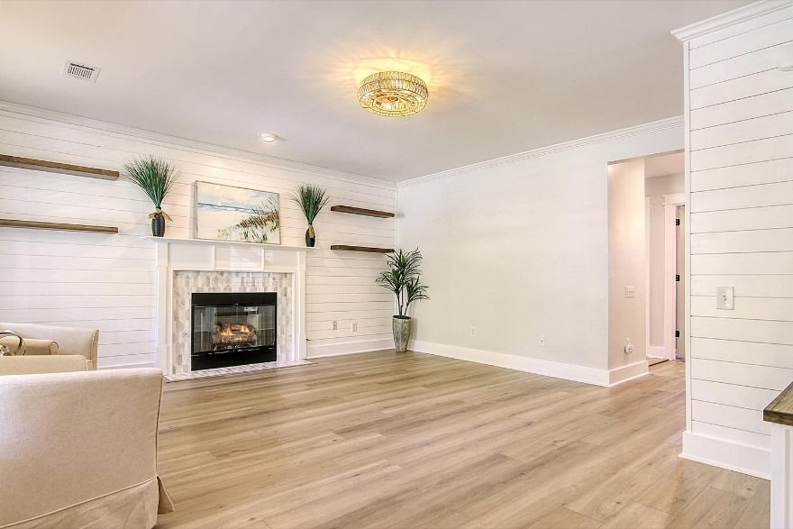
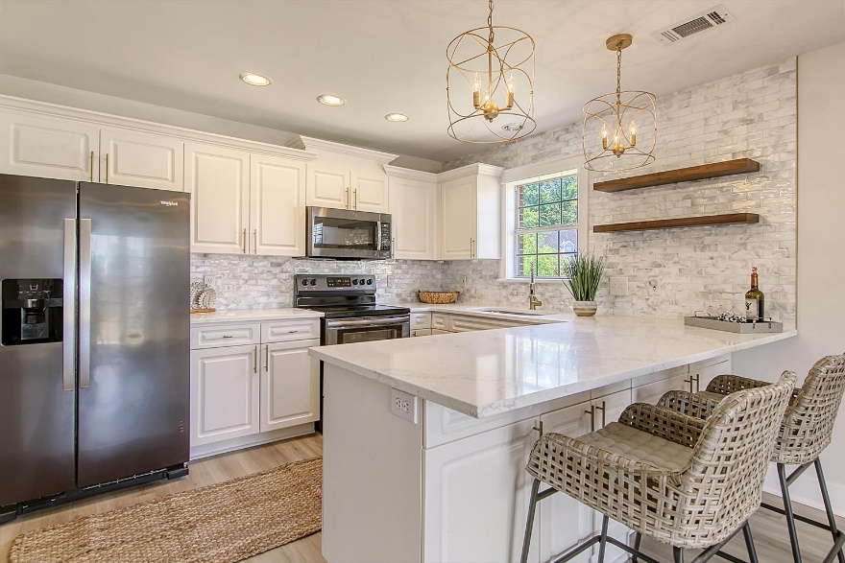


New Listing
Like New
3299 Queensgate Way
Park West | Mount Pleasant, SC 29466
MLS# 23009039 | $429,500
Chrissy Strickland
843-906-5553
chrissyresiderealestate@gmail.com
www.residerealestatellc.com
LIKE NEW!! Fully renovated and updated from top to bottom!! The turnkey property you've been looking for without the new construction wait! Amazing updates and attention to detail will catch your eye upon entering this gorgeous home! Heavy moldings and shiplap features will wow you as you walk into this bright coastal design property. Cozy up by the gas log fireplace with the dazzling tile surround and enjoy the floating shelve feature to showcase your favorite pictures or decorations. The added dropzone will help to keep you stylish and organized. Upon entering this home you are immediately embraced by fresh paint and brand new wide Luxury vinyl plank flooring throughout the entire downstairs!
Outside this rear of the property you will find a newly painted screened porch to enjoy cool spring nights, and stay bug free. Also additional fenced in space for gardening or your favorite pet. Just outside the fence is a gorgeous pond filled with nature and beauty. Finally for added piece of mind this property had a new roof installed in 2019, a new HVAC in 2017, and new PEX plumbing in 2020. Make this beauty yours today!!
Reside Real Estate LLC
155 Wingo Way Unit 421
Mt. Pleasant, SC 29464

