Slide 1
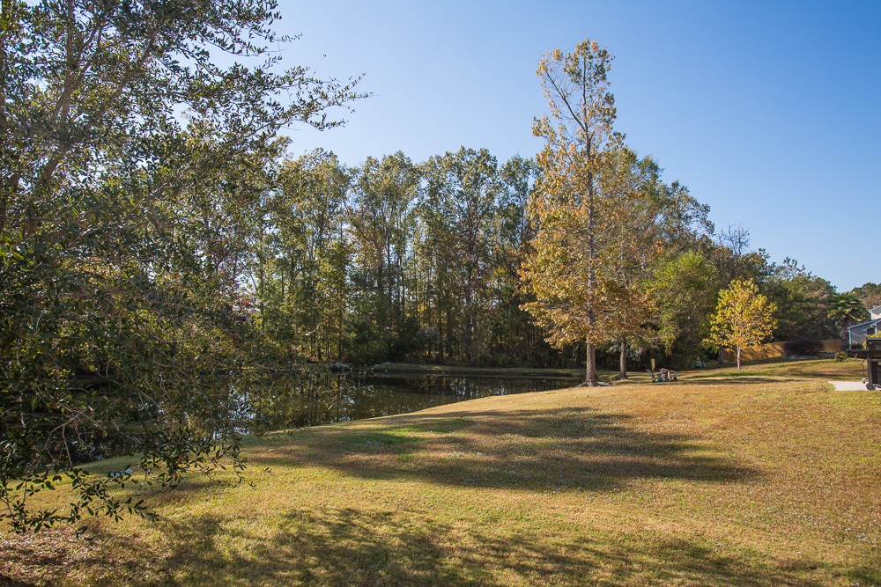
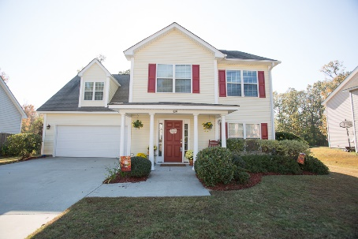
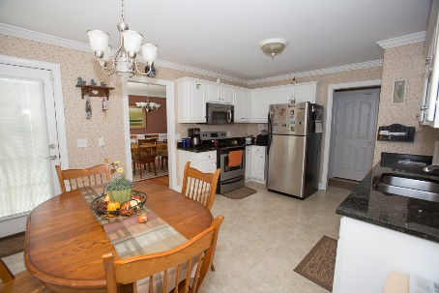
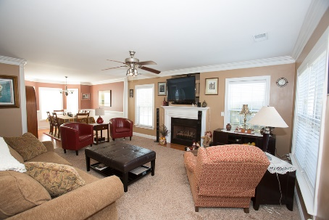
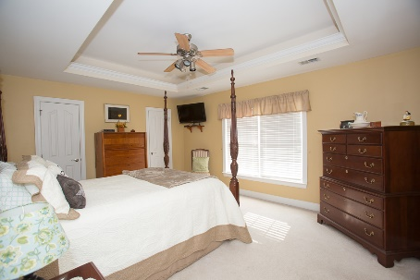
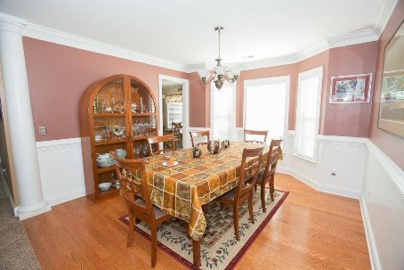
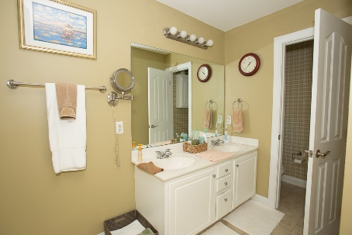


BEAUTIFUL HOME! MUST SEE!!!
329 Carriage Wheel Road
Spring Grove Plantation · Moncks Corner MLS# 16028701 · $219,900
Beautiful 3 bedroom, 2.5 bath home in Spring Grove Plantation. Exceptionally clean. Only one owner. Custom crown molding throughout, with picture-frame molding in dining room. Hard wood floors through living area. Wood-trimmed vinyl windows. Master with tub/standard shower. Stainless steel appliances. Granite counter tops in kitchen. Ceiling fans with lights in every room. 9' ceilings lower floor. Family room with natural gas log fireplace. Fisherman's dream - only 3 miles to Cypress Gardens boat ramp. Lagoon backs up to back yard. Gas grill hook up. Fully landscaped, front and back. Planned unit development with swimming pool and playgrounds.
Michael Dew
O (843) 769-5100
M (843) 870-7000
michaeledew@gmail.com
www.michaeldewrealestate.com
AgentOwned Charleston Group
902 Savannah Hwy
Charleston, SC 29407
Real Estate ● Mortgage Insurance ● Business Brokerage

