Slide 1
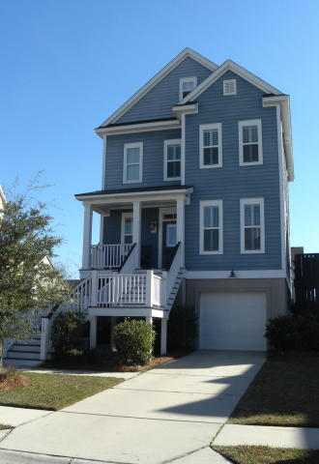
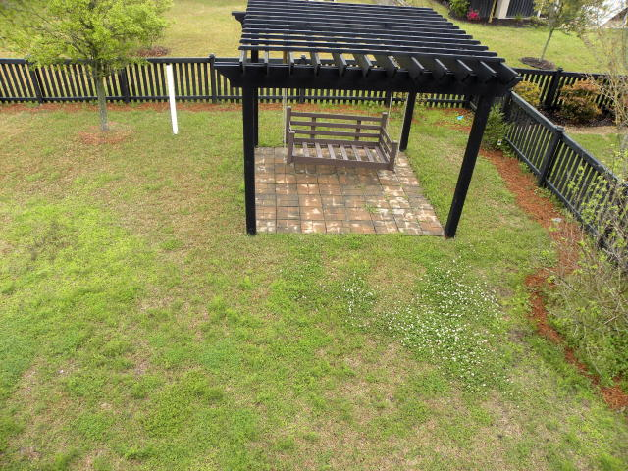
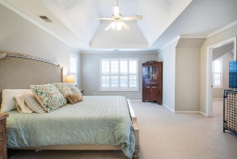
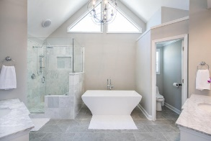
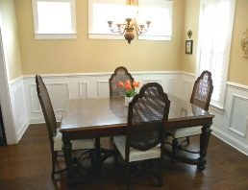
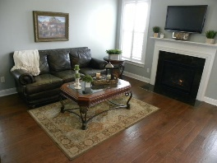
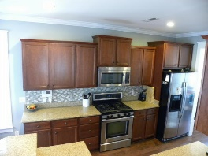
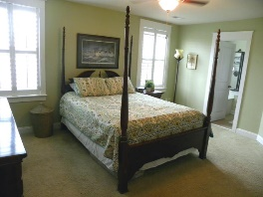
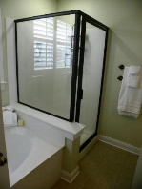
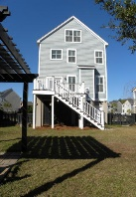



329 Megans Bay Lane
Shellring at St Thomas Island
Wando, SC 29492 ~ MLS# 17032540 ~ $410,000
Beautiful Elevated
Charleston Single
Lovely staircase and landscaped front yard begin the focal point of this beautiful 3-story home. Upon entering this well sought after Hayfield floor plan, you are greeted by wainscoting in the dining room, Plantation shutters, crown molding and beautiful hard wood floors that travel throughout the entire first floor. For the person who loves to cook, the spacious kitchen offers stainless steel appliances, GAS STOVE, recessed lighting, abundance of granite counter tops, staggered cabinets, and back splash. A pantry, eat-in kitchen area and breakfast bar are additional features of this accommodating cooking space. Kitchen is open to large family room, which makes the ideal setting for entertaining ~ it displays a gas fireplace for cozy nights and flat screen TV.
French doors lead to the deck that overlooks lovely back yard. Spacious back yard shows off a lovely pergola with swing to enjoy the Charleston weather. There is a powder room conveniently placed near entryway. The large master bedroom suite is located on 2nd floor~ it features a spacious walk/in closet and master bath has a garden tub, separate shower and a raised vanity w/ double sinks. 2 additional bedrooms are located on the 2nd floor with ample closets as well as a laundry room and another full bath. 3rd floor offers the 4th bedroom with an additional large walk-in closet...which could serve as another master bedroom. Natural light radiates throughout due to several windows and walls painted in custom paint colors. Along with the one-car garage, a ton of additional storage is located under home.
Make this gorgeous Energy Efficient home yours!
$550,000
Heather Jackson
(843) 478-0880
heather@heatherjacksonhomes.com
http://www.heatherjacksonhomes.com
Carolina One Real Estate | 900 N Main St. | Summerville, SC 29483

