Slide 1
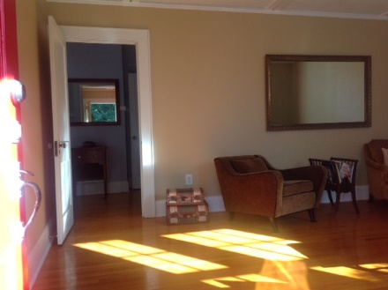
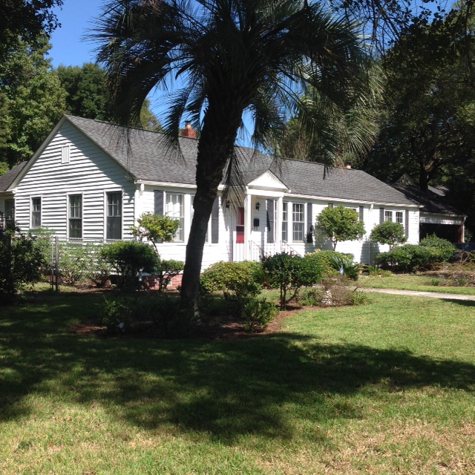

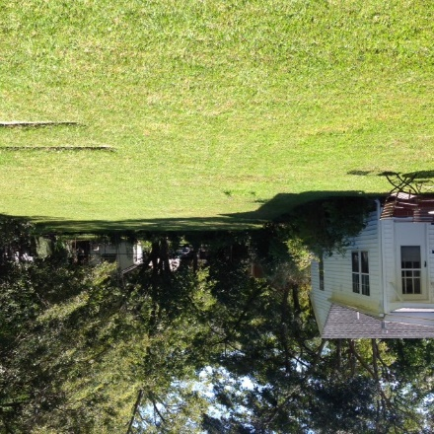
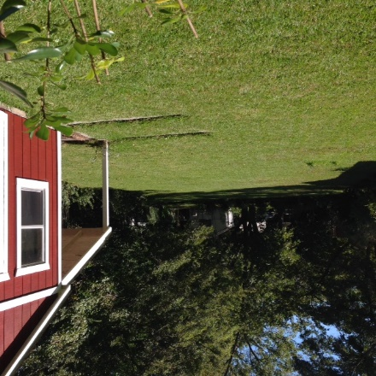
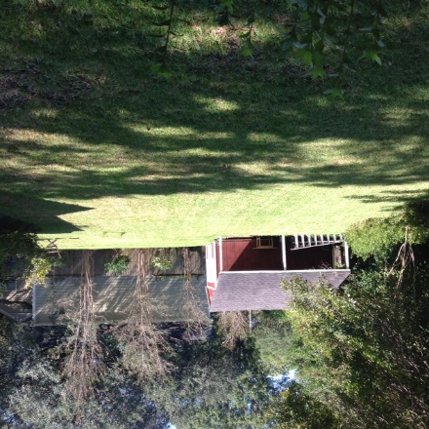

Development Opportunity in Avondale…Two Lots and One House
Perfect for a Couple
32 Rosedale Drive
Avondale ~ Charleston, SC 29407 ~ $515,000
One of the few houses in Avondale on a lot large enough to subdivide.
Many possibilities for development:
Current house can be moved over to one side of the lot, allowing a new house to be built on the other lot
Two new houses can be built
Existing house can remain and smaller house built in the rear
Coastalina Realty of Charleston 916 Palm Blvd
Ste 101 Isle Of Palms, SC 29451
Nancy Staggs, REALTOR (843) 442-7456
staggsn@yahoo.com coastalinarealtyofcharleston.com

