Slide 1
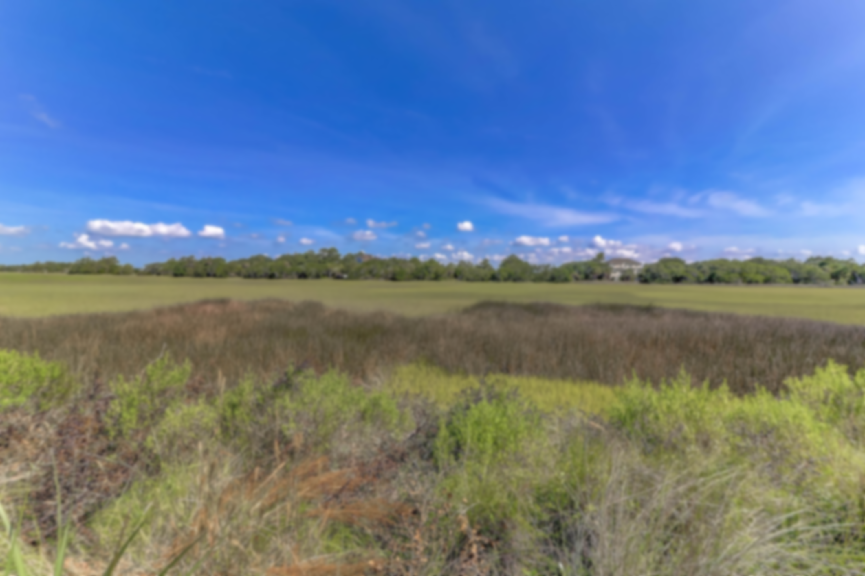
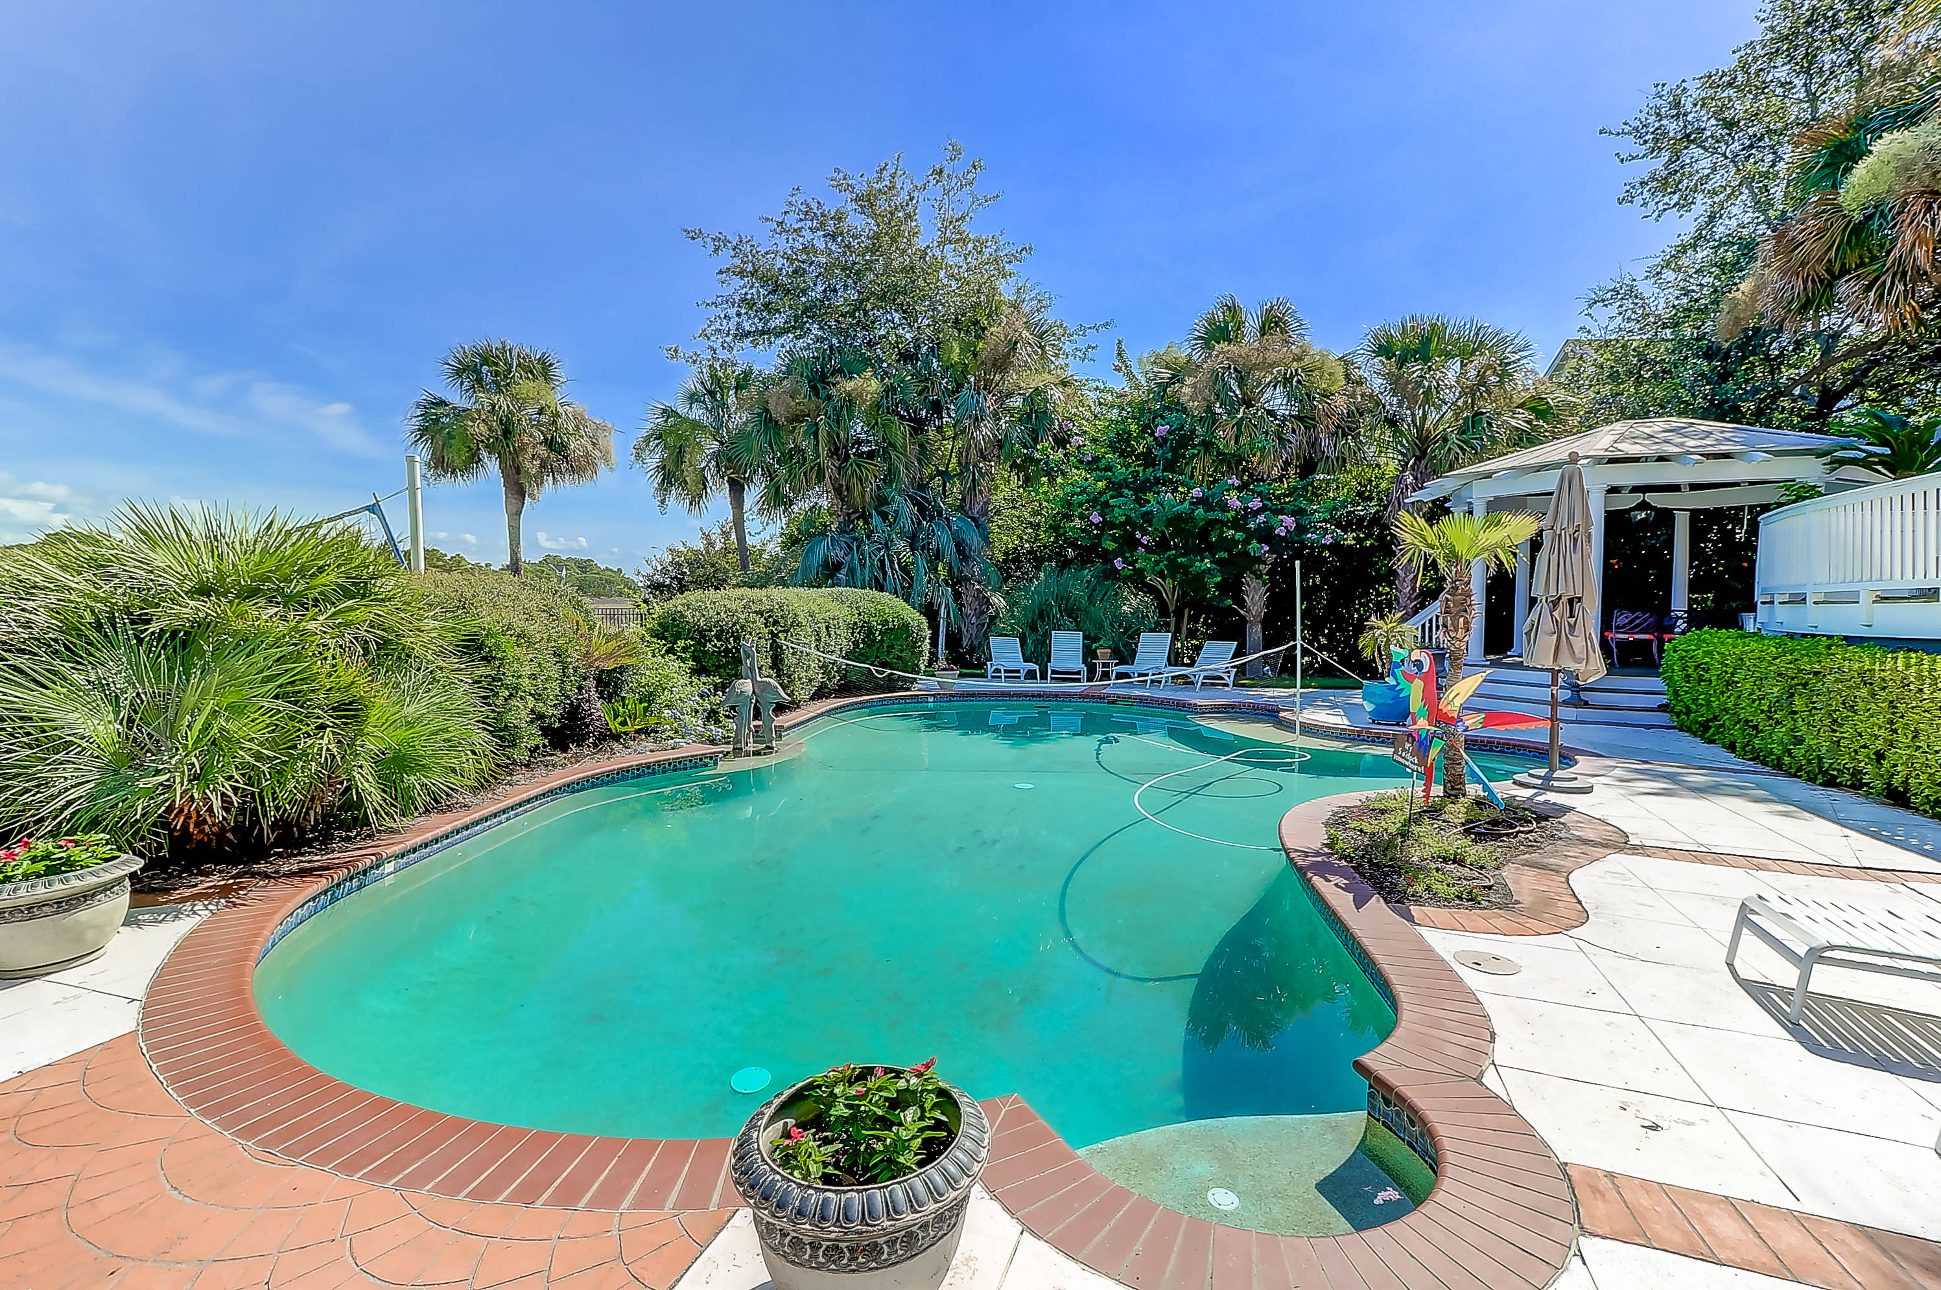
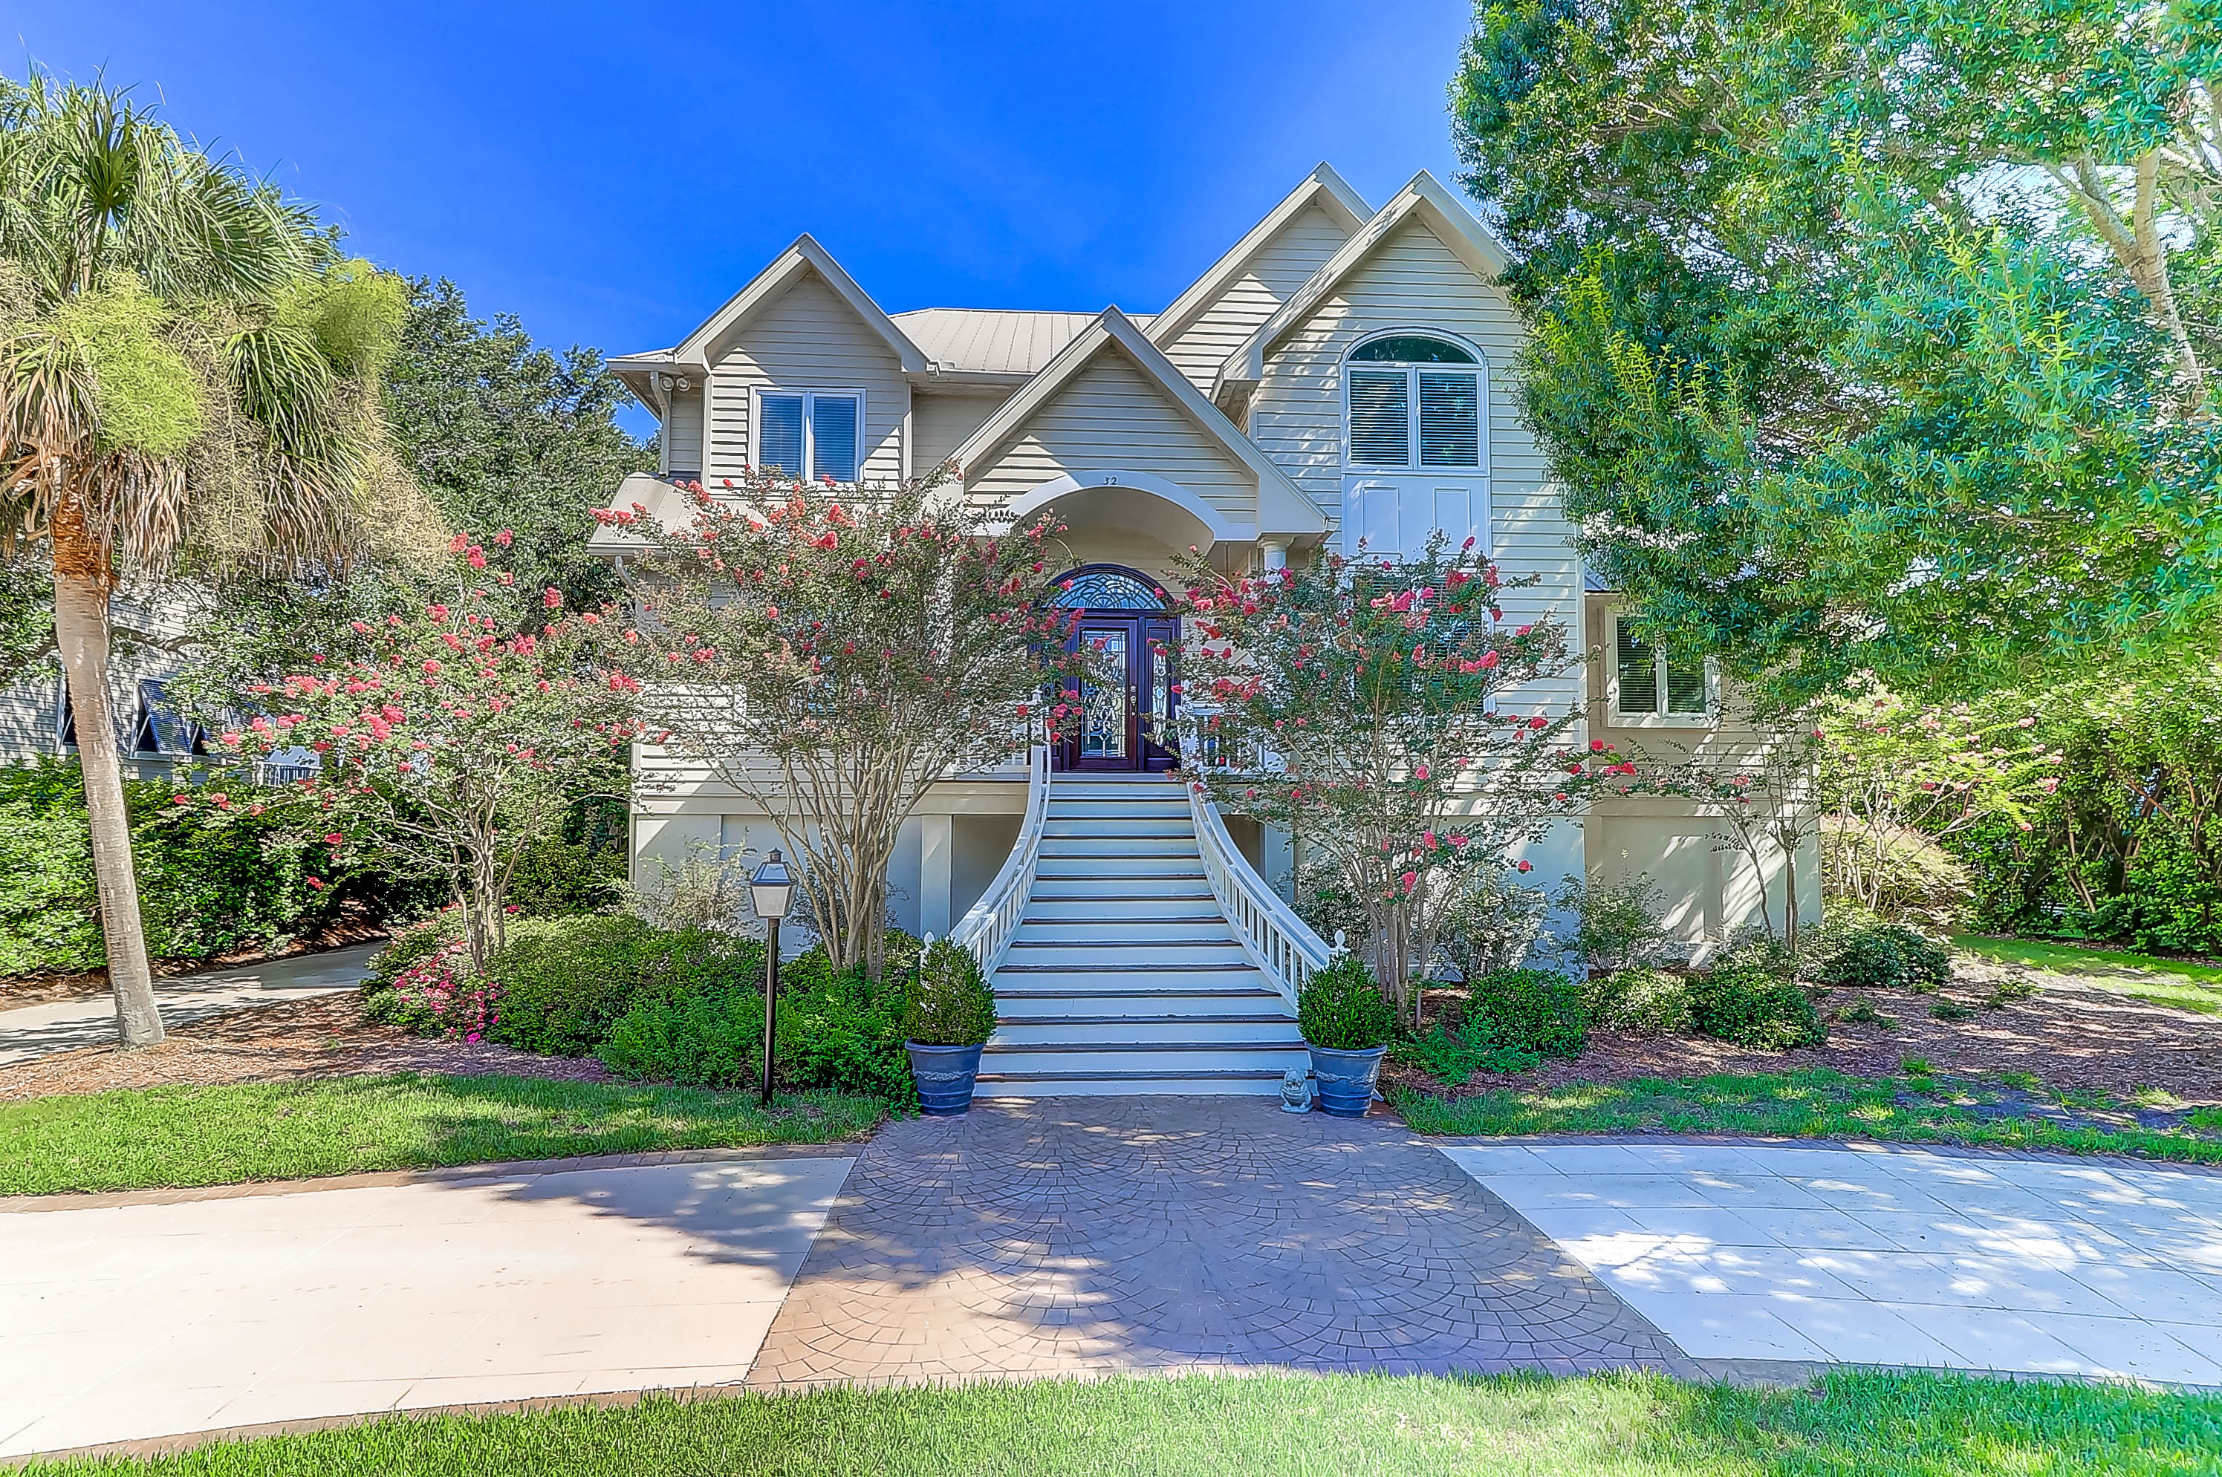
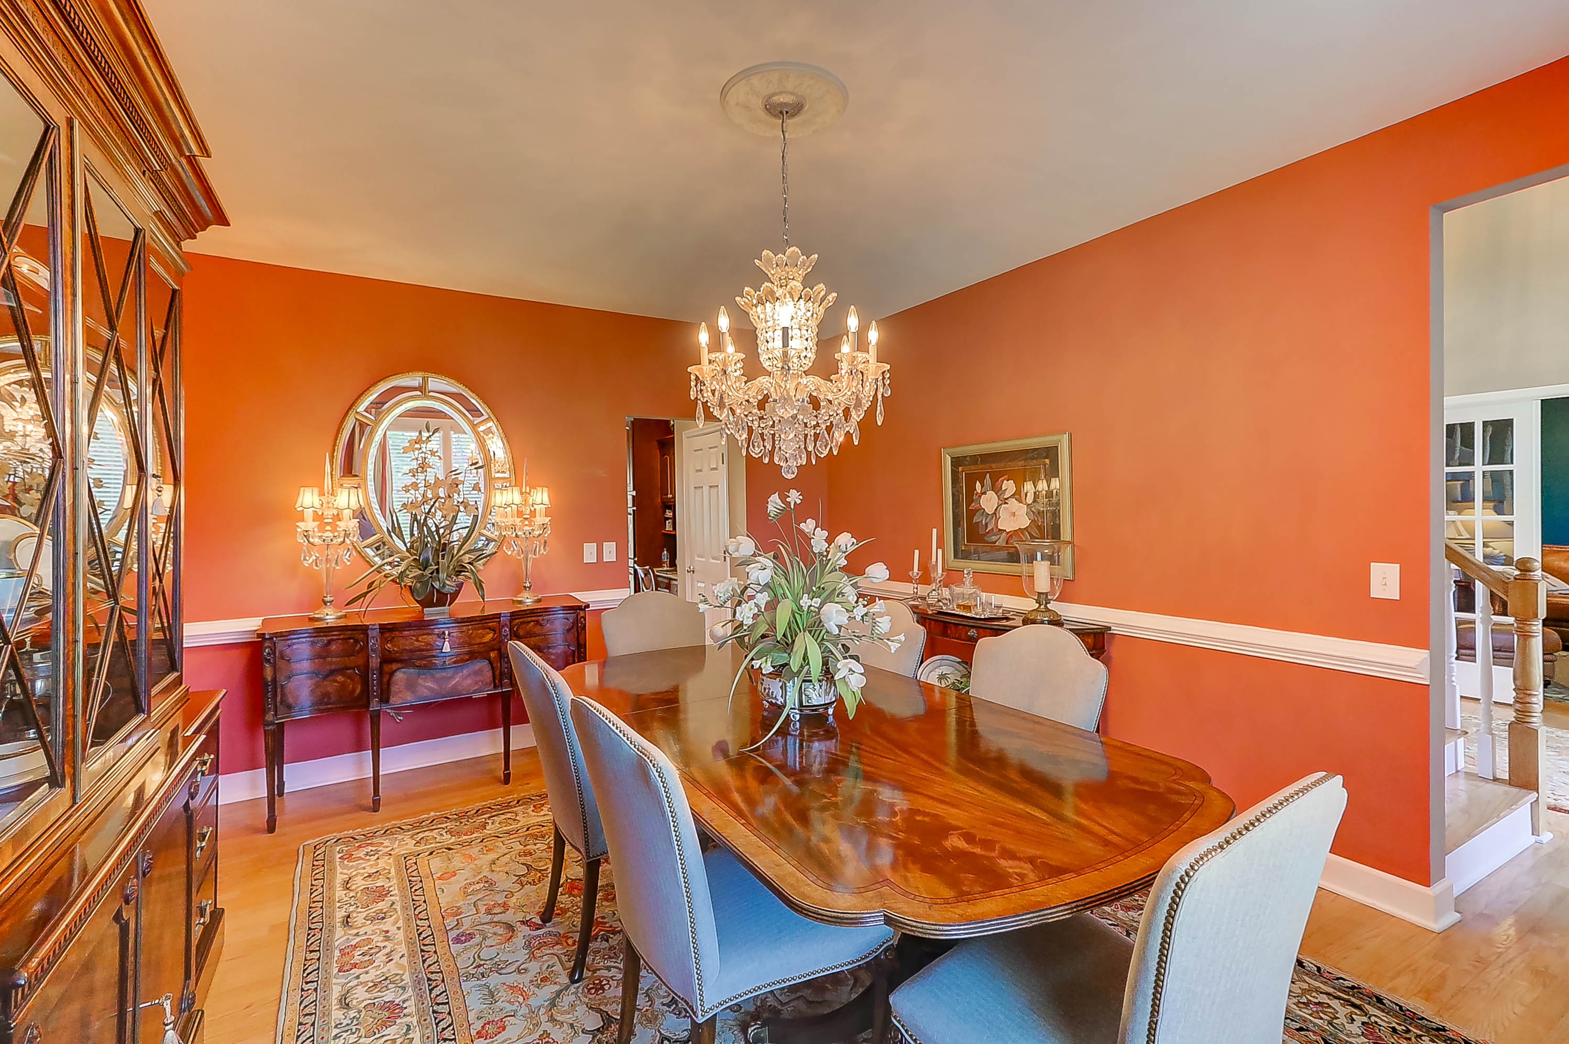
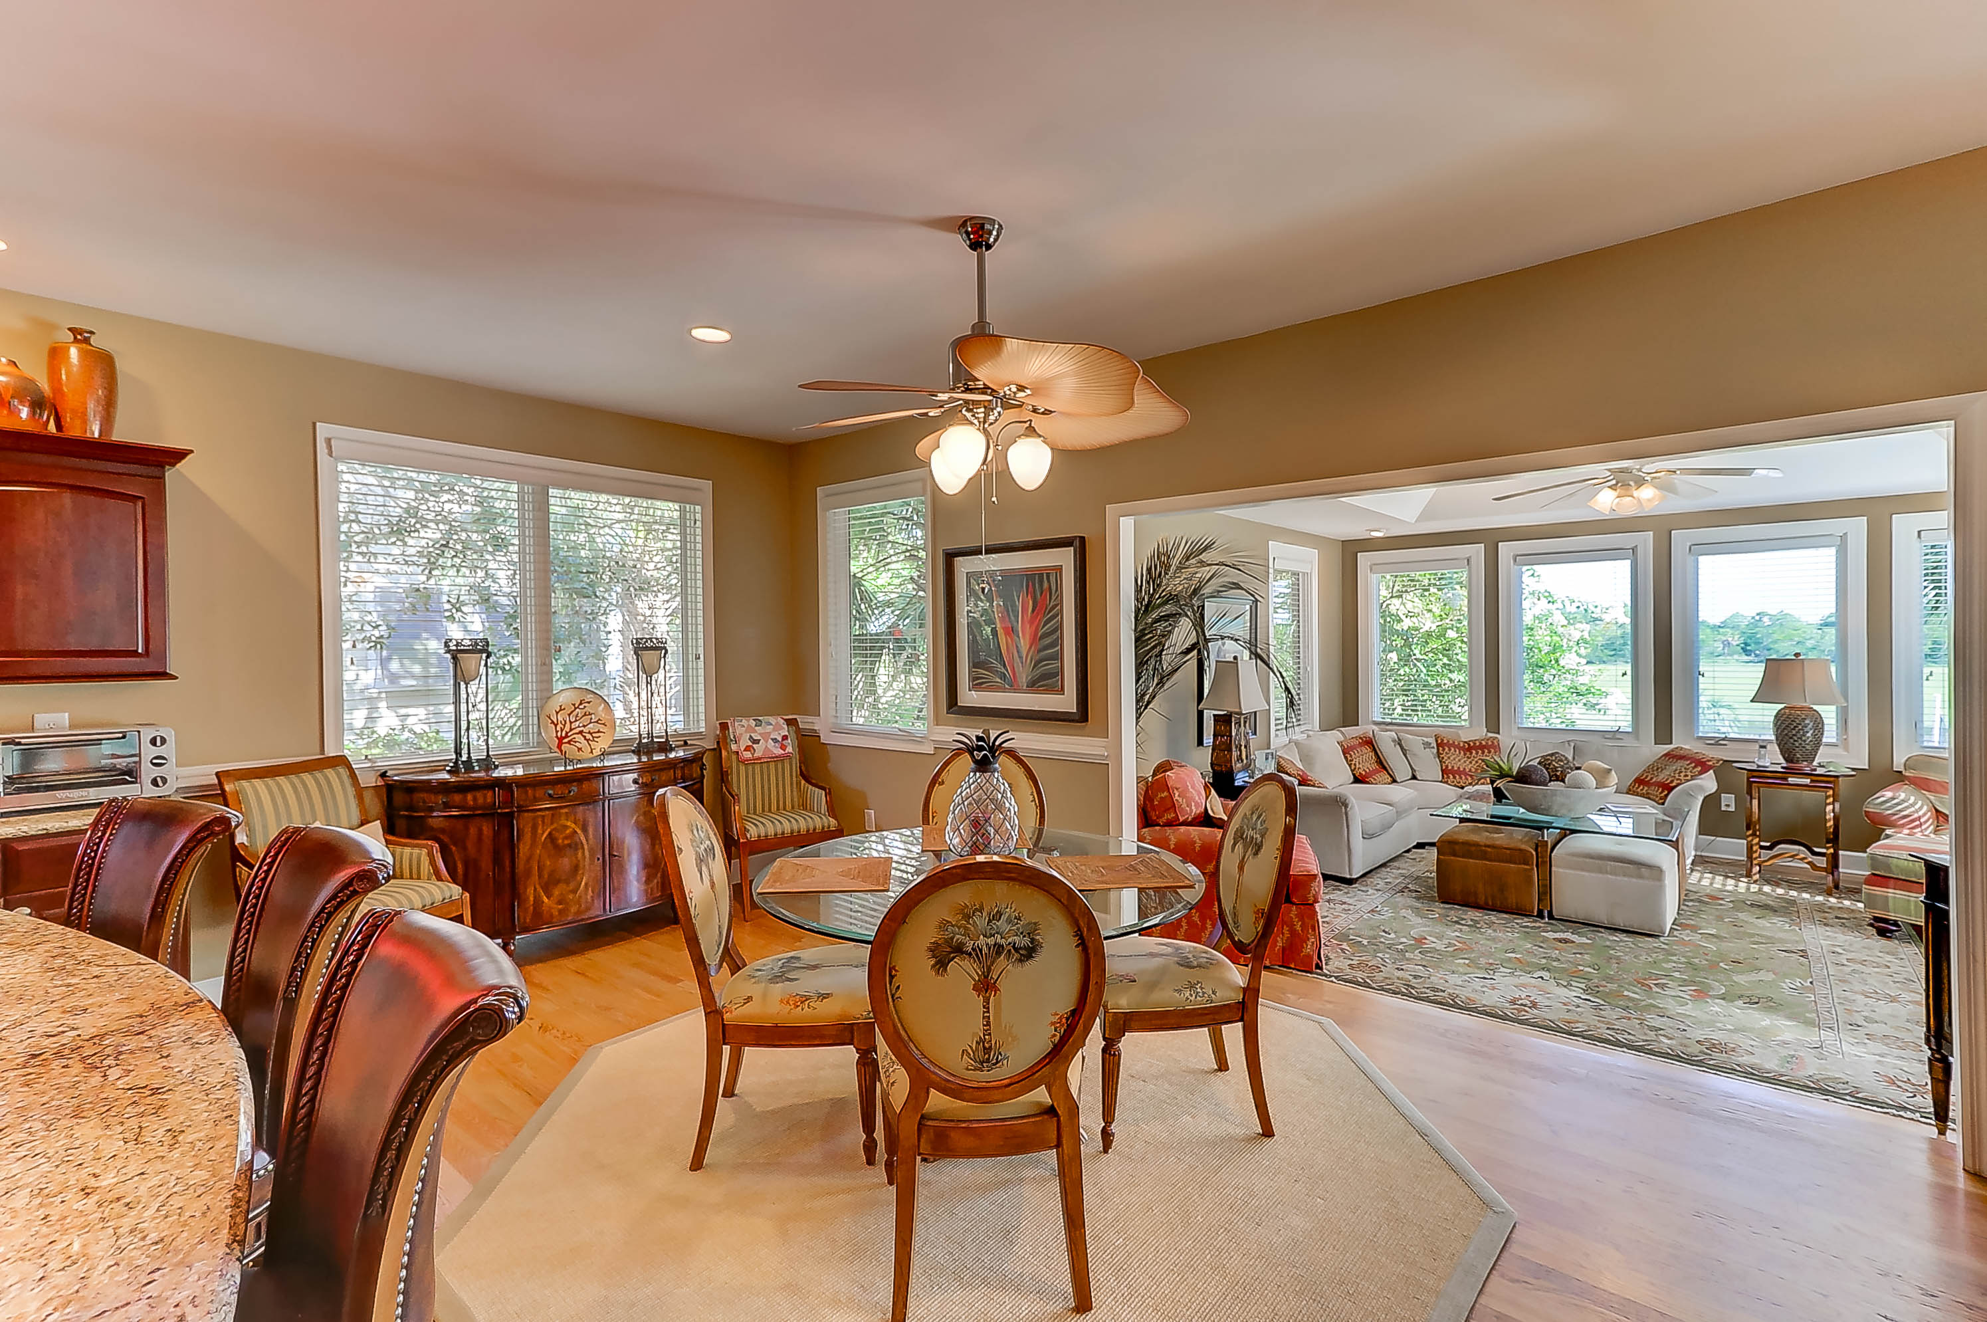
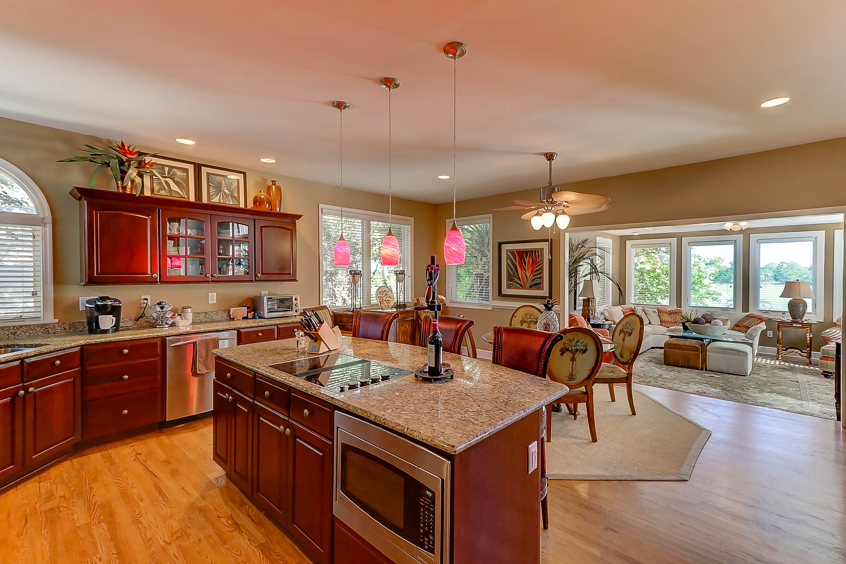
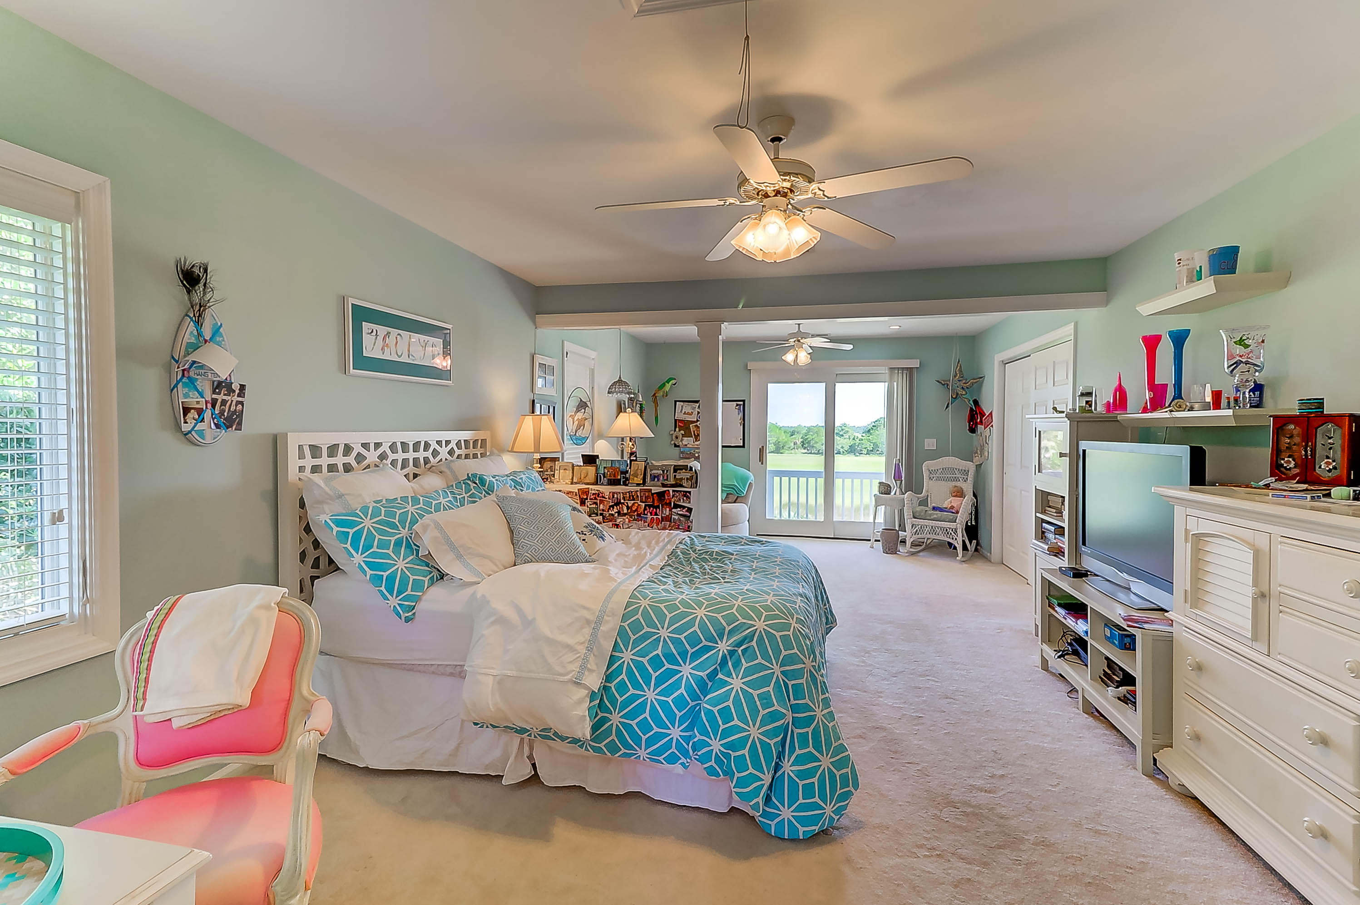
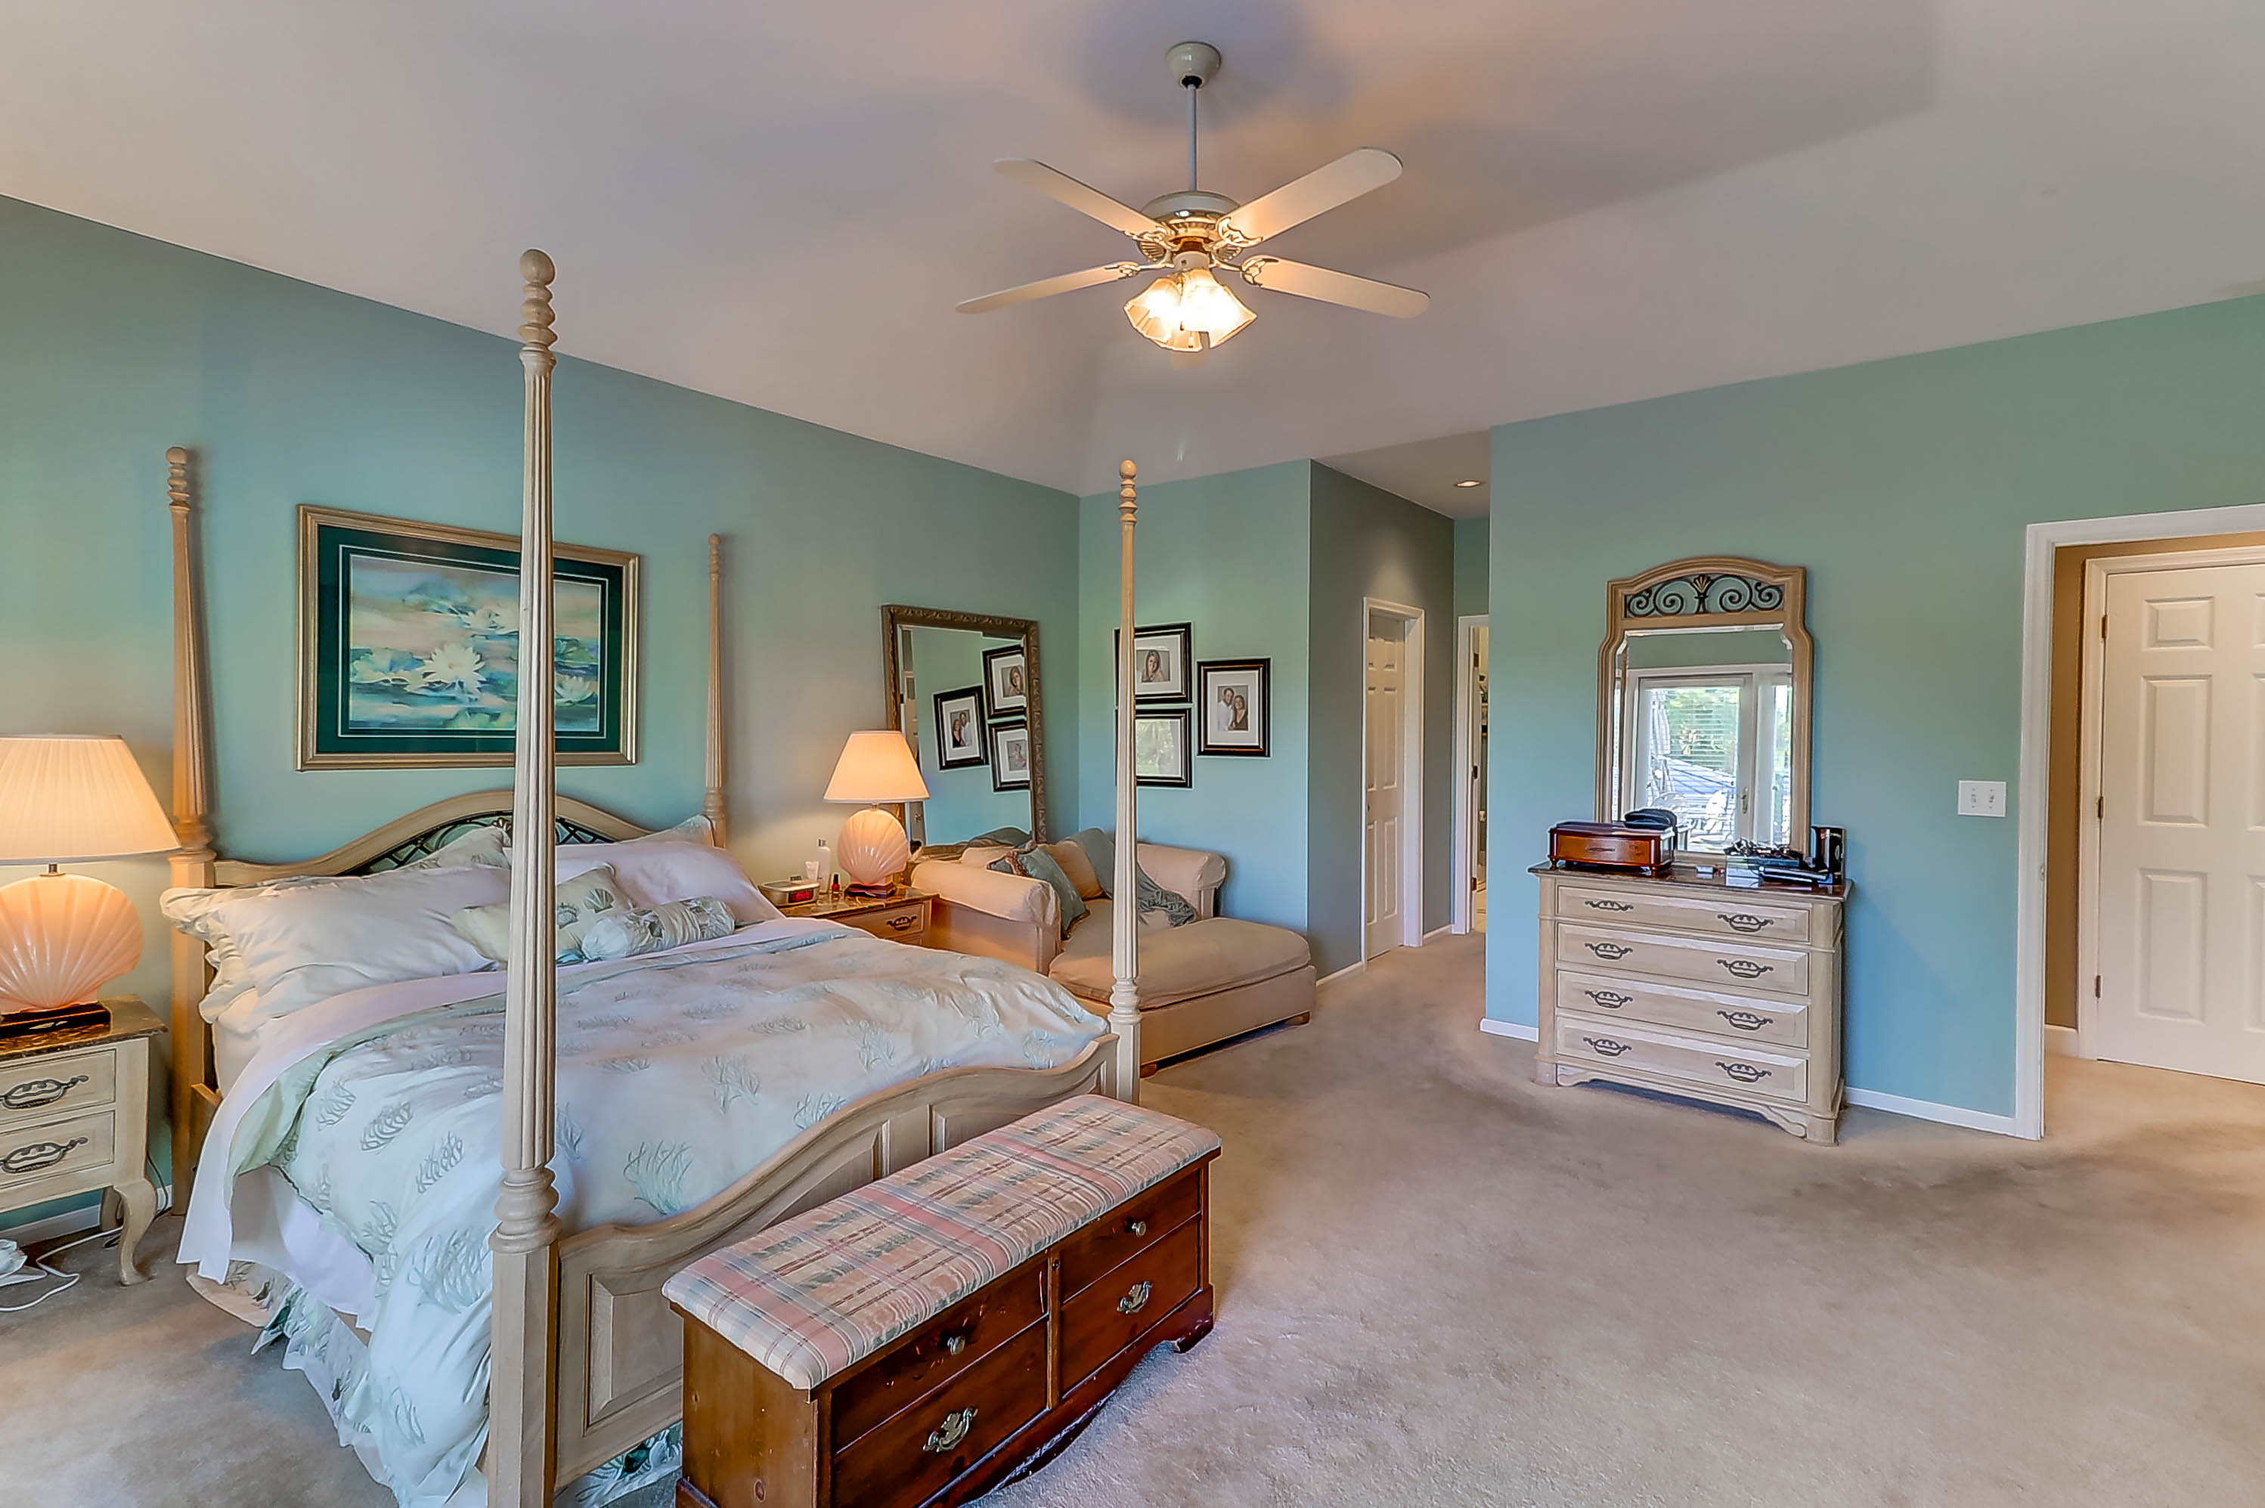
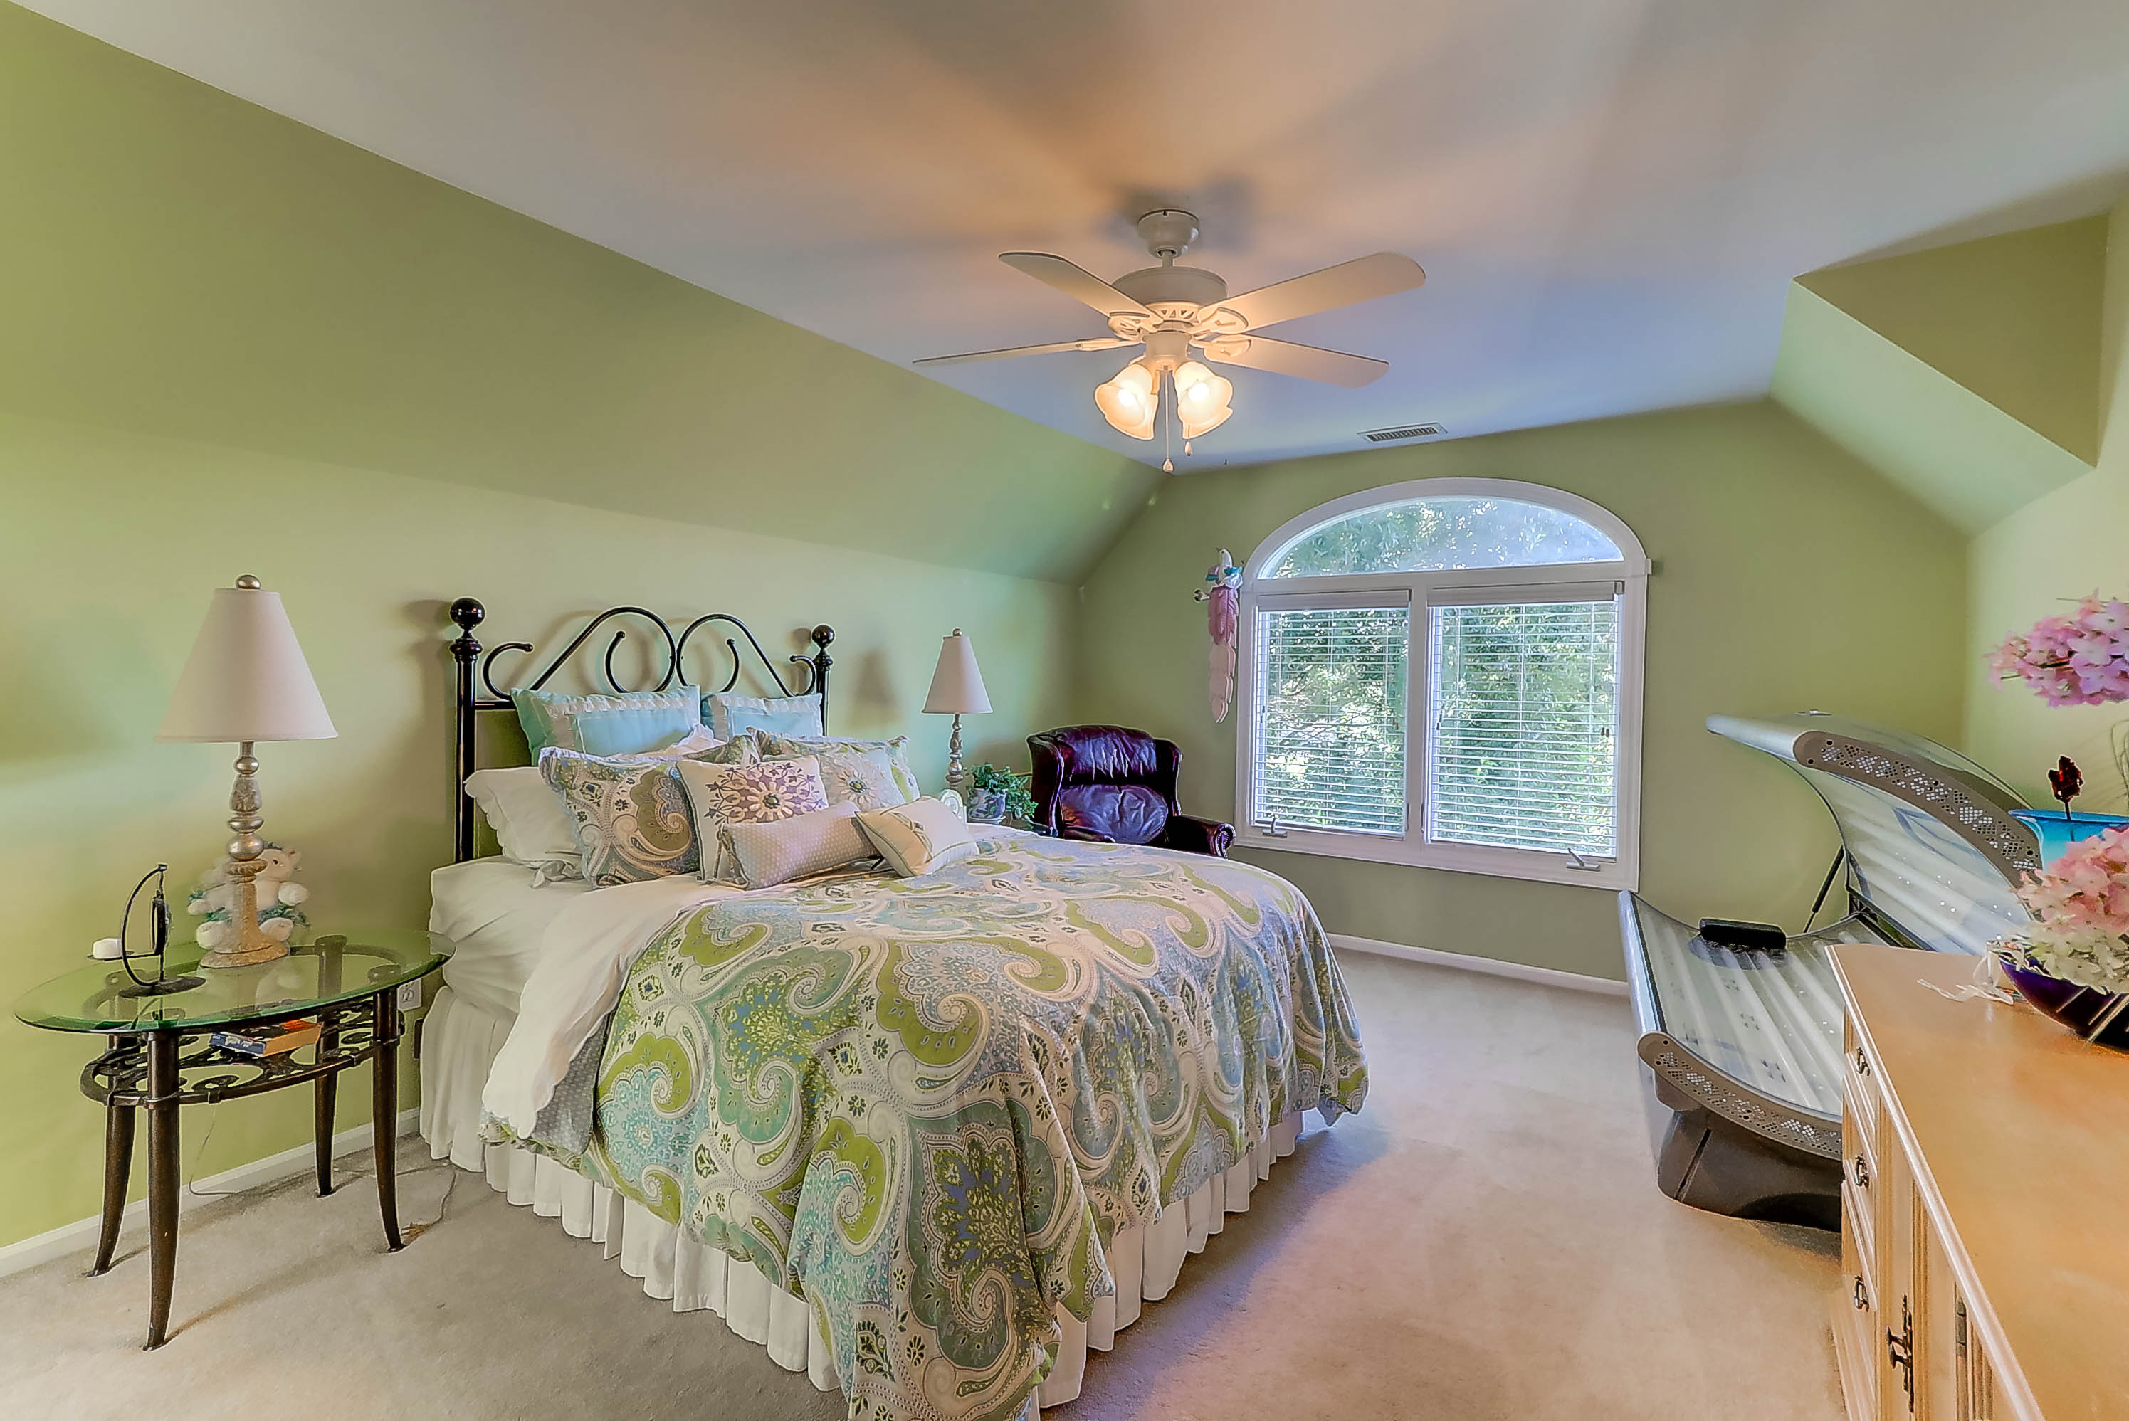
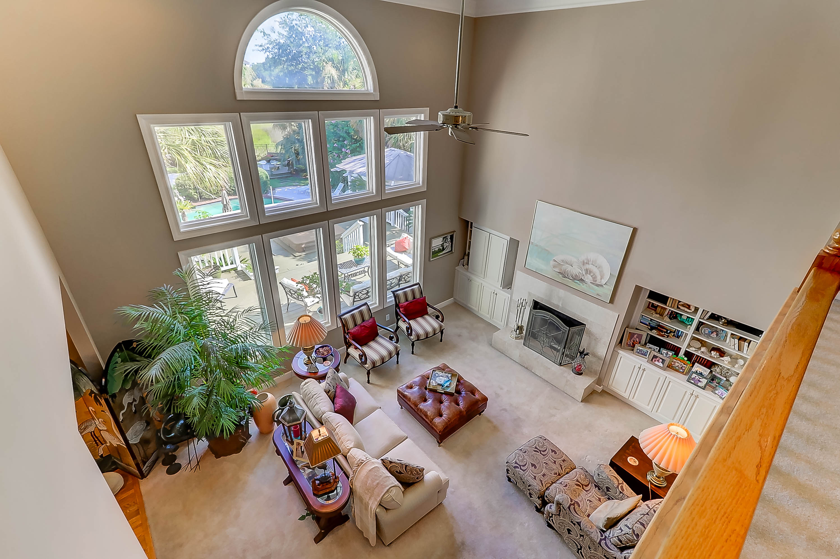


32 Seagrass Wild Dunes Isle of Palms, SC 29451 MLS# 17019716 $1,599,000
Magnificent views, nestled among beautiful trees, immediately welcomes everyone to 32 Seagrass Ln. - Out Islands. Located in one of the most desirable neighborhoods in Wild Dunes, this custom built home, with lush front yard, overlooking the 3rd hole of the Wild Dunes Links Course, offers a flattering Low country appeal. The architectural details are accented by a lovely Mahogany Custom Leaded Glass front door, special ordered at time of construction. This residence received many custom interior and exterior upgrades to include a standing-seam metal roof, oversized gourmet kitchen, high efficiency HVAC System - Solar compatible and a large heated gunite pool in a wonderful private setting. From rear of home, enjoy miles and miles of marsh, tidal creeks and wildlife which abound from almost every room along with the Intracoastal Waterway and in the distance, the Ravenel Bridge.
Please check the virtual tour for more pictures and details…
http://www.seetheproperty.com/242339
Linda Laird REALTOR
M (843) 209-7571 | O (843) 886-8110
linda.laird@carolinaoneplus.com
www.lindalaird.com
Carolina One Real Estate
1503 Palm Blvd
Isle of Palms, SC 29451-2280

