Slide 1
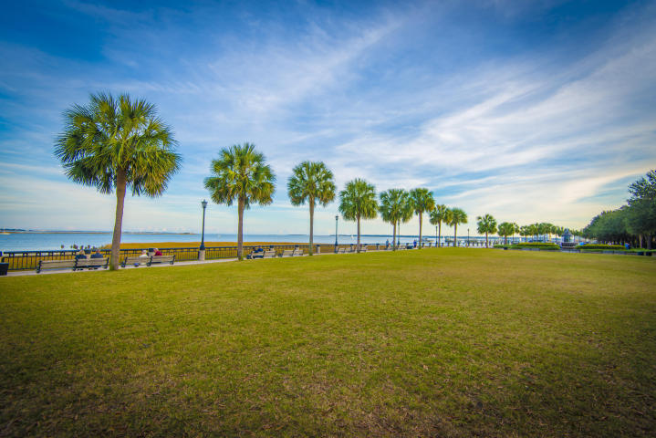
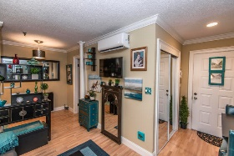
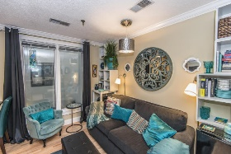
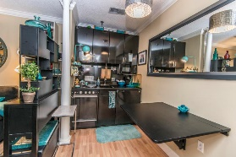
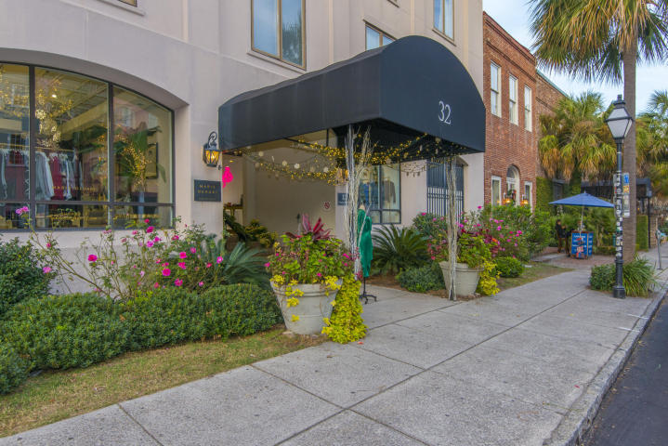
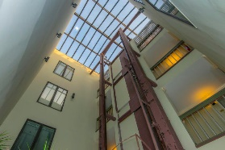
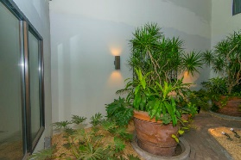
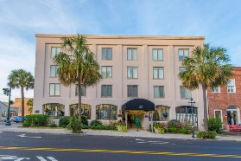
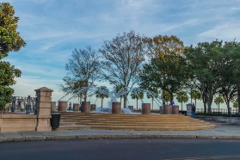
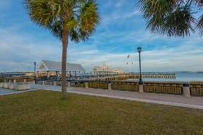
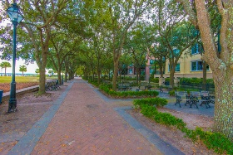

32 Vendue Range 204 French Quarter ~ Charleston, SC 29401 MLS# 17031592 ~ $225,000
Open House In The Heart Of Downtown Sunday December 10th 1-3 PM
French Quarter living at a must see price. This "pied a terre" condo is perfect for a working professional, a student at College of Charleston or MUSC, second home or a get away for a stay in downtown Charleston. The location is ideal for restaurants, shopping, galleries, historical sites and the famous Waterfront Park with its fountains is just down the street. A secure and gated entrance, elevator or stairs to your second floor condo. The condo has a large window overlooking the atrium garden. The open layout makes the best use of the floor plan. The home is staged so you can envision your furnishing in the home. There is a laundry on site as well.
George Arlet
(843) 452-7200
georgearlet@comcast.net
Joe Arlet
(843) 226-4141
joe.arlet@carolinaone.com
Carolina One Real Estate
2713 Highway 17 North
Mt. Pleasant, SC 29466

