Slide 1
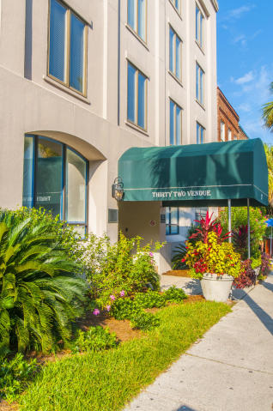
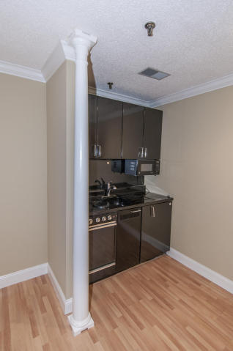
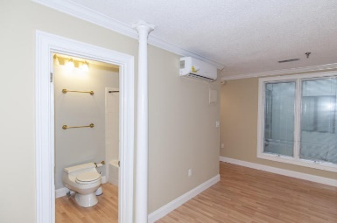
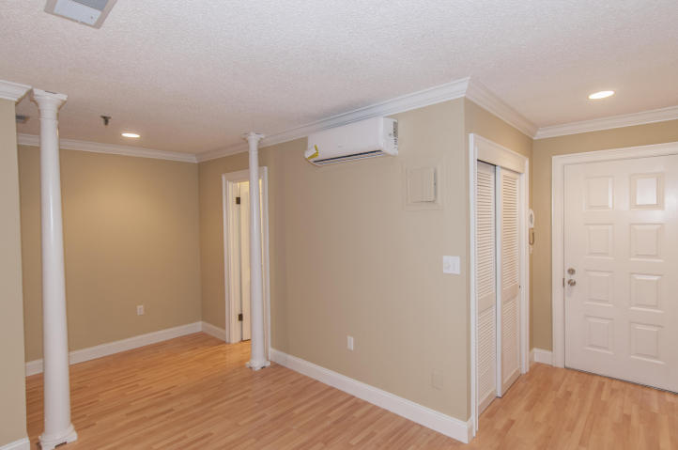
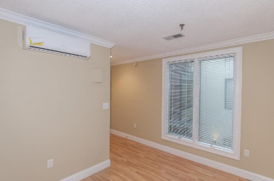

Best Condo Deal on the Peninsula!
32 Vendue Range #204
French Quarter
Charleston, SC 29401
MLS# 15026604 ~ $199,000
Don’t miss this 1Br/1Ba condo at the corner of Vendue Range and East Bay. This unit has been recently renovated and is ready for its new owner. This 2nd floor unit is easily accessible via the stairs or elevator and has a view of the interior courtyard. It is perfect for a traveling business person or as a downtown getaway. Don’t wait as this one will not last.
Will E Freeman
Office - (843) 971-1312
Mobile - (843) 270-5454
wfreeman@thebeachcompany.com
BH&G RE The Beach Company, 1973 Riviera Drive, Suite 7, Mt Pleasant, SC 29464

