Slide 1
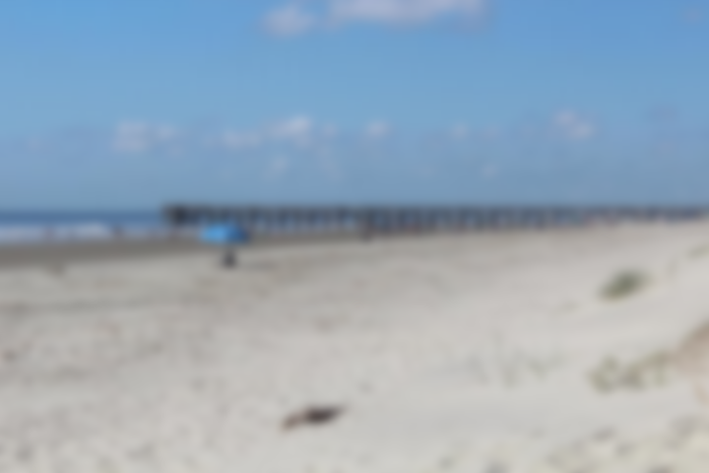
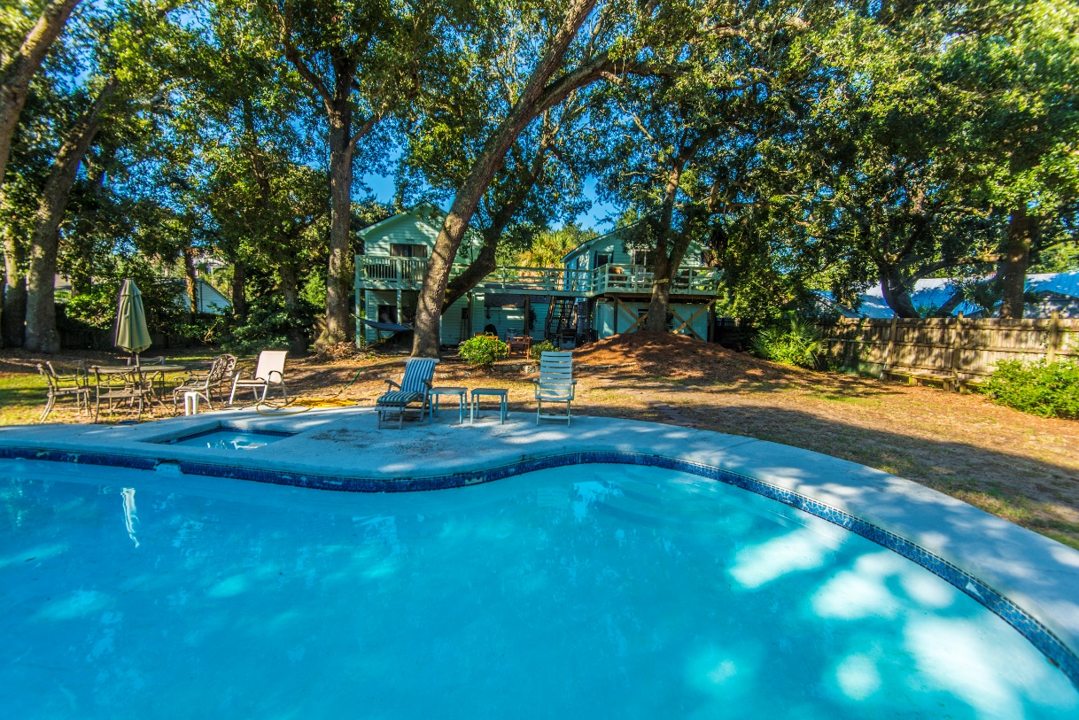
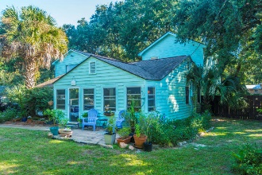
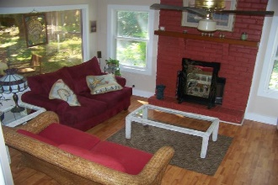
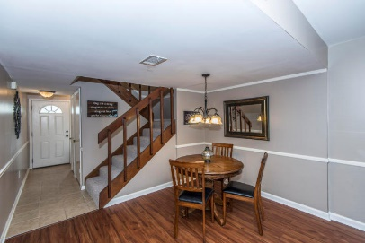
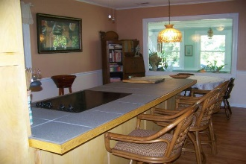
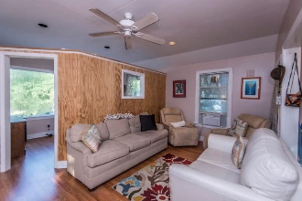
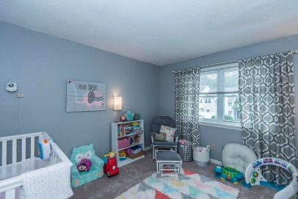
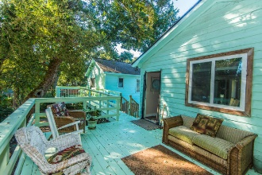
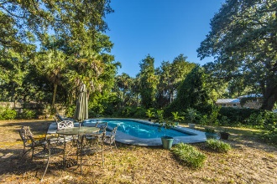
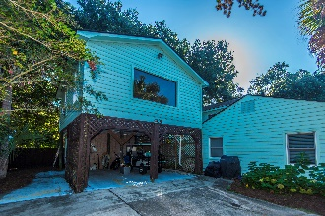


Steps to the Beach!
Close to everything ~ Pool ~ Large Lot
OPEN HOUSE Saturday from 1-3pm
32 21st Avenue
Isle of Palms, SC 29451
MLS# 18027344 ~ $800,000
This townhouse is the perfect LOCATION. You are close to Shem Creek, Trader Joe's and Whole Foods.
This townhouse has been freshly painted and just had a new hot water heater installed. The backyard has been regraded and added new sod and a new fence.
Downstairs has Smartcore luxury vinyl waterproof tile and upstairs has new carpet. Home has been inspected and repairs made. Roof was replaced in 2014 and HVAC in 2012.
Welcome to 32-21st Avenue on the beautiful barrier island of Isle of Palms! This is the first time this house has been for sale in over 40 years and one of the largest lots on the island. The main house has 3 bedrooms and 3 full baths, two of which are downstairs. There is a guest cottage (FROG) that has a full bathroom and kitchenette and has been a rental in the past.
Del Shaffer
843.408.6821
dshaffer@carolinaoneplus.com

