Slide 1
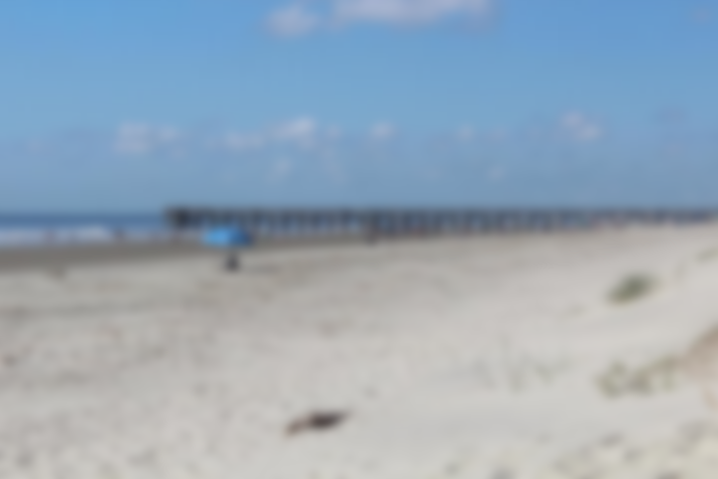
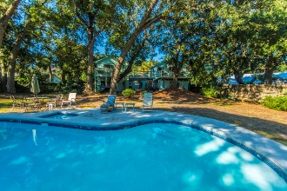
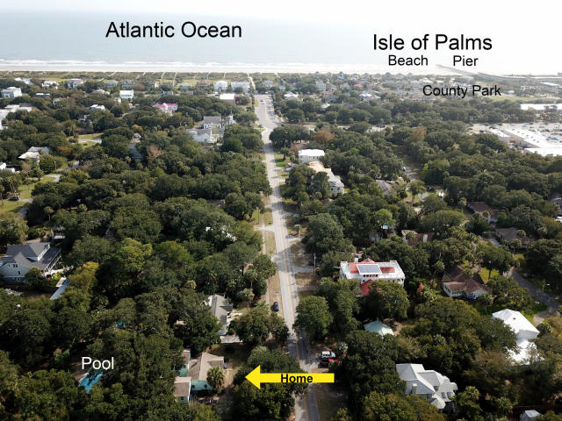
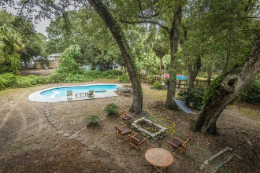
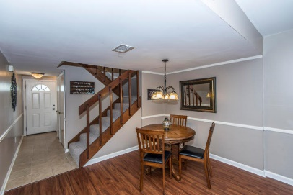
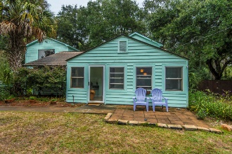
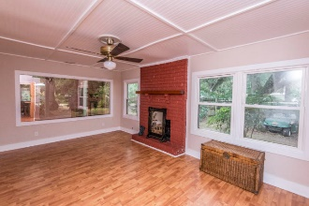
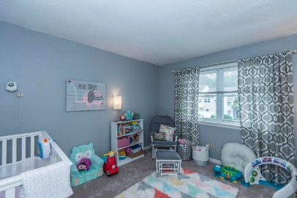
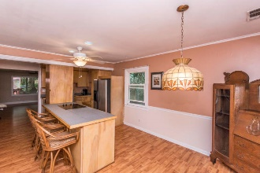
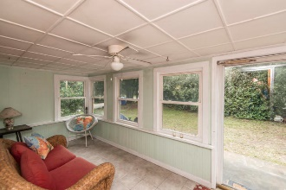
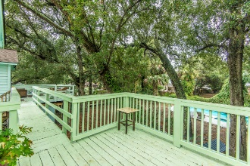


Steps to the Beach! Close to everything ~ Pool ~ Large Lot
JUST REDUCED!
This townhouse is the perfect LOCATION. You are close to Shem Creek, Trader Joe's and Whole Foods.
This townhouse has been freshly painted and just had a new hot water heater installed. The backyard has been regraded and added new sod and a new fence.
Downstairs has Smartcore luxury vinyl waterproof tile and upstairs has new carpet. Home has been inspected and repairs made. Roof was replaced in 2014 and HVAC in 2012.
32 21st Avenue
Isle of Palms, SC 29451 ~ MLS# 18027344
NEW PRICE!!! $725,000
Welcome to 32-21st Avenue on the beautiful barrier island of Isle of Palms! This is the first time this house has been for sale in about 40 years and one of the largest lots on the island. The main house has 3 bedrooms and 3 full baths, two of which are downstairs. There is a guest cottage (FROG) that has a full bathroom and kitchenette and has been a rental in the past. A $2,380 Lender Credit is available and will be applied towards the buyer's closing costs and pre-paids if the buyer chooses to use the seller's preferred lender. This credit is in addition to any negotiated seller concessions.
Del Shaffer
843.408.6821
dshaffer@carolinaoneplus.com

