Slide 1
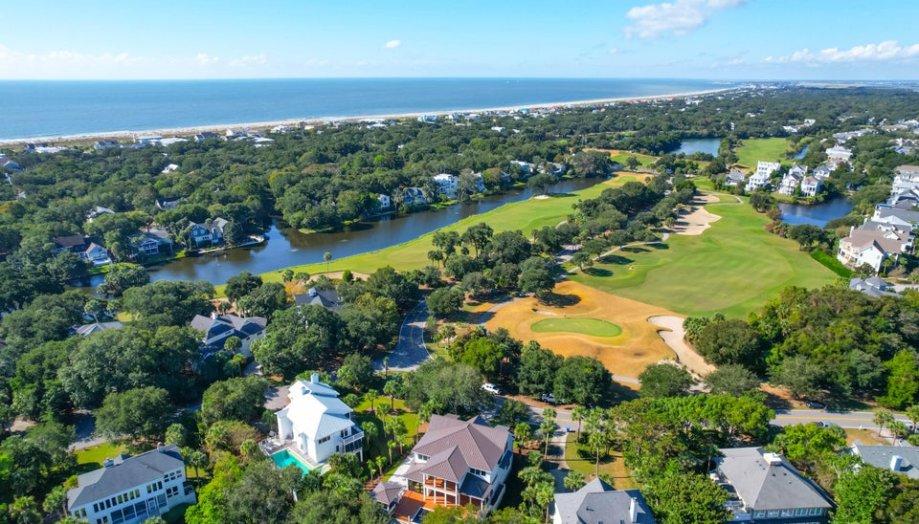
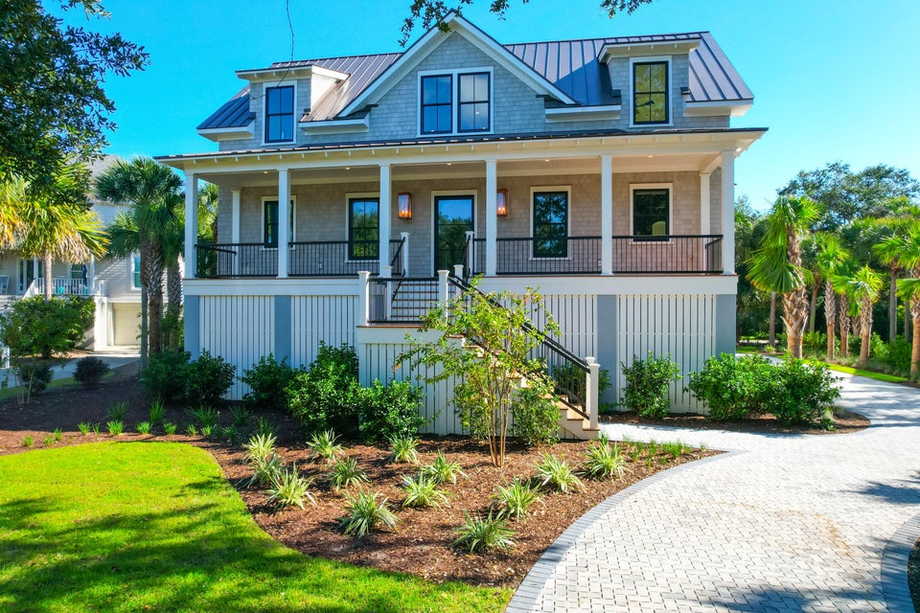
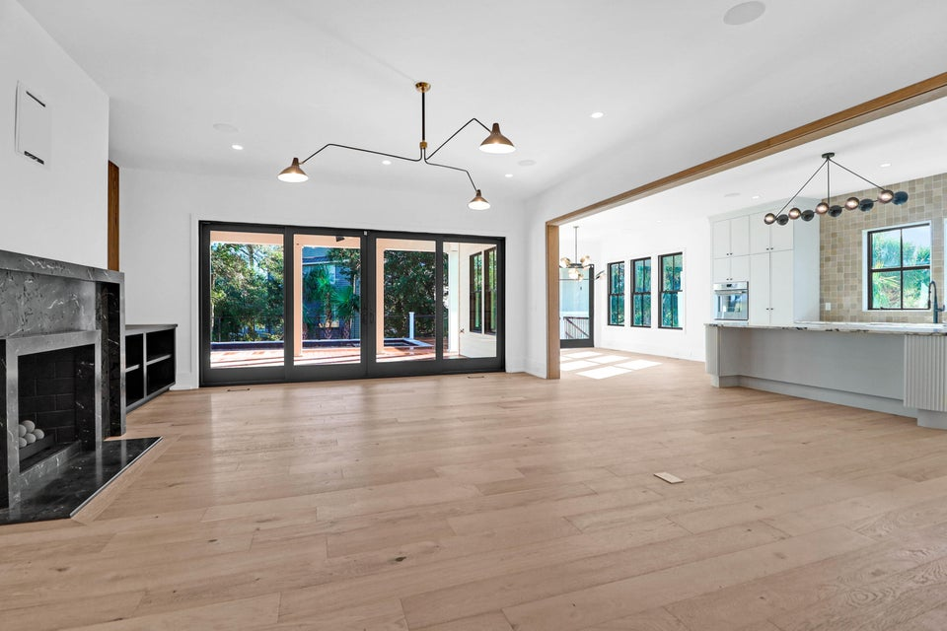
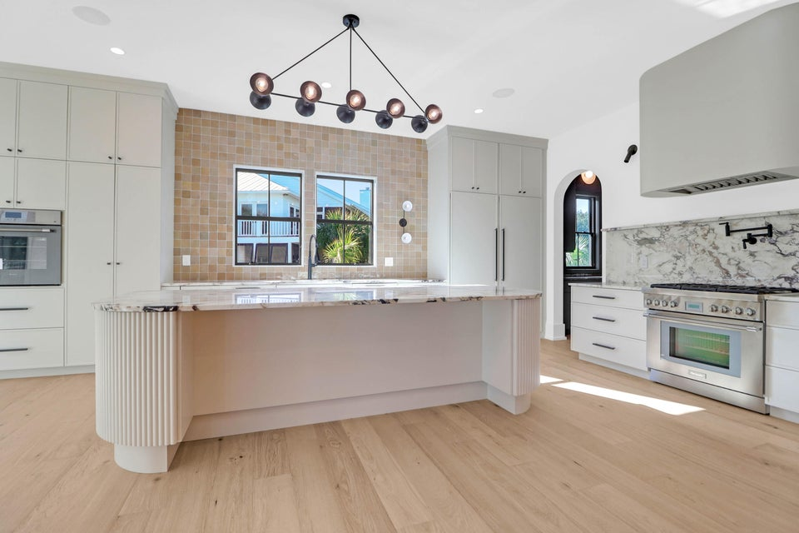
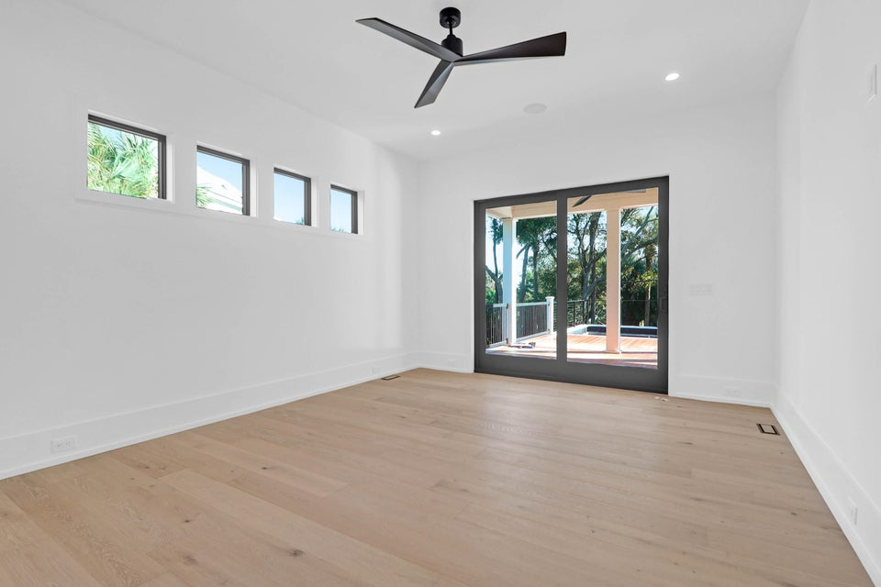
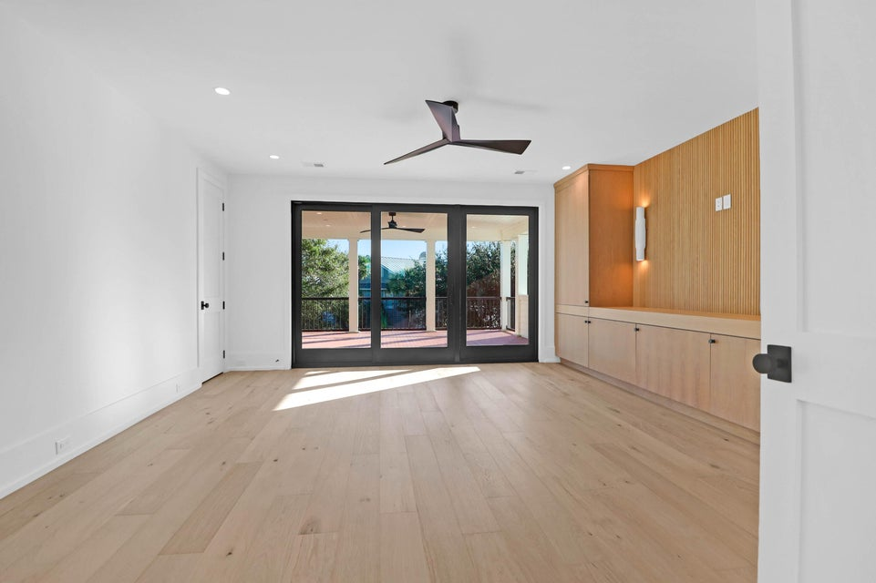
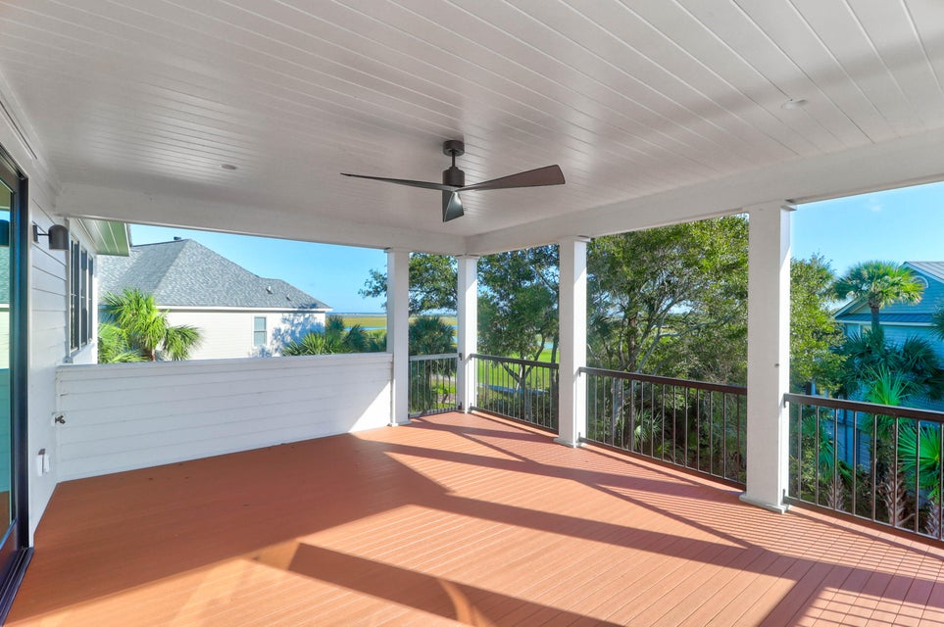
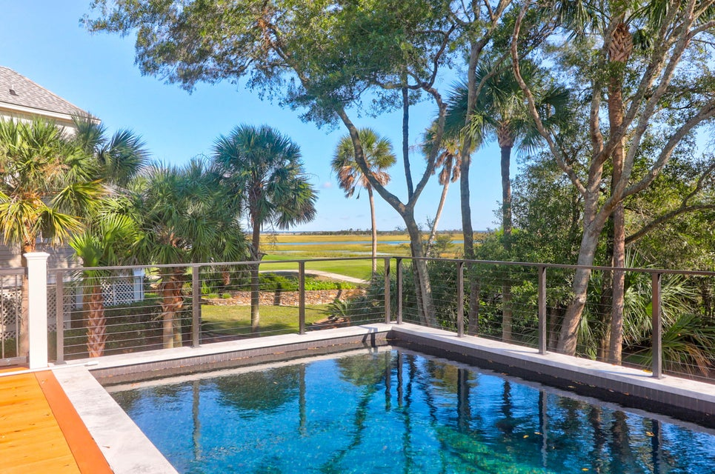
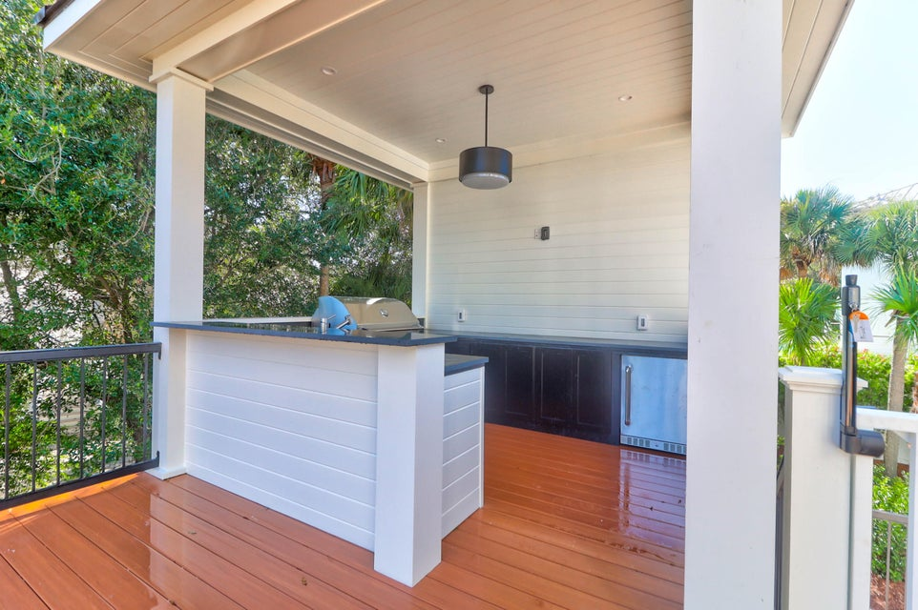
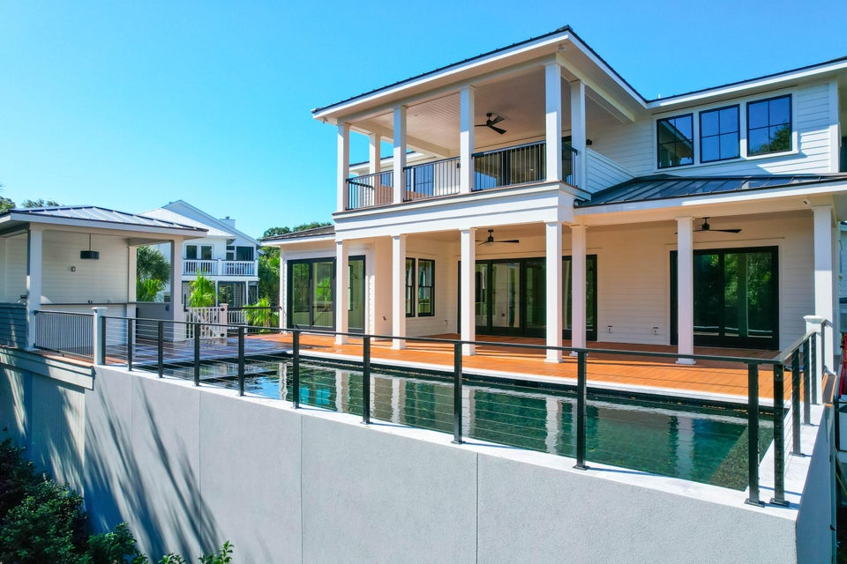
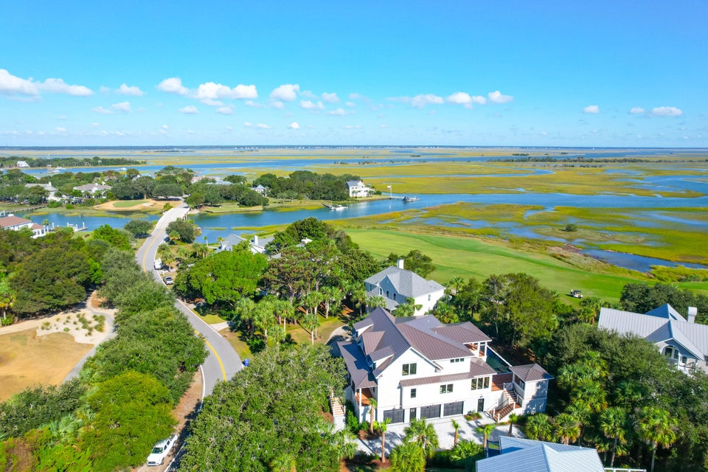
Brand New Custom Construction
32 Morgan Creek Drive
Wild Dunes | Isle of Palms, SC 29451
MLS# 24025665 | $4,495,000
Where do we start? This 4,368 sqft home is over the top! From the location to the views, to the elevated pool, to the Custom Finish's. The quality of this home and the materials used is unmatched on the IOP. This homes Features 5 BR and 5 BA, two powder rooms, separate dining, office, laundry, pantry and of course the elevated pool with built in HOT TUB and heating/cooling system. Full gazebo with bar top, sink, fridge, ice machine and built in grill. This home is a must see! Please see attached finish detail sheet.
Jamie Hollingsworth
843-442-6492 | iopsold@aol.com
Salmonsen Realty | 864 Lowcountry Blvd Ste B | Mt Pleasant, SC 29464

