Slide 1
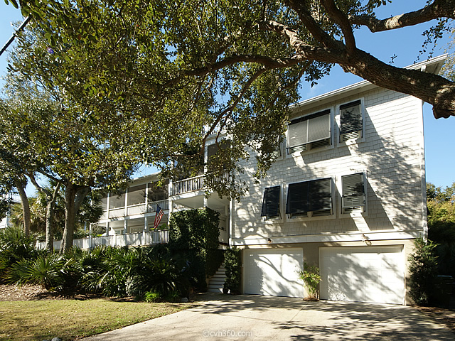
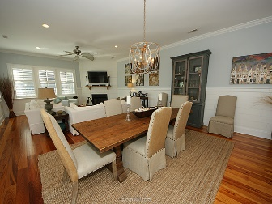
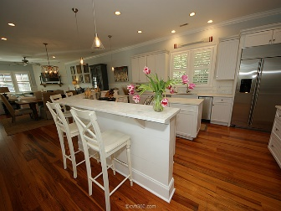
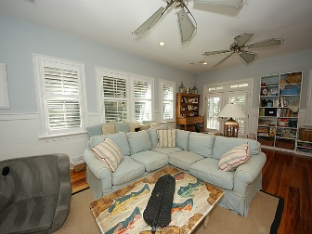
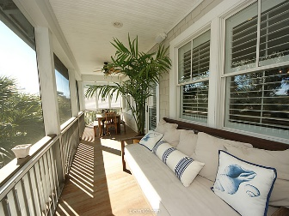
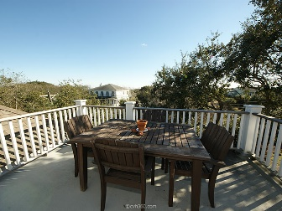
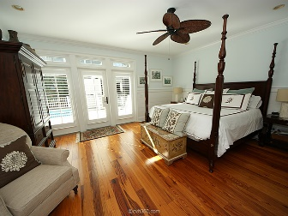
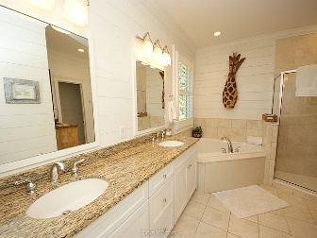
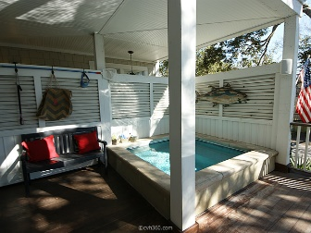
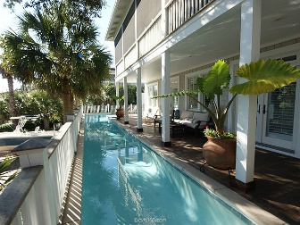
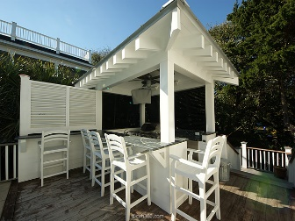
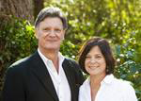

Potential Short Sale!
New Listing!
3301 Cameron Boulevard
Isle of Palms, SC 29451 ~ MLS# 16003476 ~ $1,720,000
This beautiful custom home is located one block from the Atlantic Ocean. This 5 bedroom, 5 1/2 bath home is owner occupied but has a license as a rental. The reverse floor plan allows plenty of light and offers a casual elegance and a warm inviting palate. The first floor offers 4 bedrooms each with an en suite private bath...including the master suite with private access to the deck. The main living area offers an open floor plan, and a gourmet kitchen overlooking the gorgeous outdoor living area. Complete with a 55' heated lap pool, a private spa, and a new outdoor kitchen, this is an area your family and guests can enjoy all year. Don't miss the ocean breeze from the third floor observation deck. There is also an outdoor fire pit and irrigation system.
Chuck & Edy Mimms
Cell 843-224-9507
Office 843-530-8100 www.sanddollarsc.com
www.facebook.com/Sanddollarsc
Sand Dollar Real Estate Group | 2205 Middle Street | Suite 203, Mailbox 2 | Sullivans Island, SC 29482

