Slide 1
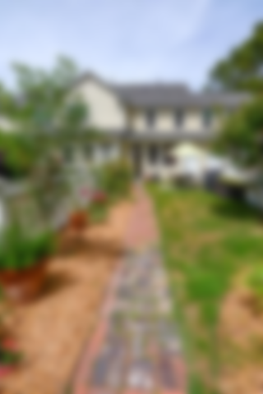
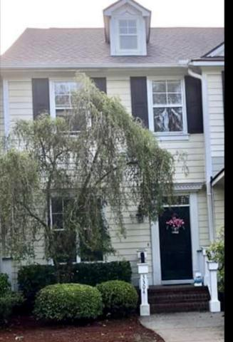
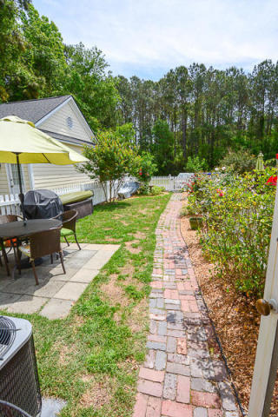
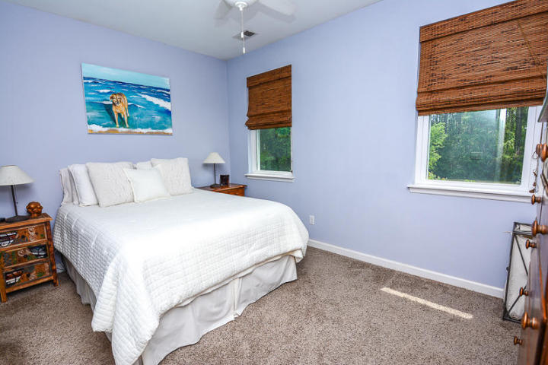
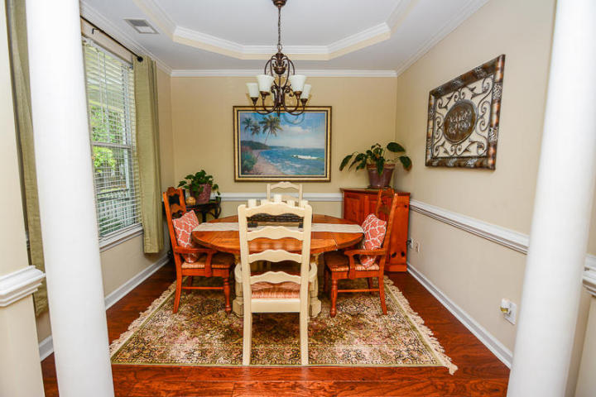
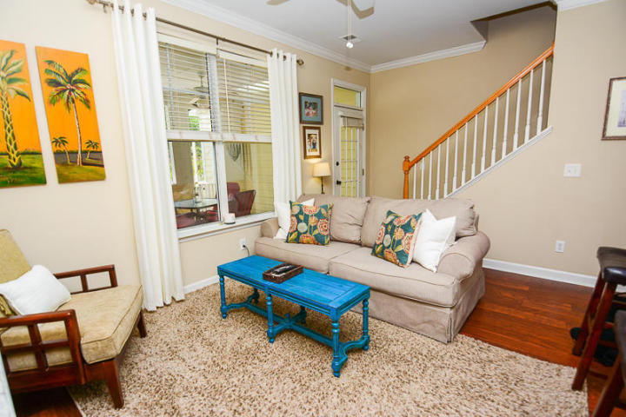
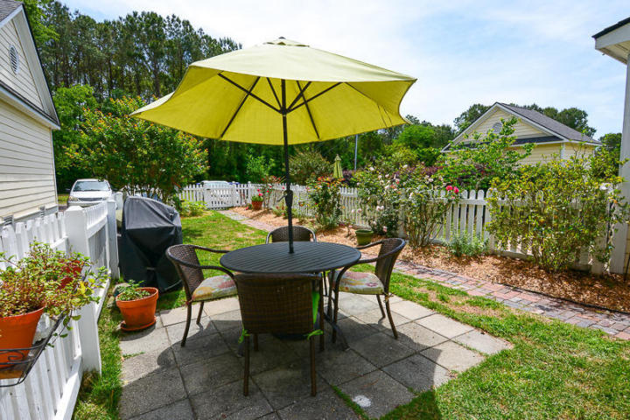
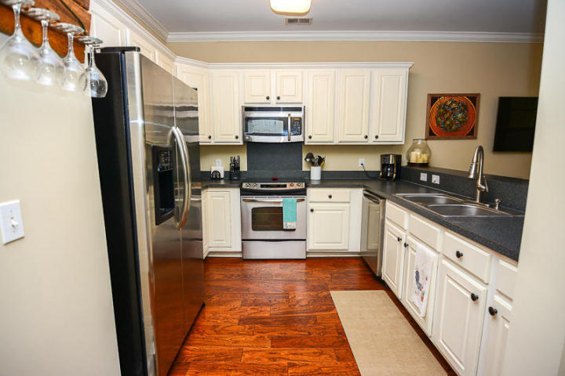
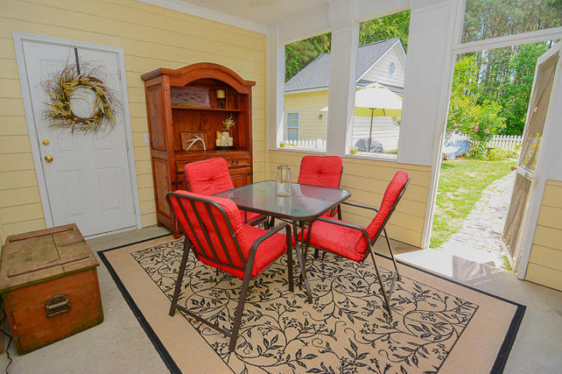


Affordable 2 bedroom 2.5 bath Townhome with First Class Amenities
3304 Billings Street
Hamlin Plantation
Mount Pleasant, SC 29466
MLS# 18012280 ~ $259,000
This home is a must see! There are beautiful hardwood floors throughout the first floor, crown molding in the main living areas, a tray ceiling in the dining room, stainless appliances in the kitchen, and a screened in porch overlooking the fenced in backyard. Enjoy the beauty of the garden which includes aromatic roses, gardenias, fragrant Russian sage, a lemon tree and Crepe Myrtle! Upstairs holds the master bedroom suite with two closets and new flooring in the master bath. The second bedroom is spacious and also has an en suite bathroom. Owners have had the bedrooms painted and carpets upstairs professionally cleaned. Ceiling fans in both bedrooms, living room and screened in porch. This home has a brand new roof which was installed in March 2018! You will LOVE the amenities of Hamlin Plantation, which include running/walking trails, a resort style pool with water slide, clubhouse, tennis courts, children's playground, and fitness center. There is also a basketball court and volleyball pit. This home also backs up to the woods and the walking trail that leads you straight to all the amenities, and it is on a dead end so there is no drive by traffic! Loads of family activities at the clubhouse are planned throughout the year, including movie nights on the clubhouse green all summer long. Hamlin Plantation is conveniently located within a few minutes drive to the Isle of Palms and Sullivan's Island beaches, as well as Town Center with tons of shops and restaurants. There are also top notch schools nearby, including award winning Laing Middle School of Technology, Jennie Moore Elementary and Wando High School. Don't miss out on this great opportunity to live in one of Mount Pleasant's best communities!
Ellen O'Neil
Broker/Owner, ABR, e-PRO, CNE
Charleston Realtor of Distinction
(843) 300-8530
www.EllenONeilProperties.com
eXp Realty Charleston
711 Fairview St
Fountain Inn, SC 29644

