Slide 1
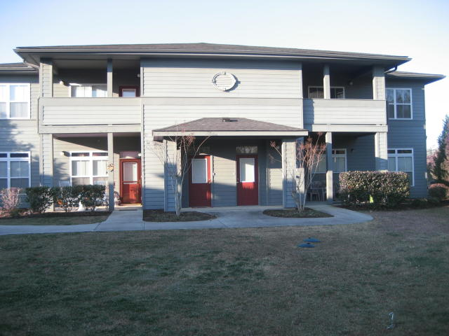
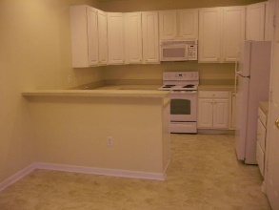
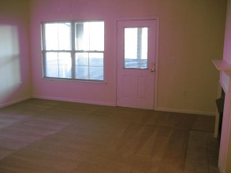
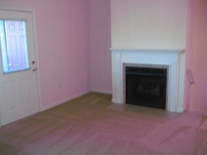
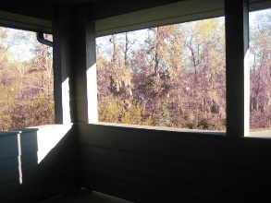
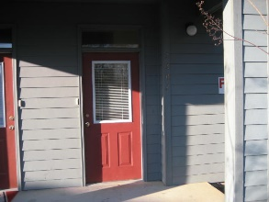


3305 Mariners Way
Moncks Corner, SC 29461 ~ MLS# 18027347 ~ $113,900
Hidden Cove Community is now FHA APPROVED
NEW CARPET and FRESH PAINT.
This is a nice upstairs condo with a ground level entrance and a foyer. The kitchen has plenty of cabinets for storage and all of the modern appliances, dishwasher, built in microwave, garbage disposal and of course a stove and refrigerator with an ice maker. All of the rooms have fans with 9' slick ceilings. The master bath has a double vanity with a garden tub. The den has a fireplace. The outside porch is spacious with a large storage room. Hidden Cove offers boat and trailer parking at no cost and also has a community pool. The Marina is nearby, with boat slips and a ramp for launching your boat. From the marina you can access the Tailrace Canal, Lake Moultrie, Diversion Canal, Lake Marion and the Charleston Harbor. Hidden Cove is in walking distance to multiple grocery stores, retail shops and restaurants. The water, sewage, garbage collection and lawn maintenance is all included in the HOA fee . Enjoy all of the outdoor sports that Berkeley County has to offer and also only thirty five minutes from Charleston. Come enjoy the Hidden Cove quiet life with great neighbors.
Asking $1,200,000
MLS# 17023051
3,692 SqFt
4 Bed/3½ Baths
Short Drive to Historic Downtown Charleston & Beaches
Norris Law
(843) 870-0011
norrislawrealestate@gmail.com
Access Real Estate, LLC
1647 Redbank Rd
PO Box 944
Goose Creek, SC 29445

