Slide 1
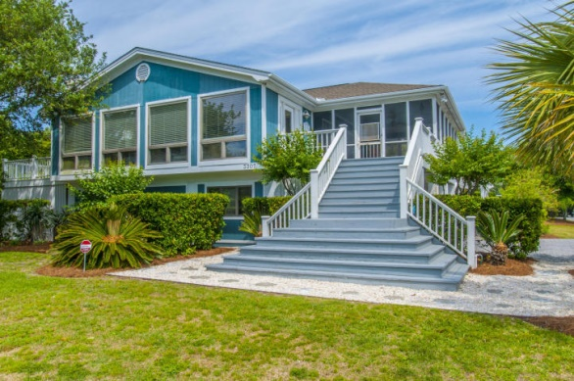
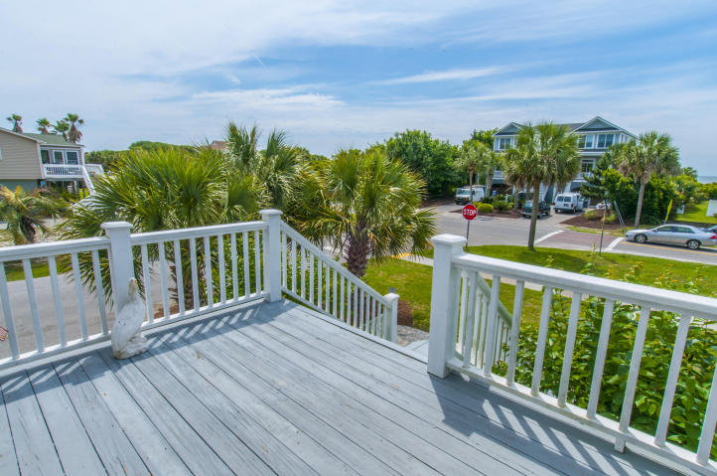
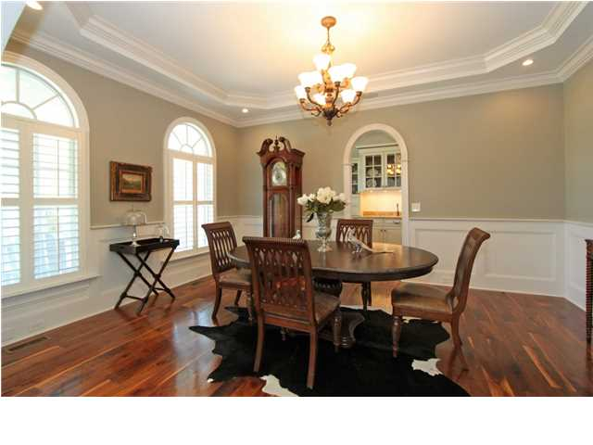
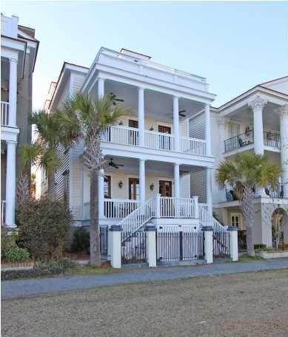
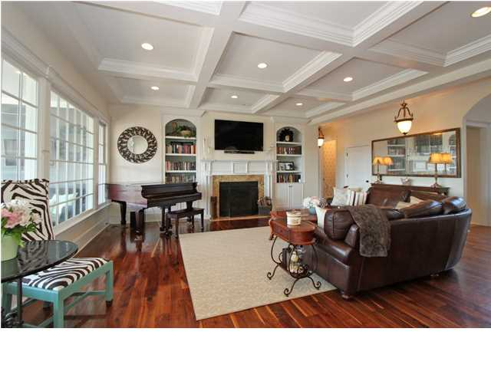
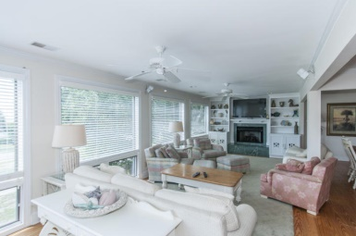
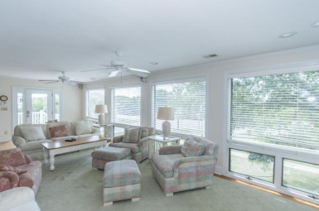
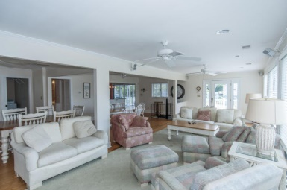
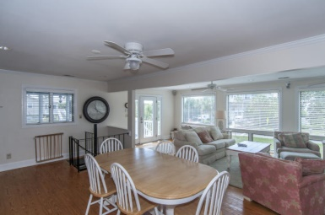
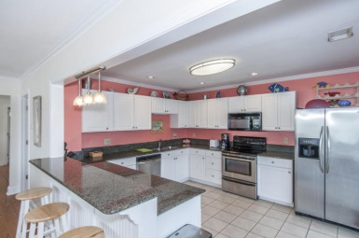
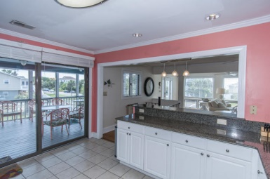
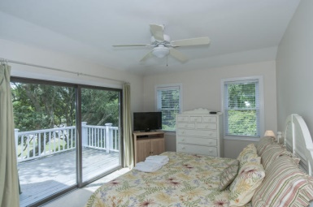
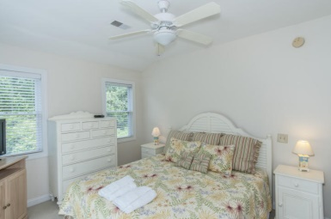
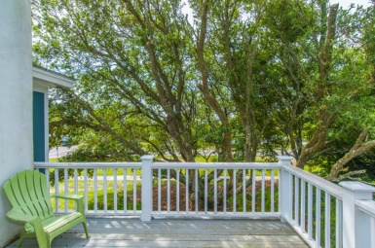
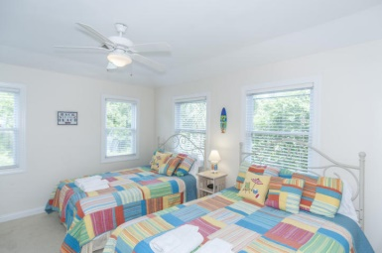
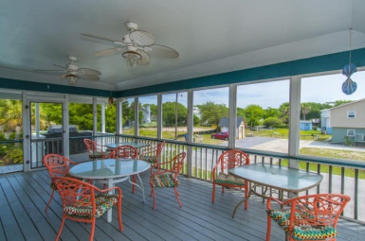
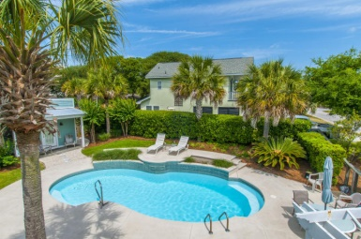
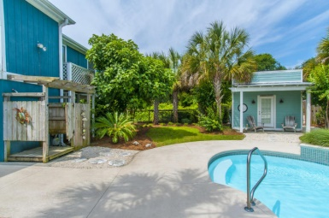
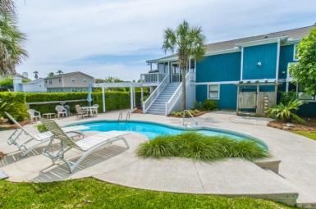


3307 Palm Blvd Isle of Palms MLS# 15011548 $999,900
2nd Row Beach Home with Great Views
Perfect Beach home sits 2nd row with Gorgeous Ocean Views on an exceptional lot!! The Great room has beautiful pine floors, A gas fireplace with built-ins and mantel. Large eat in-kitchen w/ granite counter tops , stainless steel appliances and overflowing cabinetry . There are two bedrooms that are upstairs and four down with a game room and sitting area. There is a large screened porch that has dual access to the Beach Path and the pool that sits perfectly along side a charming cabana that has a half bath and changing area with a side covered patio. The home is surrounded w/ lush tropical landscapes and large Oak tree's that are supported with an irrigation system. This home has a promising income and all furnishings viewed convey.
Clay Cunningham
Office - (843) 886-8110
Cell - (843) 345-4647
Fax - (843) 202-2921
clay@carolinaone.com
Carolina One Real Estate
1400-E Palm Boulevard
Isle of Palms, SC 29451

