Slide 1
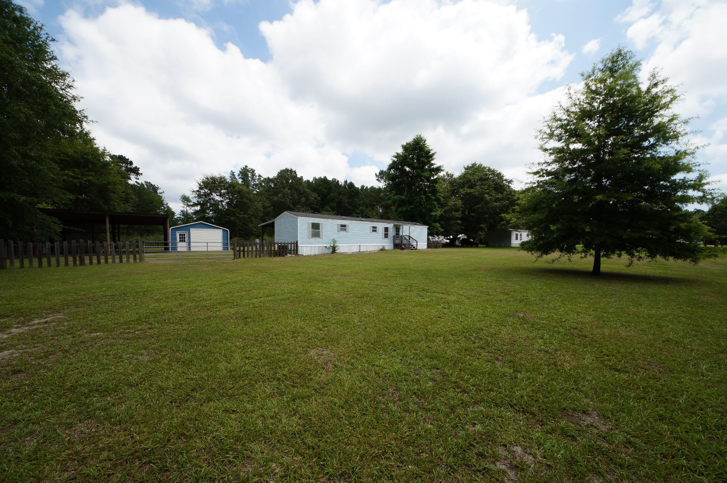
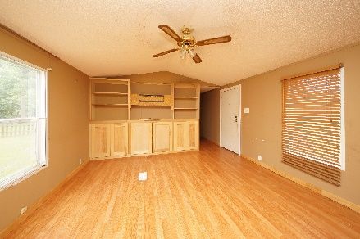
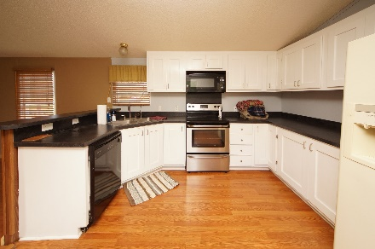
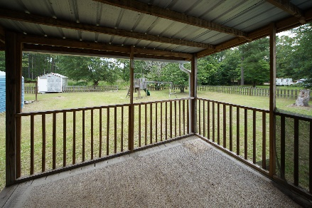


330 Red Briar Lane Loyal Acres :: Cross, SC 29436 MLS# 18016249 :: $90,000 3 Bed / 2 Bath
Quiet Country Living
3+ Acres!
Enjoy quite living on 3.37 acres of land.
3 bedroom 2 bath single wide has spacious kitchen and living area.
Perfect area for a business owner to take advantage of 2 workshops with electric.
Home is being sold as is.
Connie White, Broker
843-532-3356
conniesyouragent@gmail.com
Charleston Homes · 597 Old Mt. Holly Road · Suite 301 · Goose Creek, SC 29445

