Slide 1
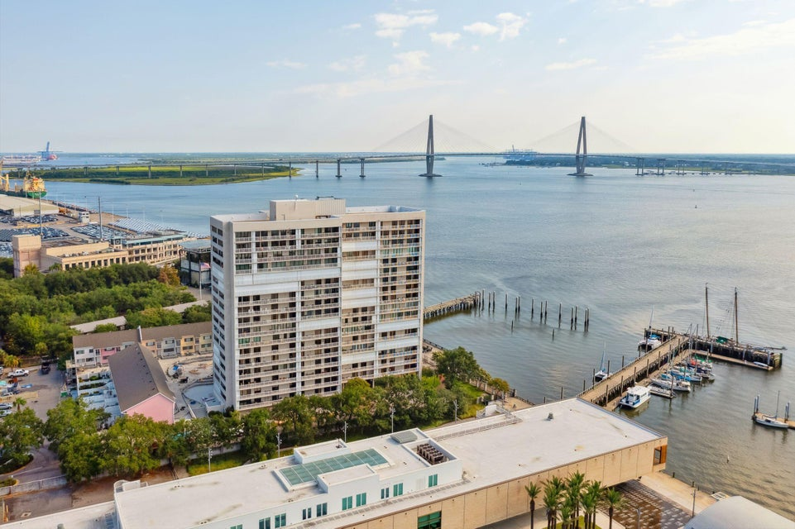

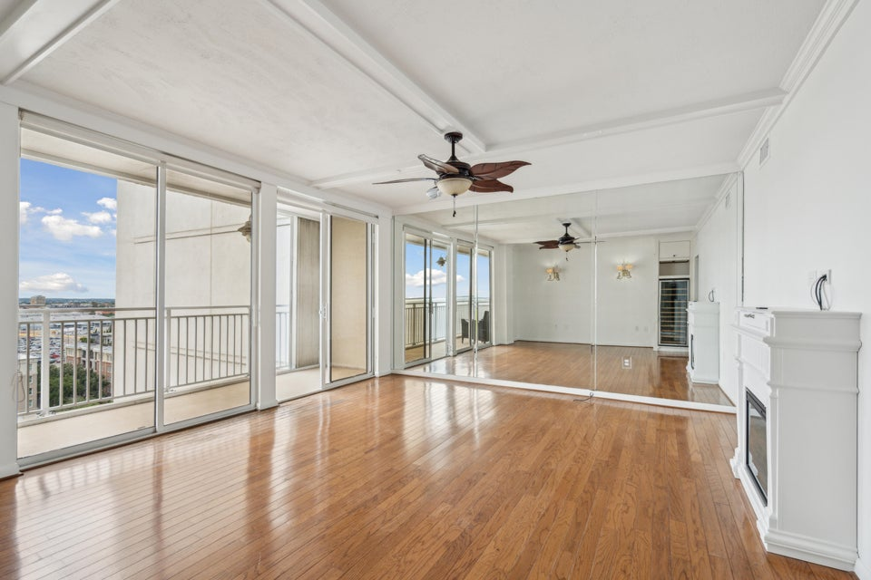
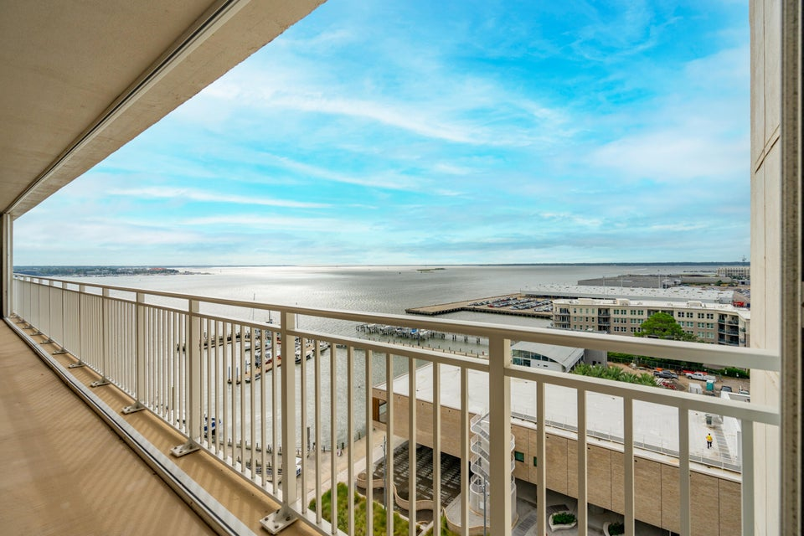


Be sure to watch the YouTube video to see more!
UNIQUE Jewel Box in the
OLD WALLED CITY
Waterside Condo in Downtown Charleston
330 Concord Street 12 H
Dockside | Charleston, SC 29401 | MLS# 24025892 | $599,000
2 Bedrooms | 2 Baths | 1,237 sf
Beautiful Condo with Dead ON Views of the Charleston Harbor and FORT SUMTER, and the aircraft carrier YORKTOWN!
Complete built-in office with Desk and Murphy Bed. All California Closets.
Handsome Properties, Inc
53 Broad St
Charleston, SC 29401
Ellen Leigh Murray
843-813-2006
chaspremierprop@bellsouth.net

