Slide 1
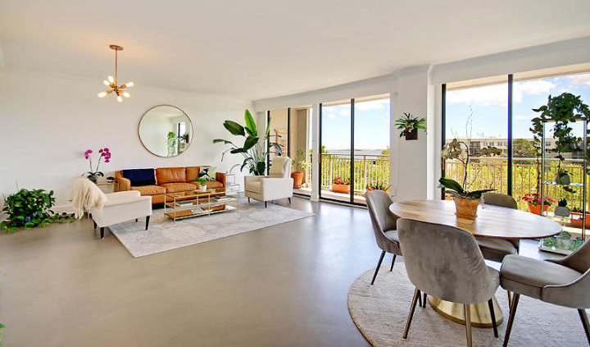
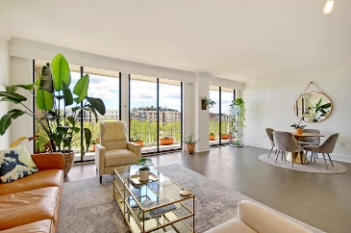
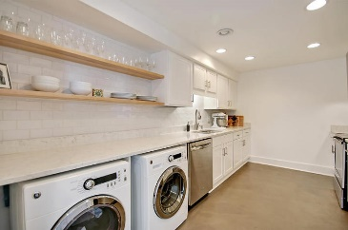
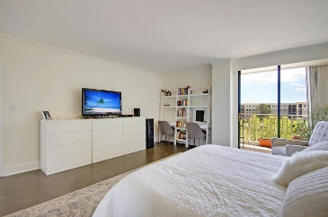
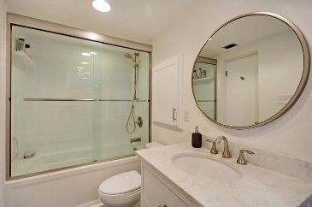
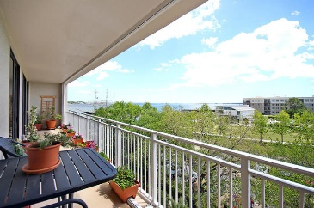
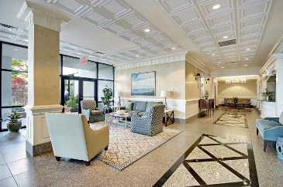
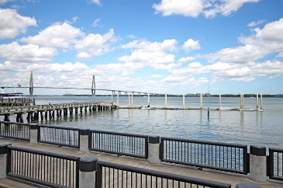
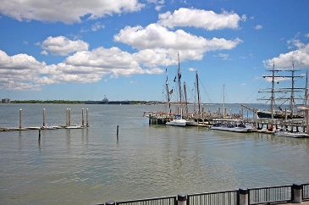

330 Concord Street 4A
Charleston, SC 29401 · MLS# 19012292 · $450,000
New Low Price in Dockside!
Just Listed in Grassy Creek
STUNNING TOTALLY RENOVATED 1 bedroom, 1 bath condo in highly desirable Dockside! This unit is GORGEOUS! Upon entering the foyer you are greeted with new custom cement floors which extend throughout the entire condo and SPECTACULAR VIEWS of Charleston, the harbor, and church steeples! To the left of the foyer is the new gourmet chef's kitchen with granite countertops, stainless steel appliances, hand made white tile backsplash, and maple shelving to maximize space. The living area is extremely spacious, fresh paint on all ceilings and walls, custom light feature, and has an abundance of natural light. The full length balcony is amazing, faces Southeast and is a gardner's dream: anything can grow inside or out. The master bedroom is large, light filled, and has the same phenomenal views.
The master closet has been completely redone, and has maple shelving to maximize all available space. Finally, the bath has been enlarged, and upgraded with granite, handmade white tile, maple shelving and is absolutely a spa-like relaxing retreat. New water heater in 2019. Dockside had a huge ($1.5MM) renovation project to to update all hallway common areas and clubroom is complete and is paid for and gorgeous! Dockside has beautiful and resort like amenities including a stately library, covered parking, inside pool, gym, sauna, deck, clubroom and a private dock that you can dock your boat, or simply sit and enjoy the wonderful views and breezes. From Dockside you can easily walk to historic sites in downtown Charleston, the finest restaurants, shopping and it is right next door to the South Carolina Aquarium. Call today, because you will not find another home that offers as much as this one: spectacular views, chef's dream kitchen, spa-like bathroom, gardner's oasis, and resort style amenities!
Stan Huff
843-670-2835
stan.huff@agentowned.com
Jill Marcacci
843-297-5590
jill@agentowned.com
www.agentownedrealty.com
AgentOwned Realty Co. Preferred Group, Inc. | 824 Johnnie Dodds Blvd | Mt Pleasant, SC 29464

