Slide 1

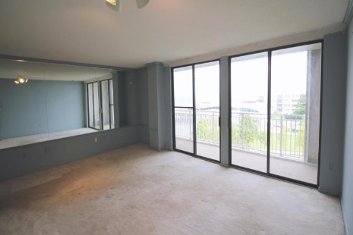
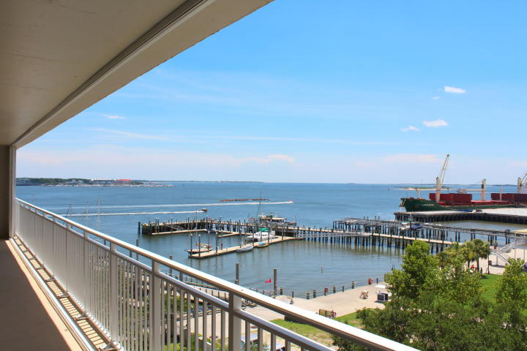
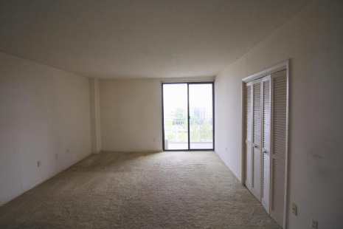
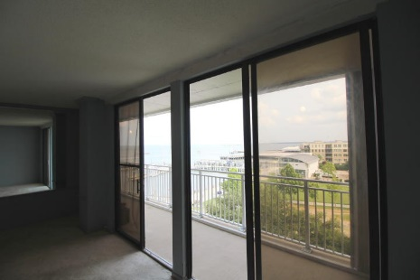
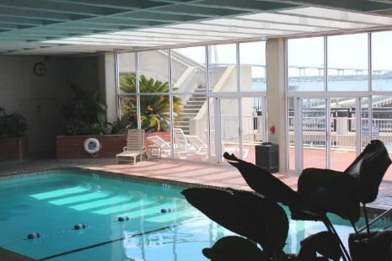


Sweeping Harbor Views at Dockside!
330 Concord Street 6H
Charleston, SC 29401 ~ MLS# 15017201 ~ $425,000
Wake up each morning to sweeping views of the Charleston Harbor as you watch the cruise ships roll in from your south-facing private balcony. This large 2 bedroom 2 bath condo offers endless possibilities & balcony access from both bedrooms and living room. Perfect as an investment, second home, or relocation. Dockside is full of amenities including shared dock access, indoor pool, exercise room, library, and walking proximity to aquarium, grocery, and all that Charleston has to offer! The home is priced to sell and is awaiting your personal touch.
Peter Stanley
M 843-300-8251 | O 843-885-6199
petermstanleyjr@gmail.com
Colony & Craft LLC
76-A Spring St
Charleston, SC 29403

