Slide 1
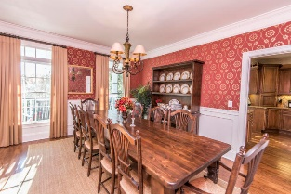
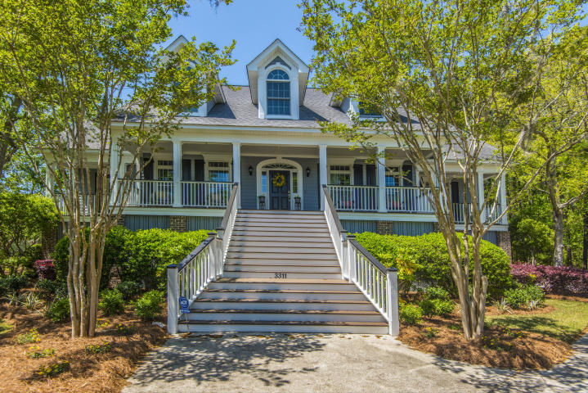
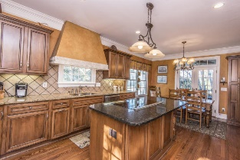
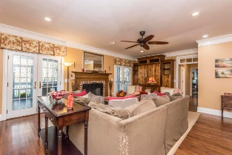
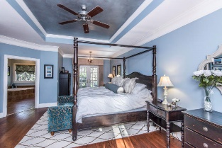
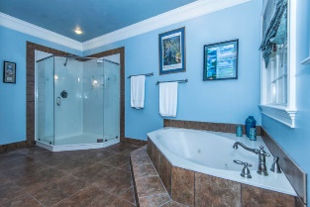
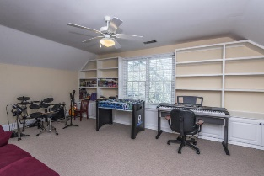
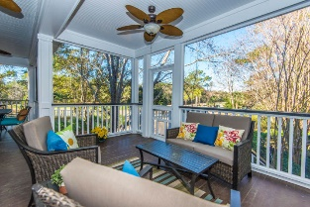
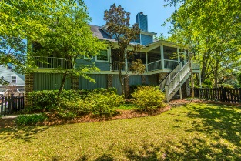
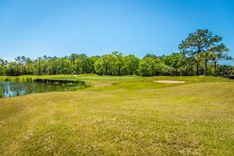


3311 Rees Row Mt Pleasant ~ MLS# 19005954 Reduced to $725,000
Open House Saturday 12:30-2:30
Stately, elevated 5 bedroom, 3.5 bath home with full front porch on a quiet cul-de-sac street in Charleston National. Enter to a dramatic 2-story foyer which leads to an enclosed executive office and formal dining room. The beautiful custom kitchen and spacious family room have expansive views of the golf course, lagoon, and protected wetlands. There is a master bedroom on the first floor; however, a large upstairs bedroom with ensuite bath could function as a second master bedroom as well. Upstairs, there are two additional large bedrooms as well as a media/bonus room. The exterior of the home features an extensive screened in porch ideal for entertaining guests.
A $1500 lender credit is available and will be applied towards the buyer's closing costs if the buyer chooses the seller's preferred lender. This credit is in addition to any other negotiated seller concessions.
Kristin Schatmeyer
Cell - (843) 697-7370
kristin.schatmeyer@carolinaone.com
www.KristinSchatmeyer.com
Carolina One Real Estate
2713 Highway 17 North
Mt. Pleasant, SC 29466

