Slide 1
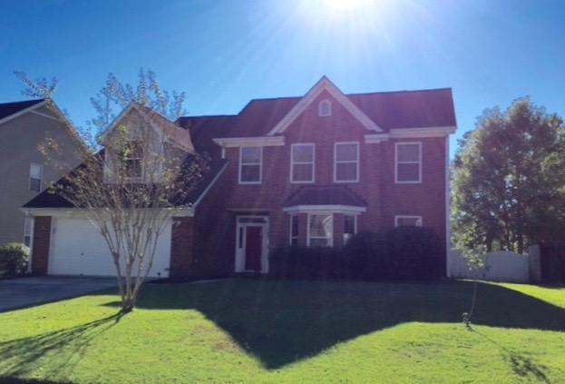
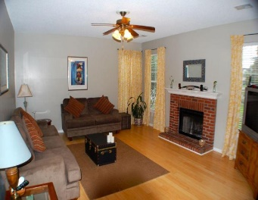
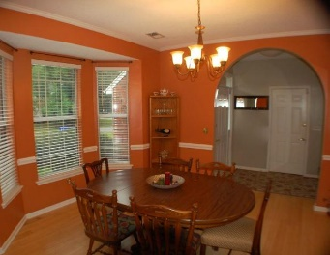
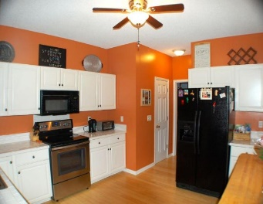
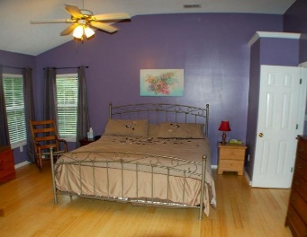
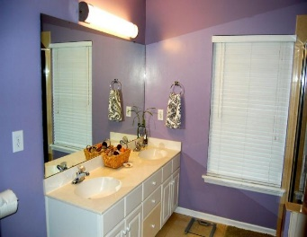
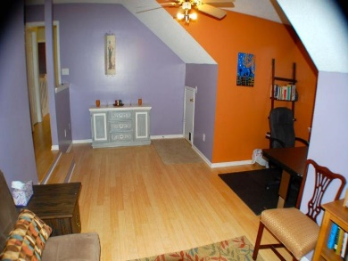
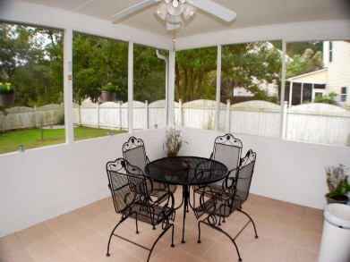
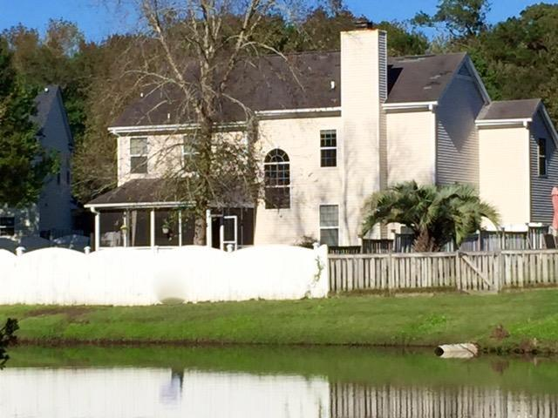
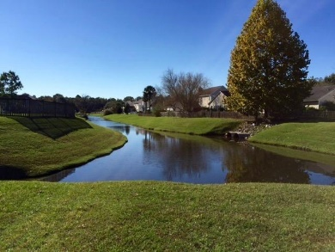


3313 Hearthside Drive
Village Green
Charleston
MLS# 15028129
$275,000
4 Beds | 2½ Baths
2,222 Square Feet
A floorplan that is easy to love.
BAMBOO FLOORS THROUGHOUT. Large living room with a cozy brick FIREPLACE. Oversized kitchen with NEW APPLIANCES. A dining room that will fit any size table w/ bay window. Lovely SCREENED PORCH over looks the fence yard. Lots and lots of storage and walk in closets. Large pond view. Master suite has a garden tub & separate shower & dual sink vanity.
Best of all, large forth bedroom or GIANT PLAYROOM/media room. Minutes to pool or bike path and well rated Drayton Hall Elementary. 20 minutes to downtown, 5 minutes to 526, 15 minutes to airport and Boeing, down the street from newly widened Bees Ferry and The Citadel Mall.
Di Johnson
843-270-6448
dijohnsonsc@gmail.com
www.agentownedrealty.com
AgentOwned Premiere Group
100 Crowfield Blvd
Goose Creek, SC 29445

