Slide 1

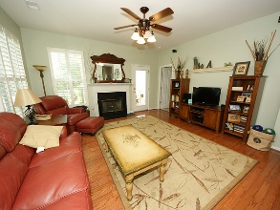
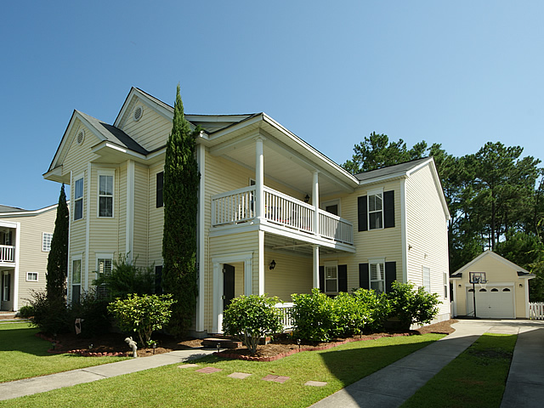
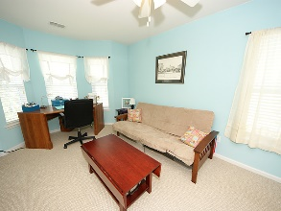
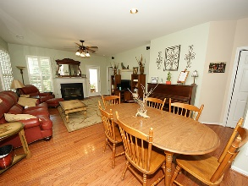
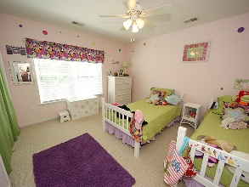
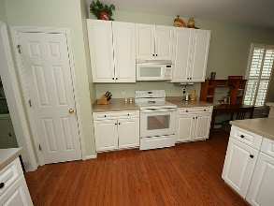
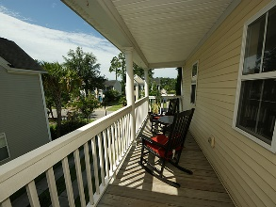
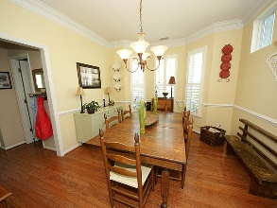
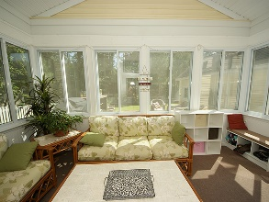
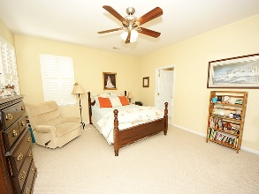
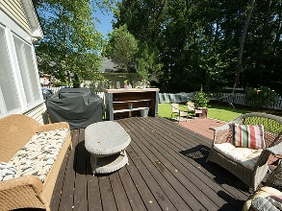

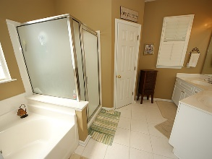
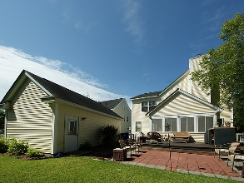

Priced Right & Ready to Sell in Park West
A true 5 bedroom, 3.5 bathroom home (Berkeley Floor Plan) priced right and ready to sell. A full video tour is available showing just how flexible this home truly is. Not only in a wonderful neighborhood, well maintained with a deck, patio, sunroom and fenced back yard perfect for entertaining. An open kitchen floor plan allows you the opportunity for a kitchen table yet still has a dedicated dining room. The master bedroom is on the ground floor and the 4 more bedrooms are on the second floor with an additional flex room that could serve as a home office, homeschool classroom or amazing playroom or arts and crafts room. This is a must, must see.
Address: 3317 Barkla Avenue
City: Mount Pleasant
Area: 41 - Mt Pleasant N of IOP Connector
Apx Square Feet: 2,416
Bedrooms: 5 Baths: 3½
MLS#: 16020299
Offering at: $399,900

