Slide 1
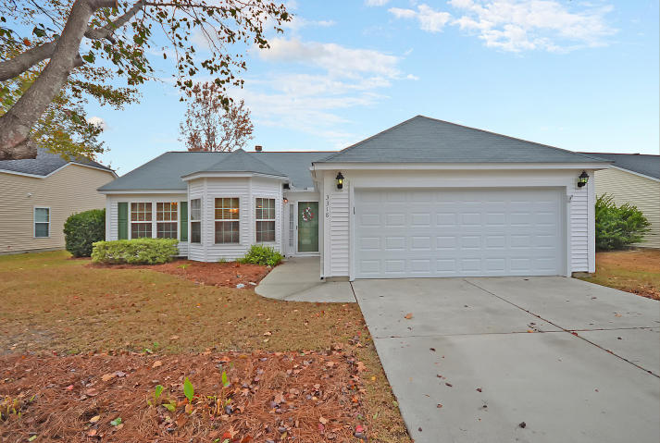
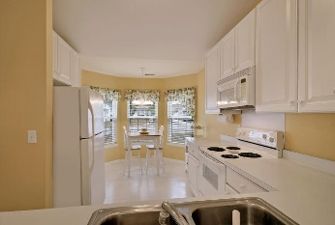
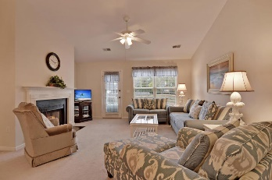
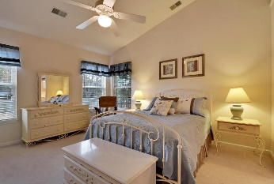
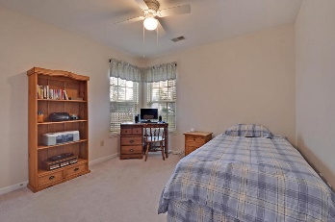
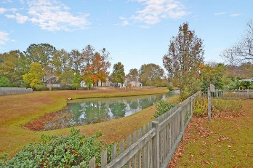


HOLIDAY SPECIAL!
3318 Lindner Lane
Planters Pointe
Mt Pleasant, SC 29466
MLS# 16030623
$299,999
An Awesome detached ranch style home situated on a quiet tree-lined street and is surrounded by a large private fenced yard with incredible pond views. This Remarkable home has 3 large bedrooms including the spacious master bedroom suite with vaulted ceiling, private master bathroom and a large walk-in closet. There are several large rooms with stylish ceiling fans and spotless wall-wall carpet including the Distinctive Great Room with a popular fireplace and unique vaulted ceiling. The modern kitchen is equipped with built-in appliances and offers a bright breakfast room for the informal dining. The Charming Dining Room is perfectly situated adjacent to the kitchen and is ideal for formal dining. There is a private walk-out to the valuable oversized patio and the beautiful fenced back yard that is a recommended retreat for bird watching, outside entertaining or cook-outs. Additional items of interest include newly installed roof shingles, new garage door and a new garbage disposal, Amenity Center offering a wonderful Club House, amenities include quality tennis courts, beautiful pool, basketball courts and ball field. Do You Recognize a Good Buy? Opportunity Knocks! Bring your checkbook. Age, sqft., taxes, acreage, schools, and hoa fees are approx. buyer to verify any and all information deemed necessary.
Bill Everett, Jr
Broker
843-693-8539
Bill@TheEverettGroup.net
RE/MAX Pro Realty, 9209 University Blvd, Charleston, SC 29406

