Slide 1
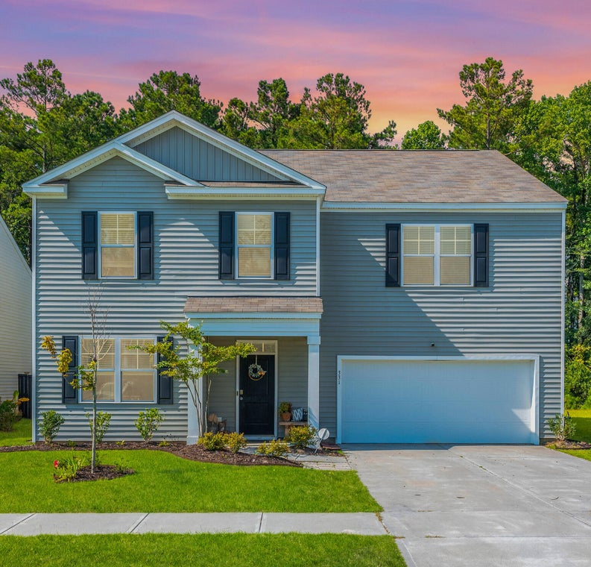
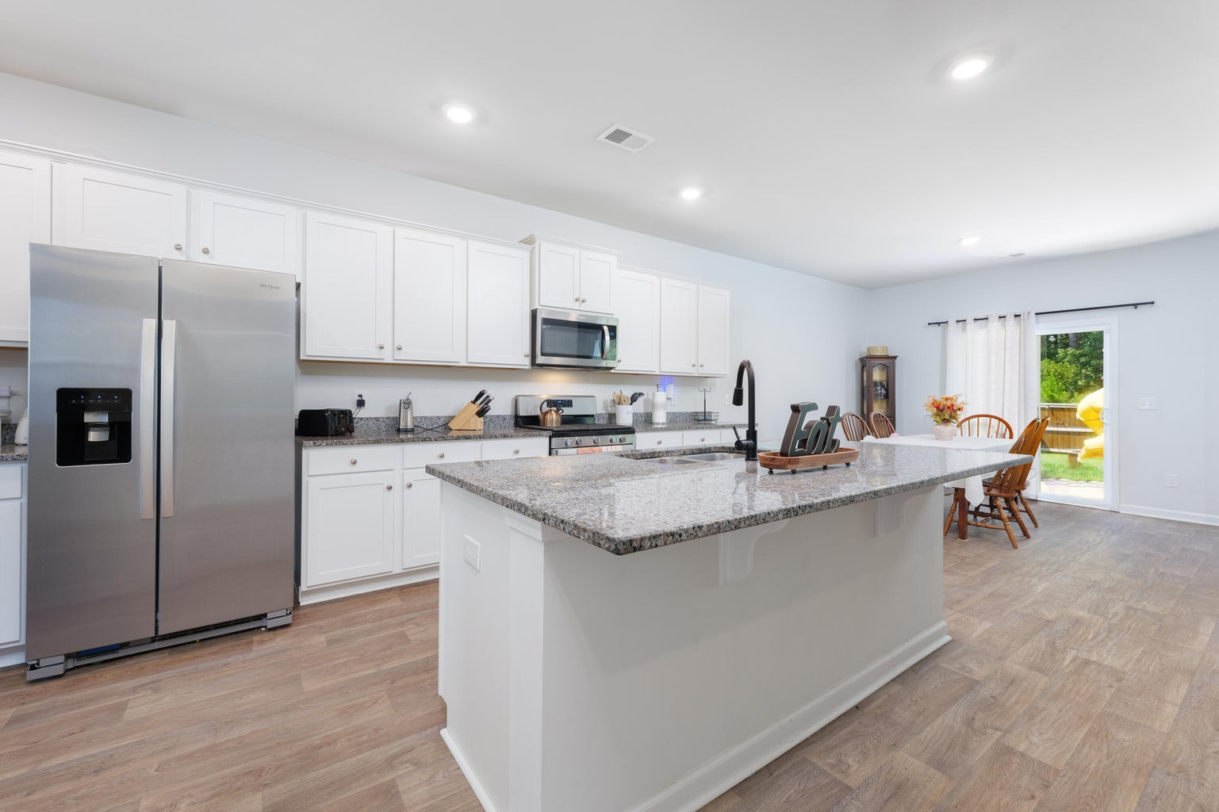
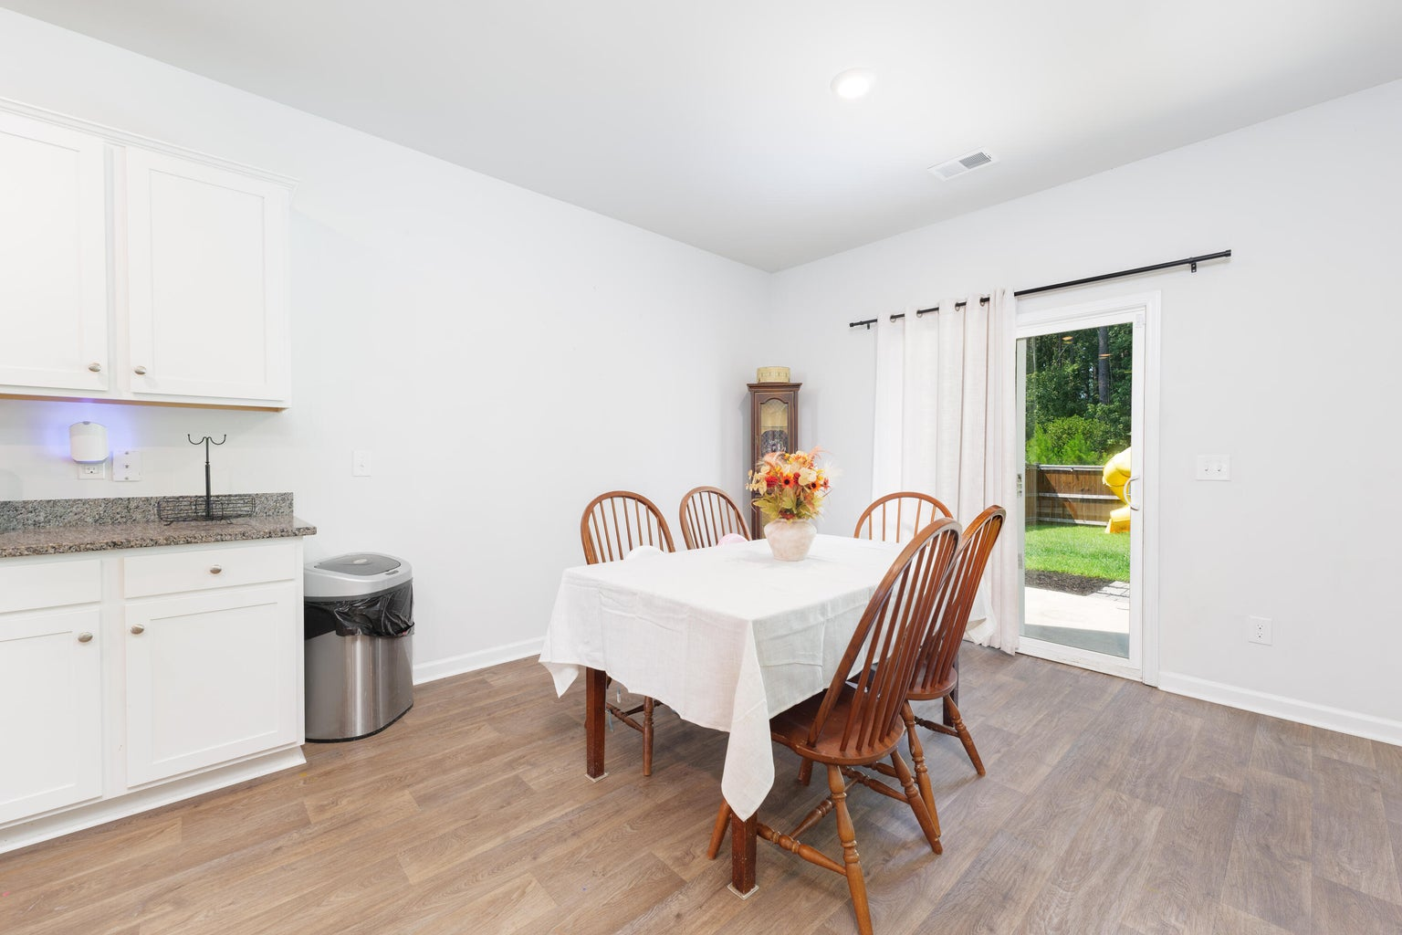
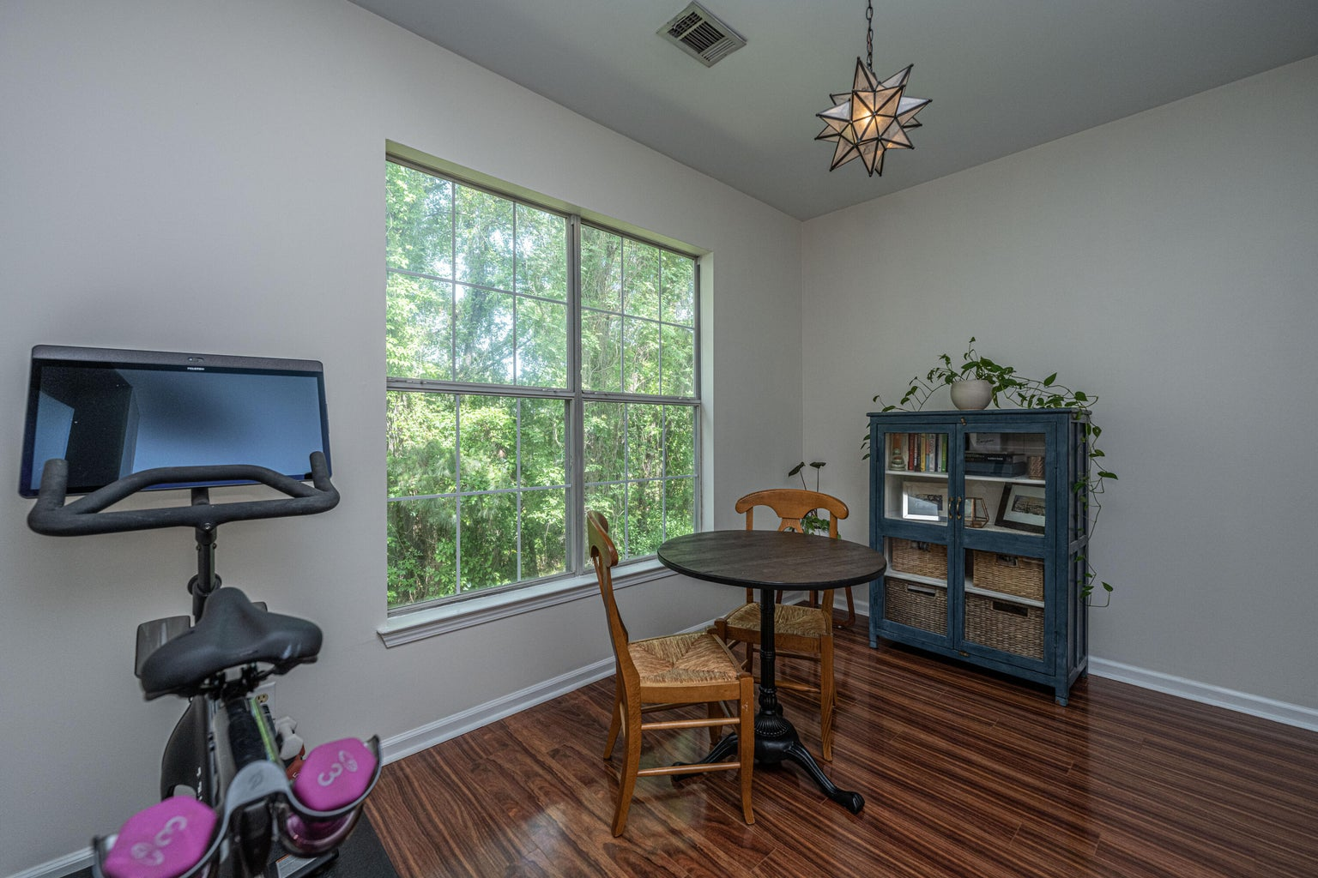
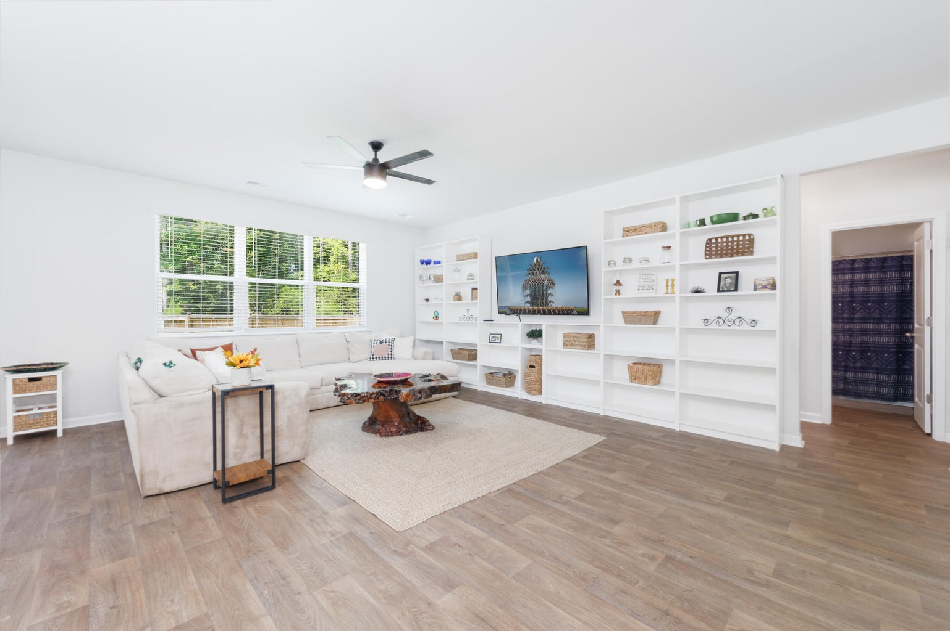
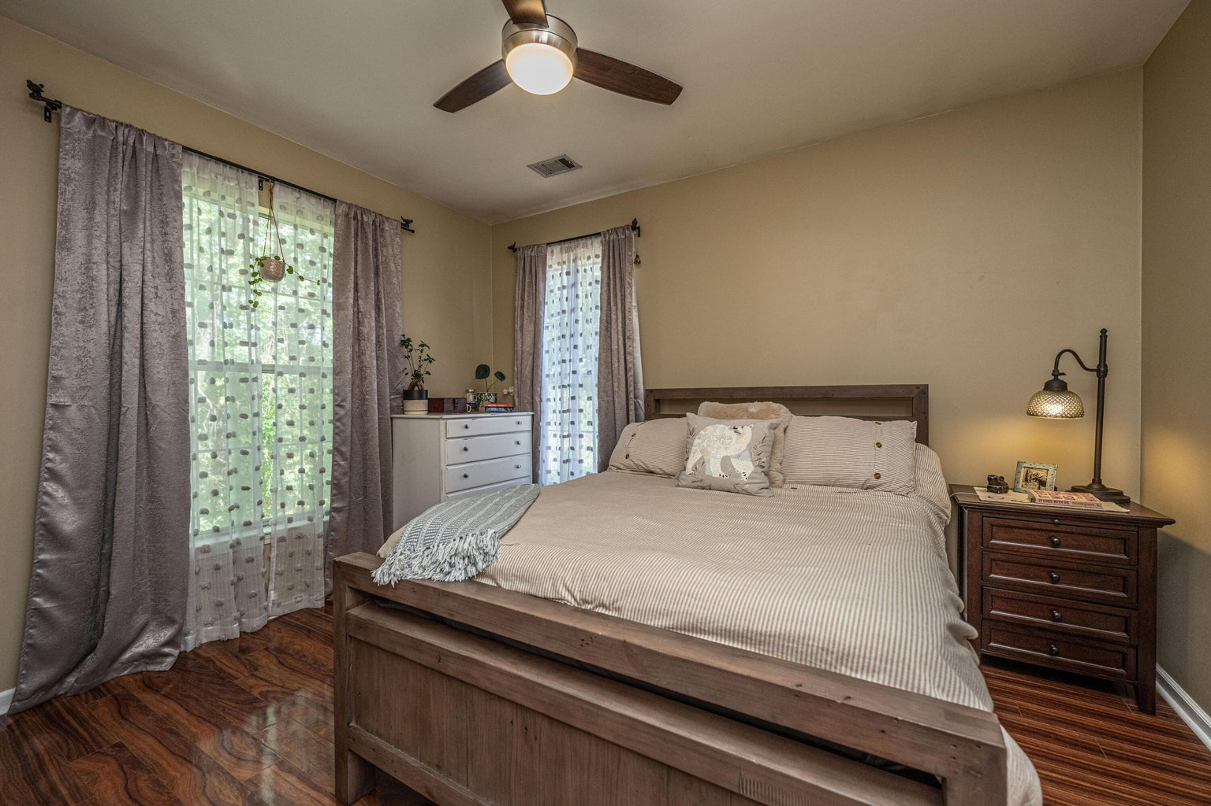
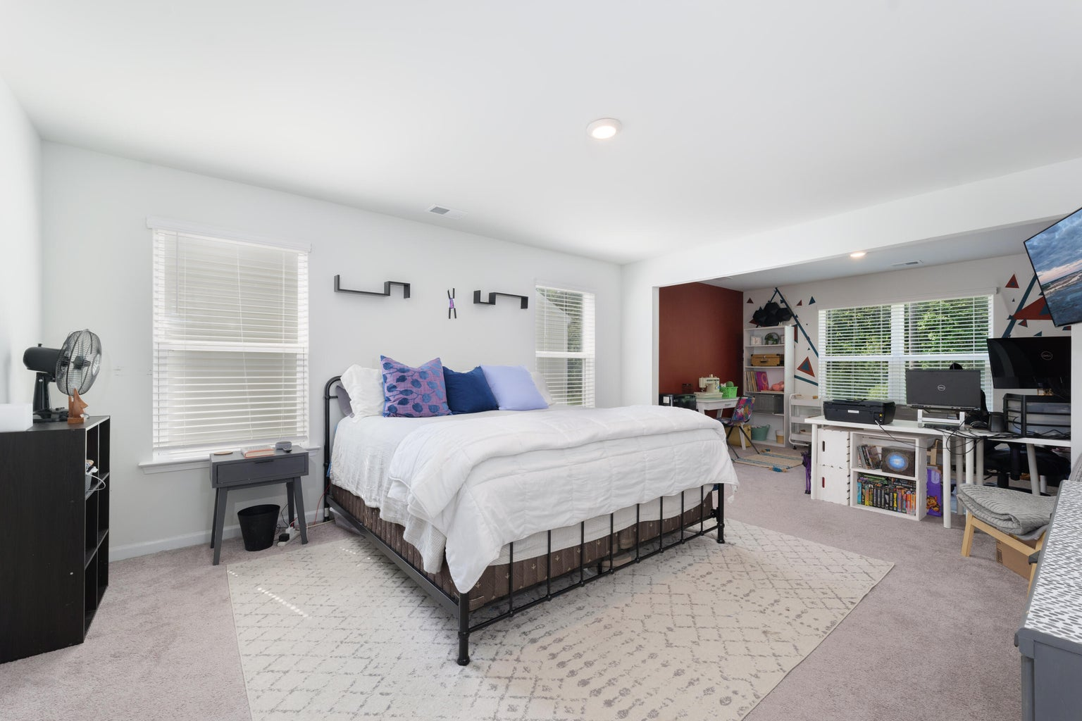



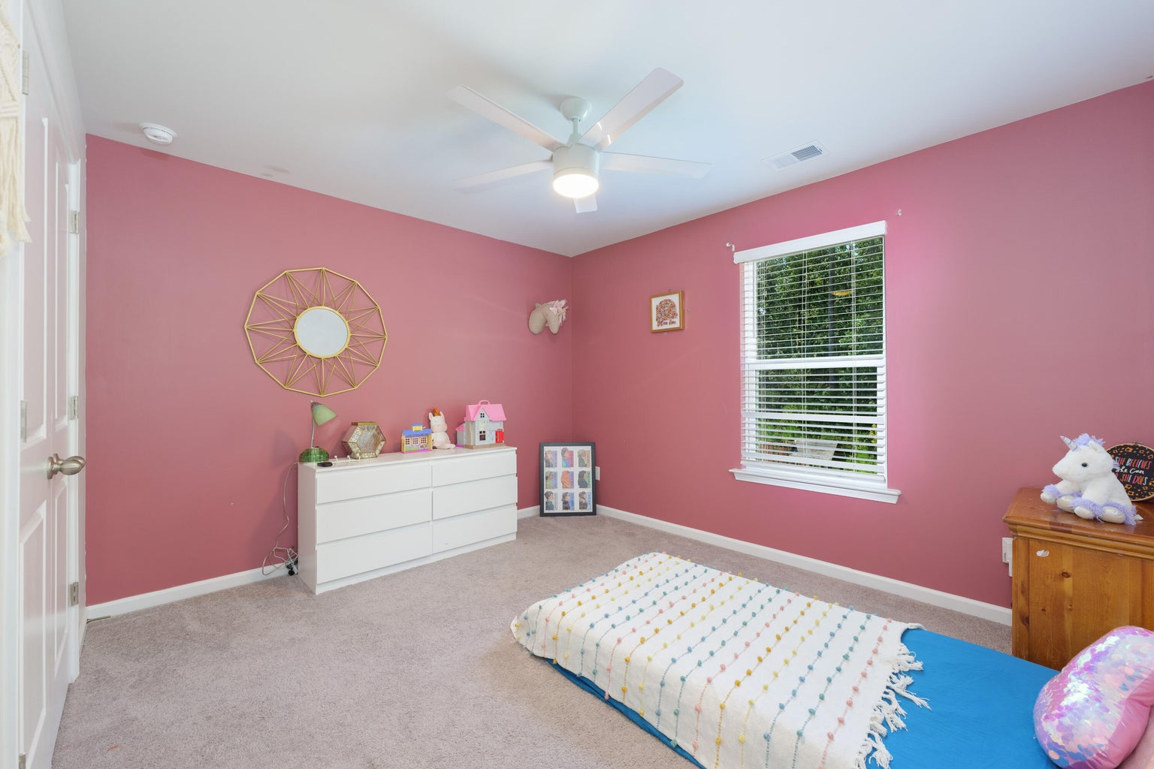
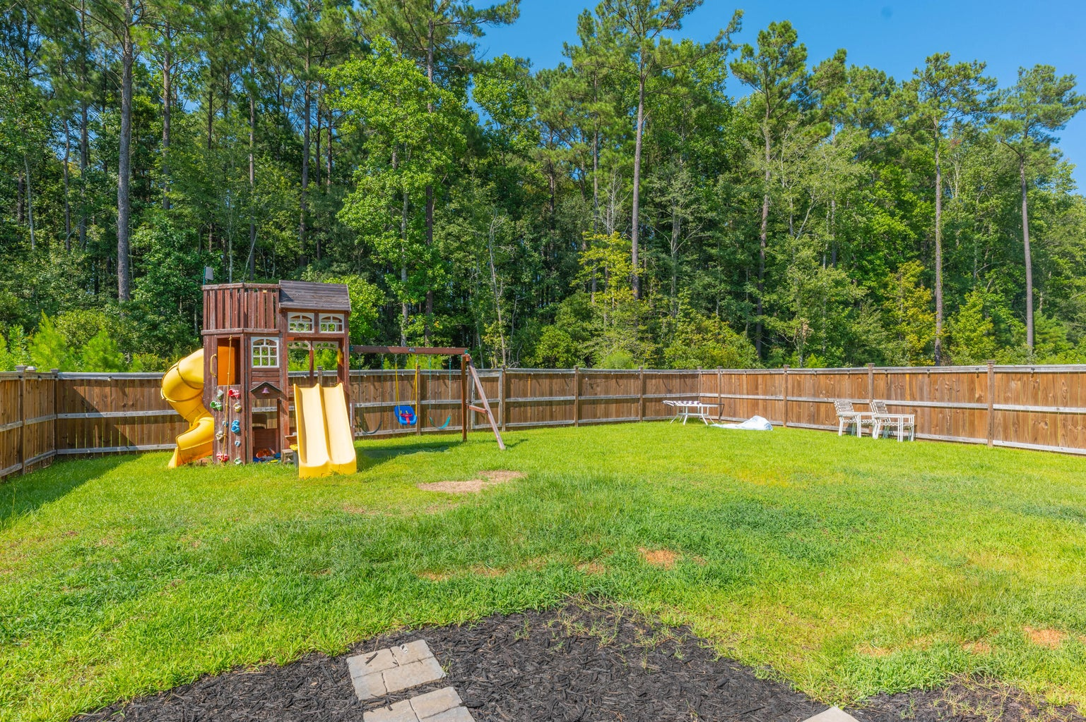
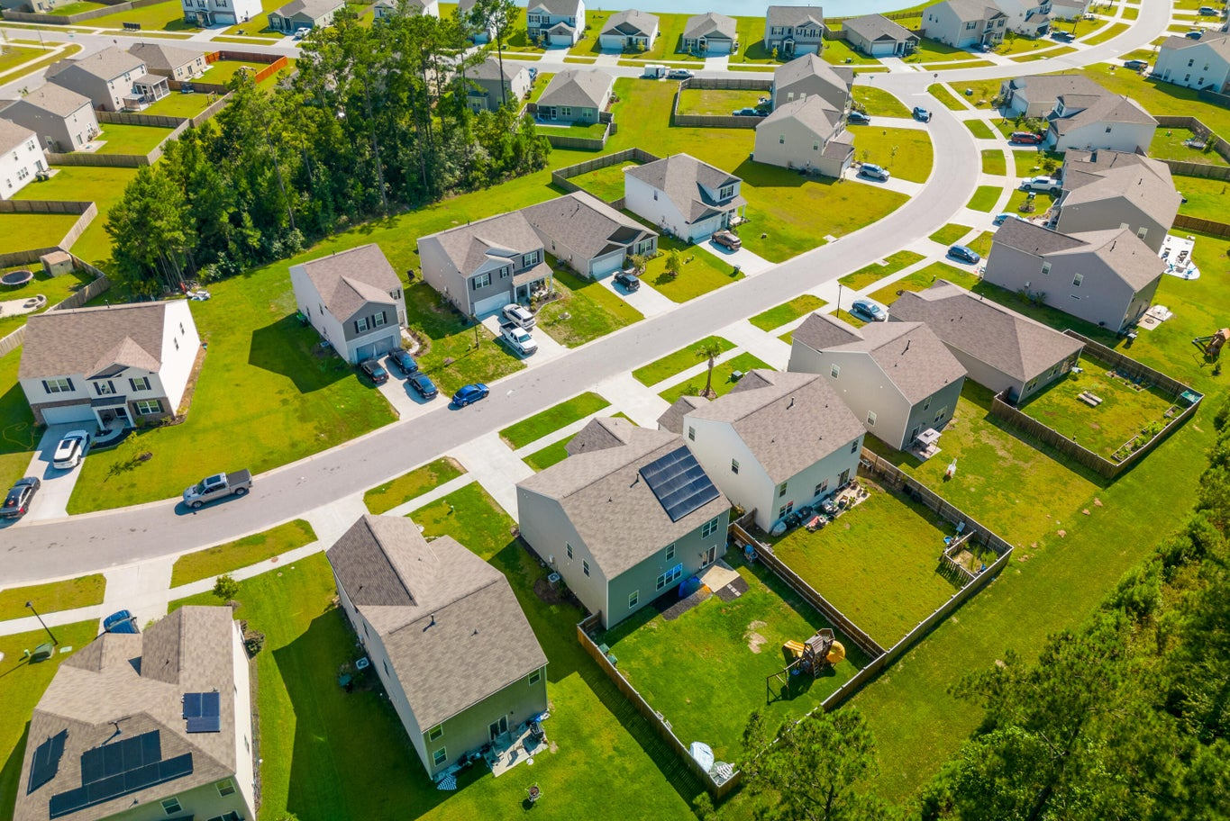
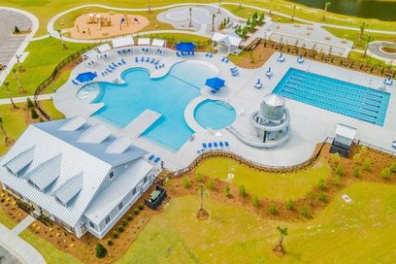


6 BED/3 BATH DUAL MASTERS
Custom 5br, 4.5ba 4700 Sqft Of Flex Space
10’ Smooth Ceiling
Heart Pine Flooring
Master Bedroom Suite On First Level
Second Master On Upper Level
Two Dens With Gas Fireplaces
Formal Dining Room
Gourmet Kitchen With Second Den/Warming Room And Breakfast Room
Walk-in Pantry
Large Bonus/Game Room Above Oversized Two Car Garage
Screen Porch & Outdoor Firepit
Large Pond Lot With Mature Trees And Irrigation System
3 Separate AC Units
Gas Hot Water Heater
New 35-year Roof
Private Gated Community With Community Pool, Clubhouse, Boat Launch And Dock
331 Willow Pointe Circle
Cane Bay Plantation | Summerville, SC 29486
MLS# 23019637 | $439,000
This impressive floorplan includes a flex space, open living area, chef's kitchen, dining area, and a private guest suite on the first floor. Upstairs, there is a large primary bedroom with a sitting area, two walk-in closets, and a spacious bathroom. Additionally, there are four secondary bedrooms, a loft area, and a laundry room. The Cane Ridge community offers resort-style amenities such as a pool, walking/bike paths. Cane Bay Plantation is a highly desirable neighborhood in the Tri County area with easy access to shopping, dining, medical services, walking trails, and the Cane Bay YMCA.
4
3
1,844
Telecia Bilton
843-412-3586
tmbilton@rogcoastal.com
Realty ONE Group Coastal
1510 Trolley Rd
Summerville, SC 29485

