Slide 1
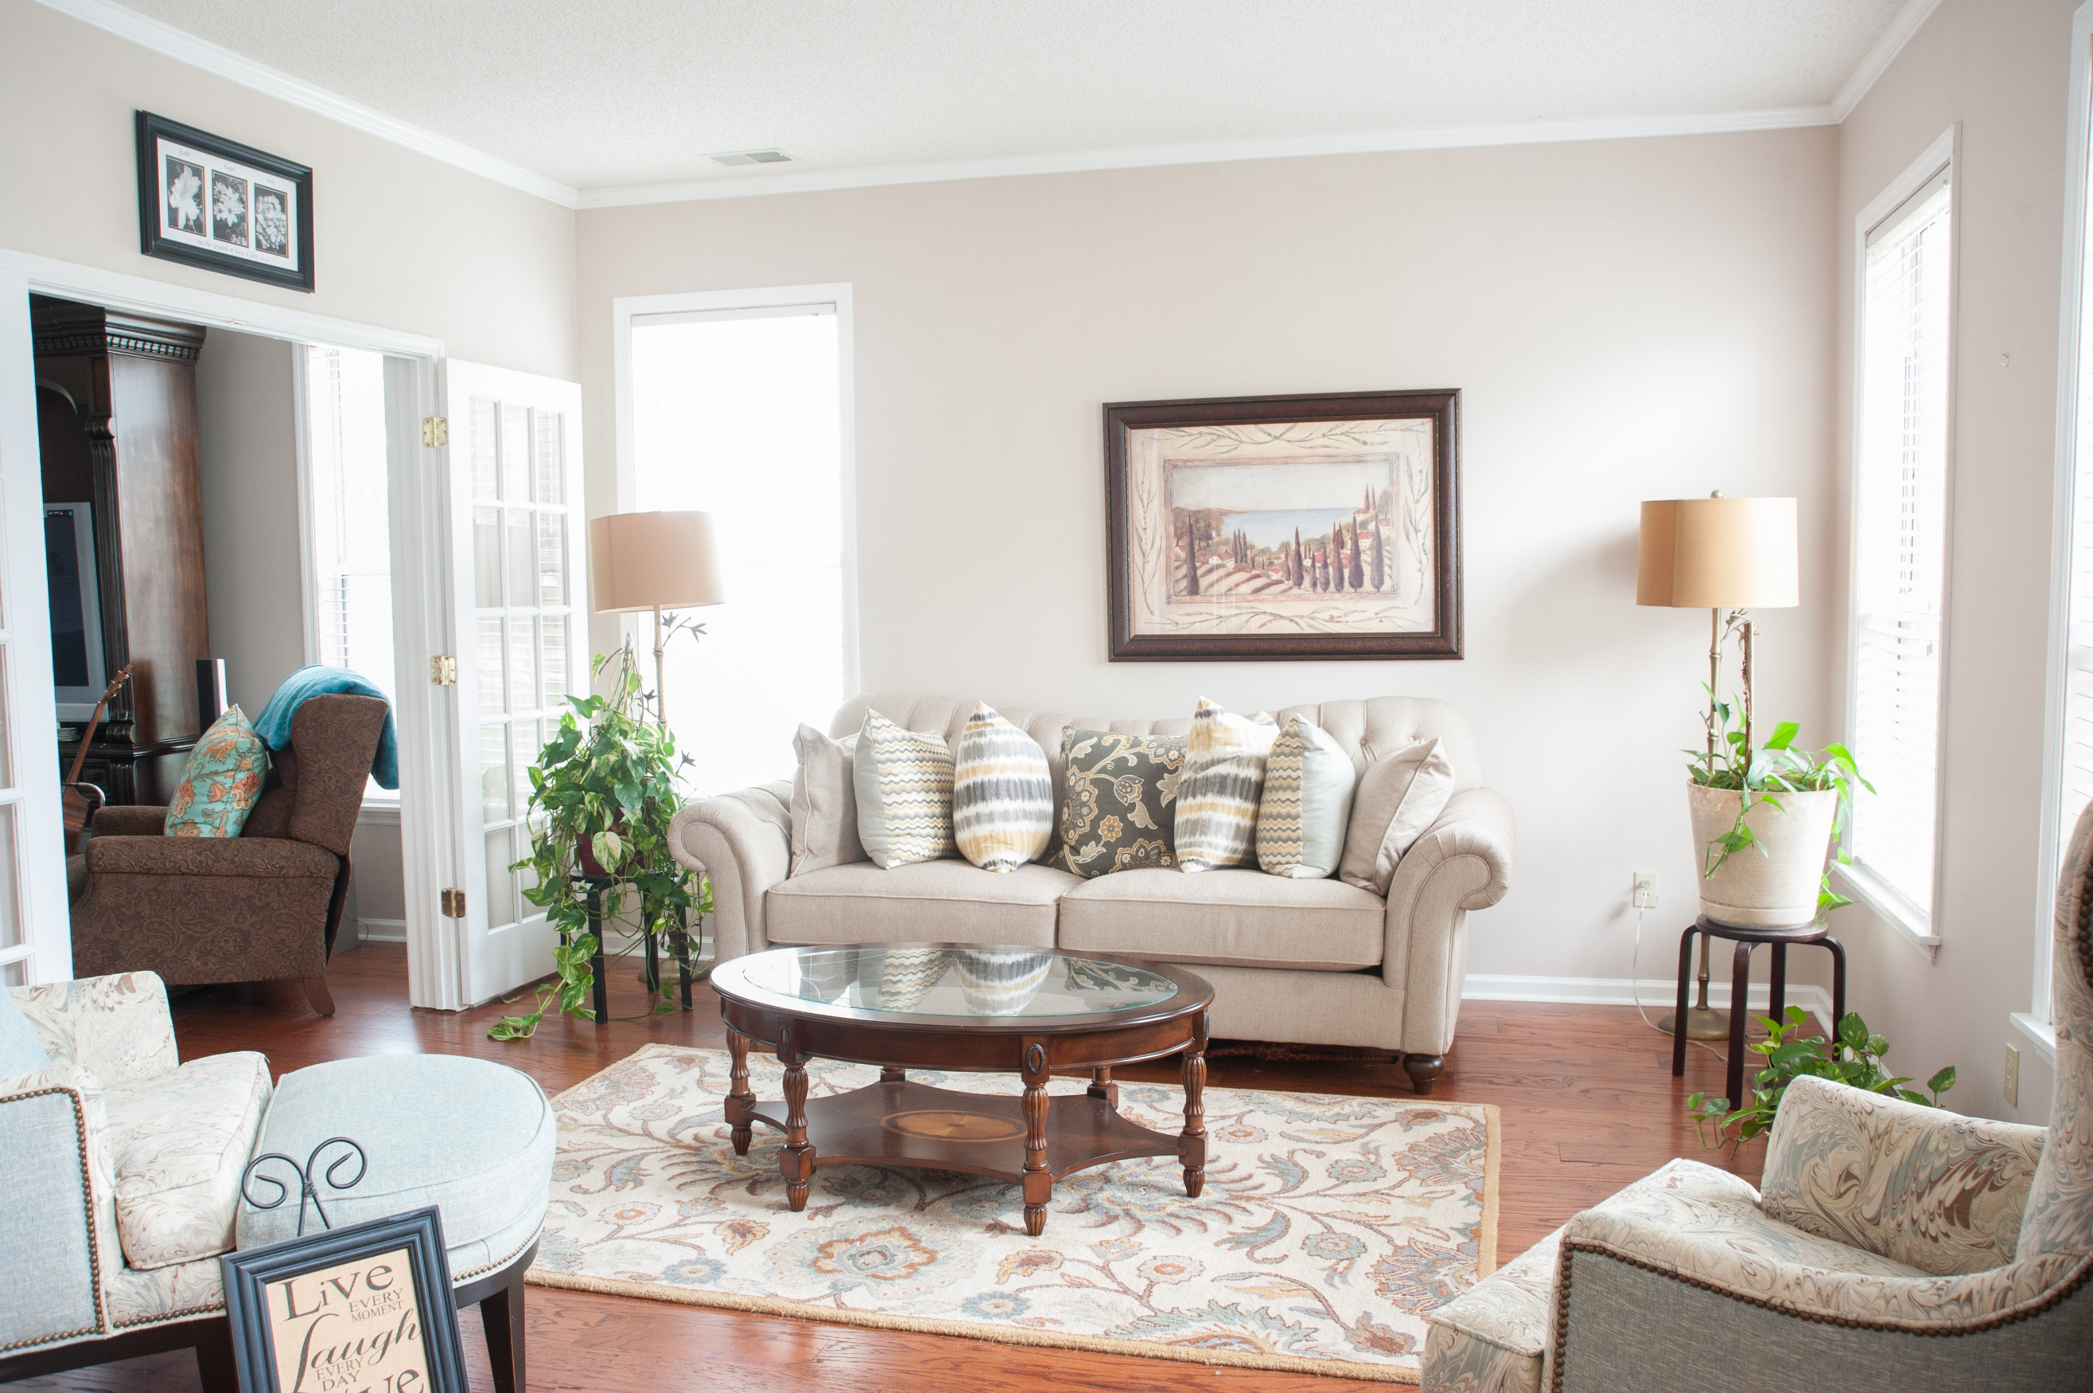
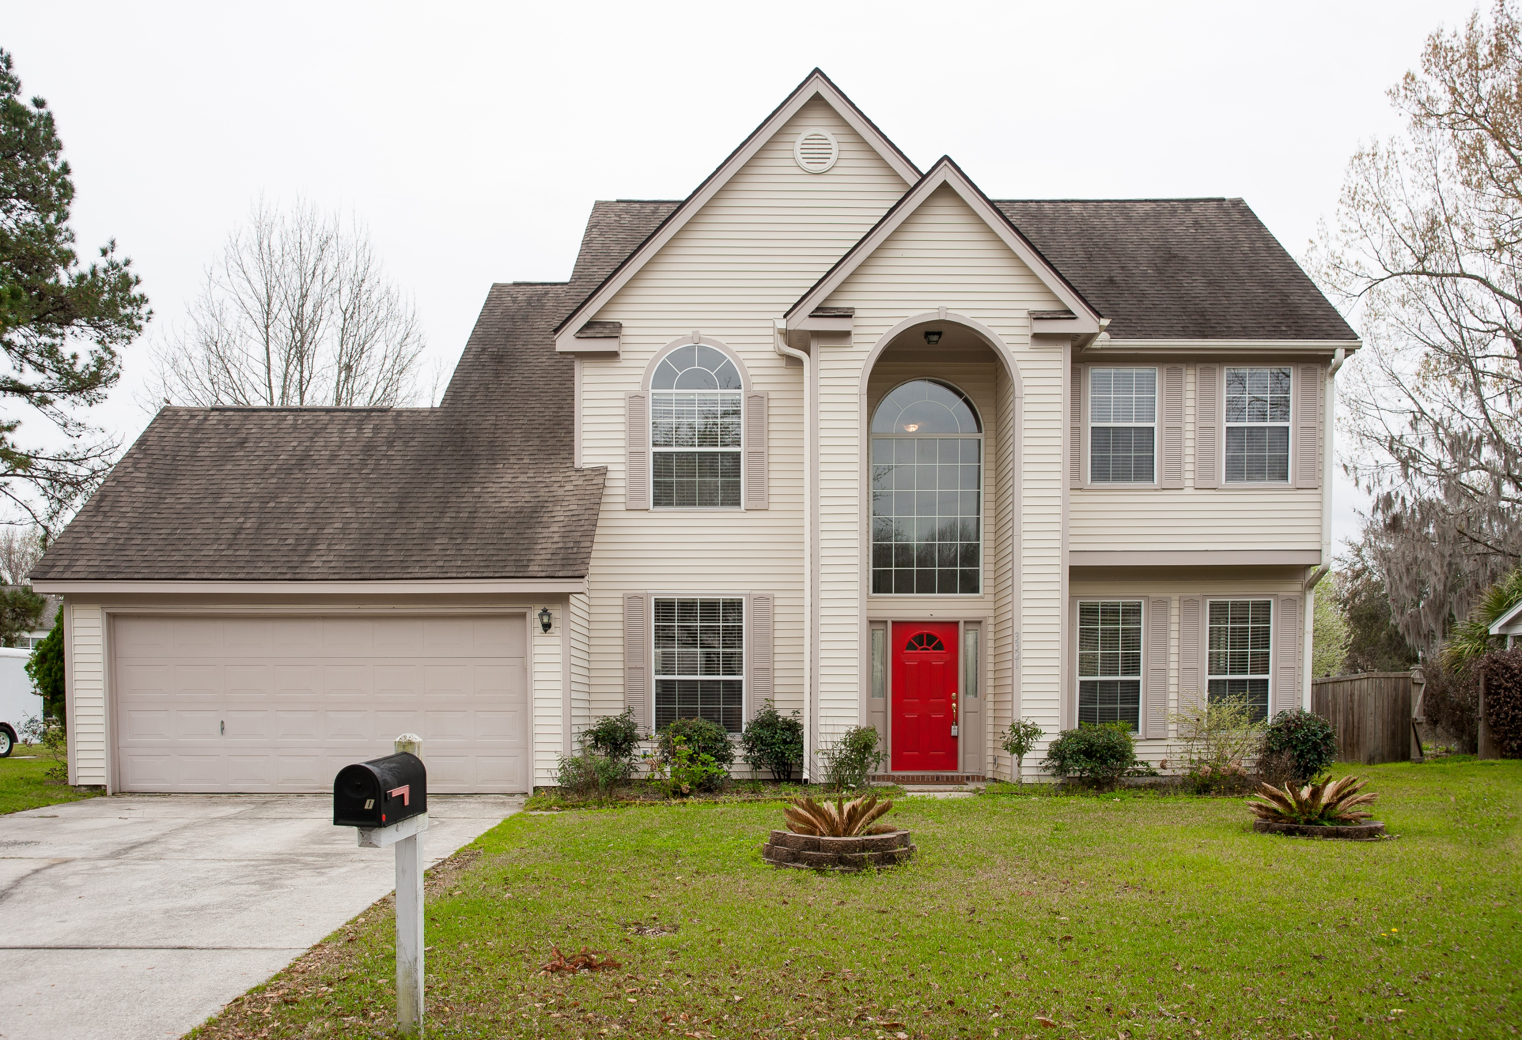
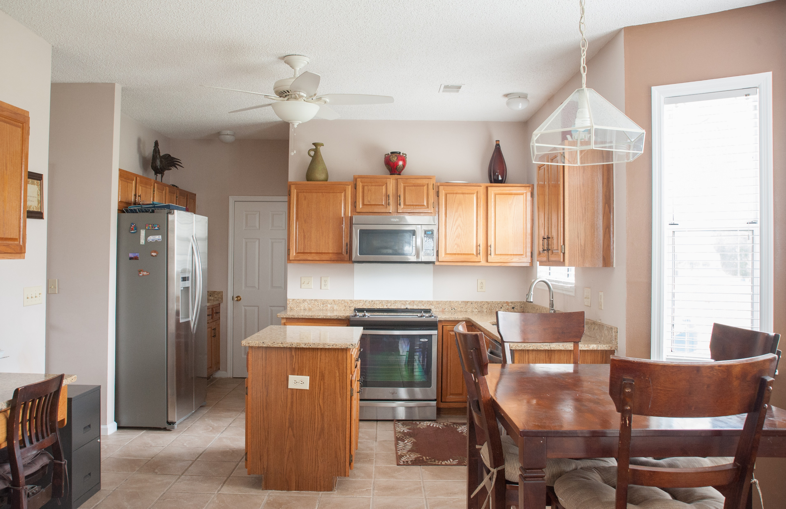
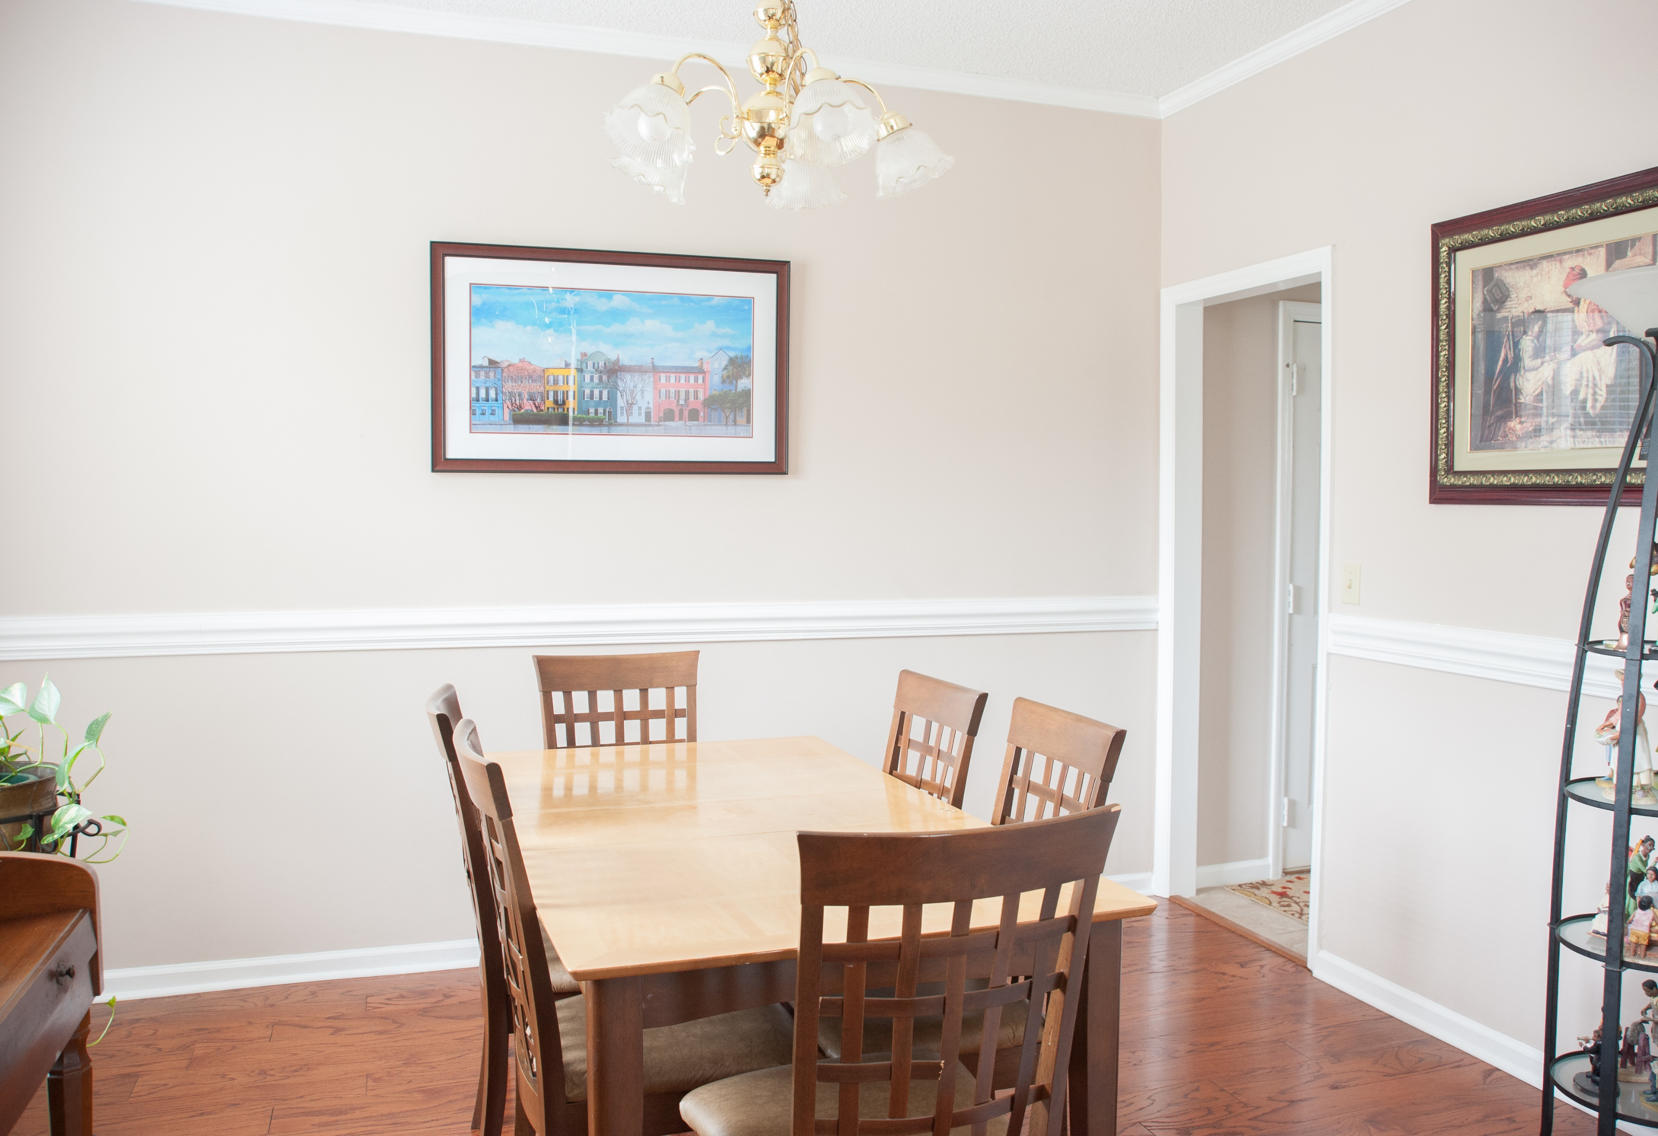
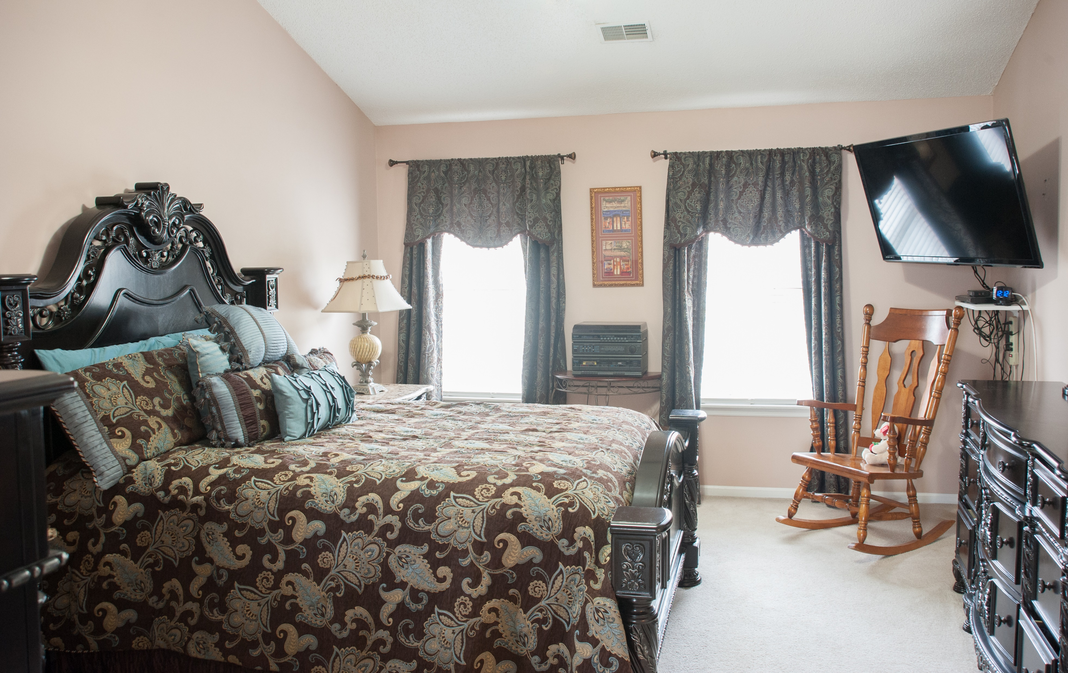
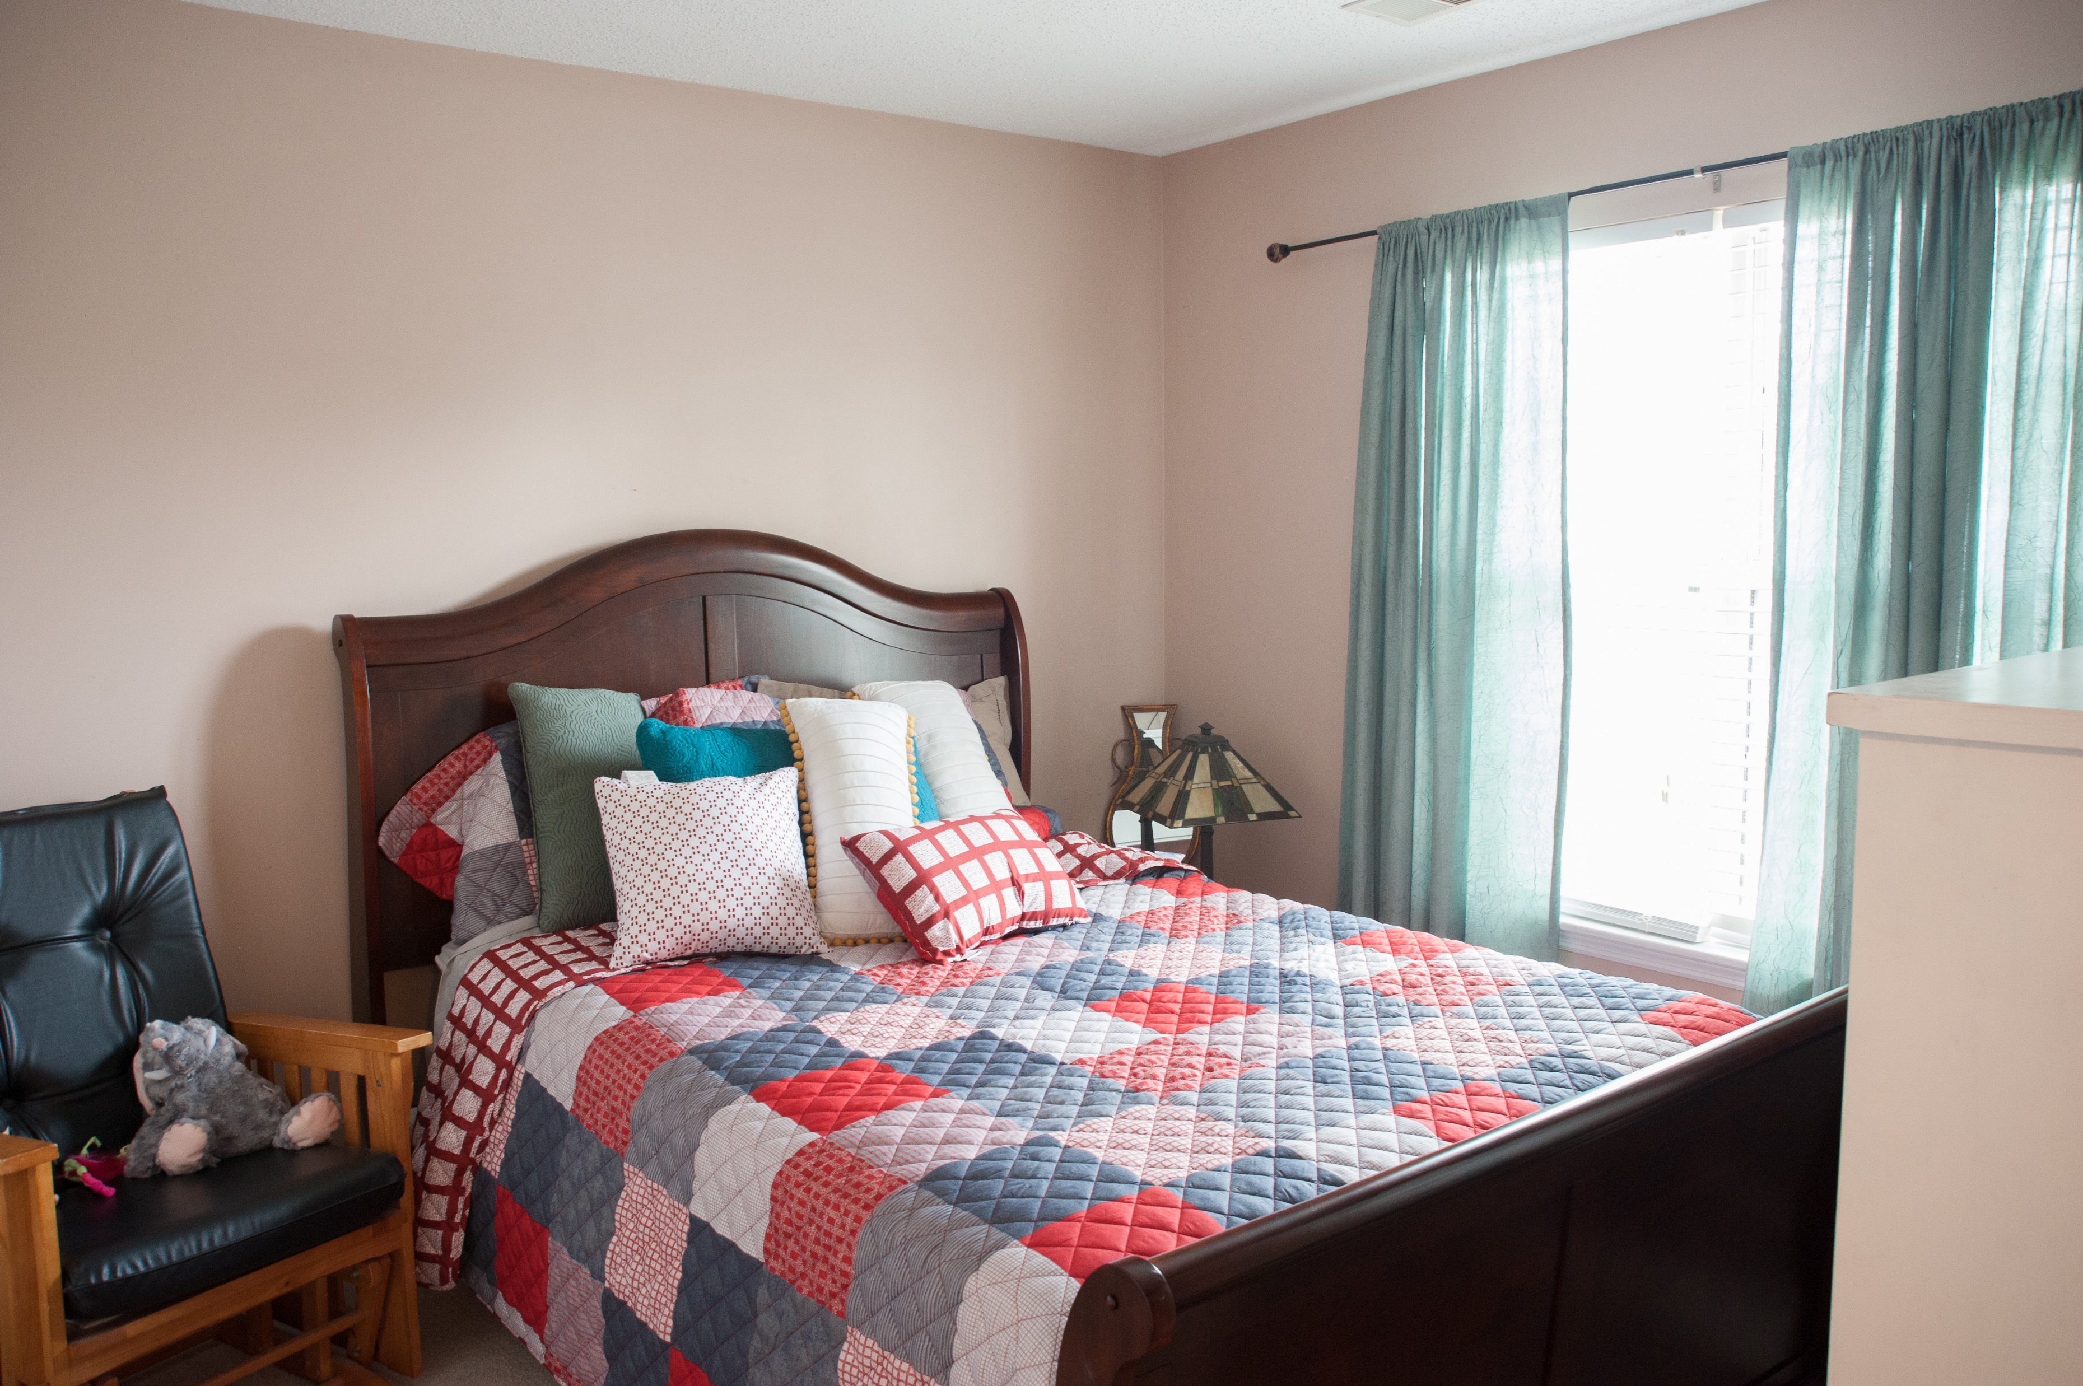
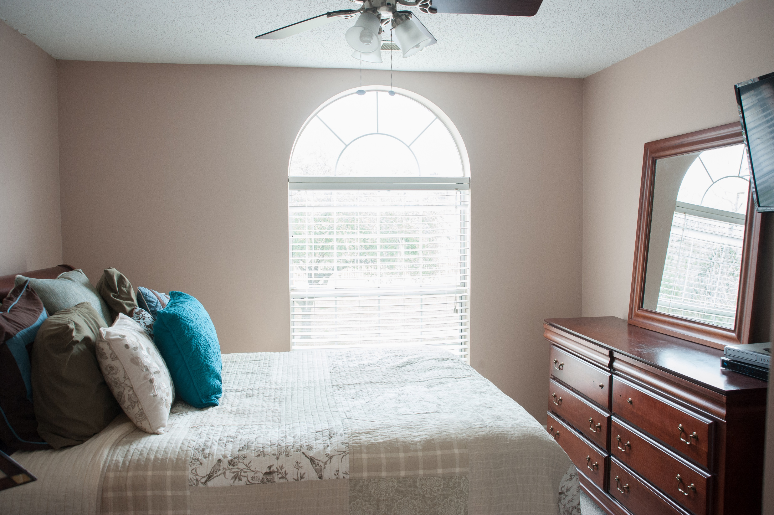
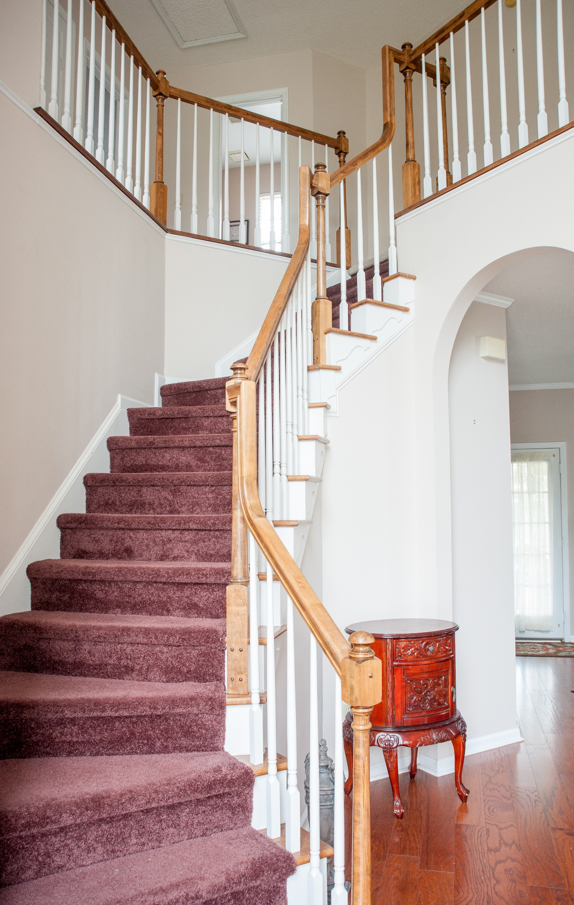
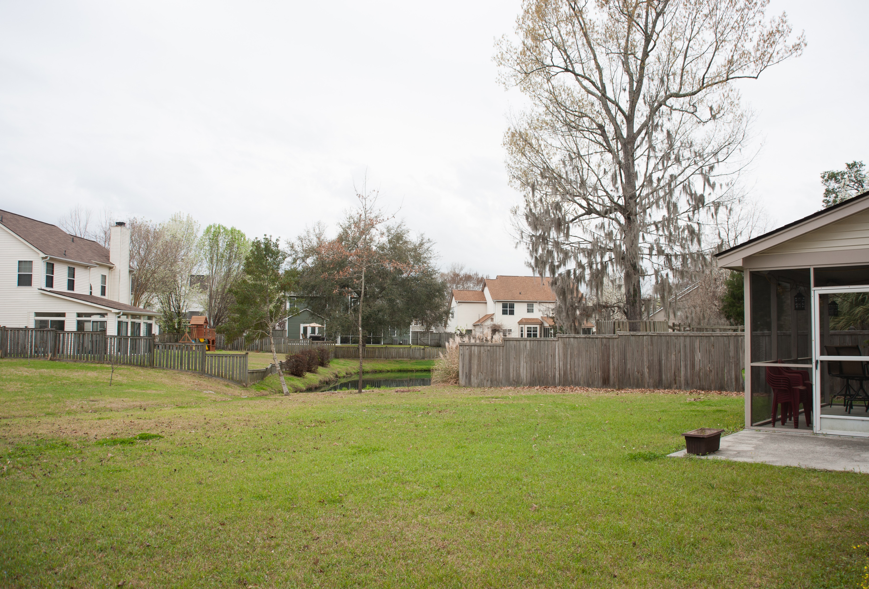
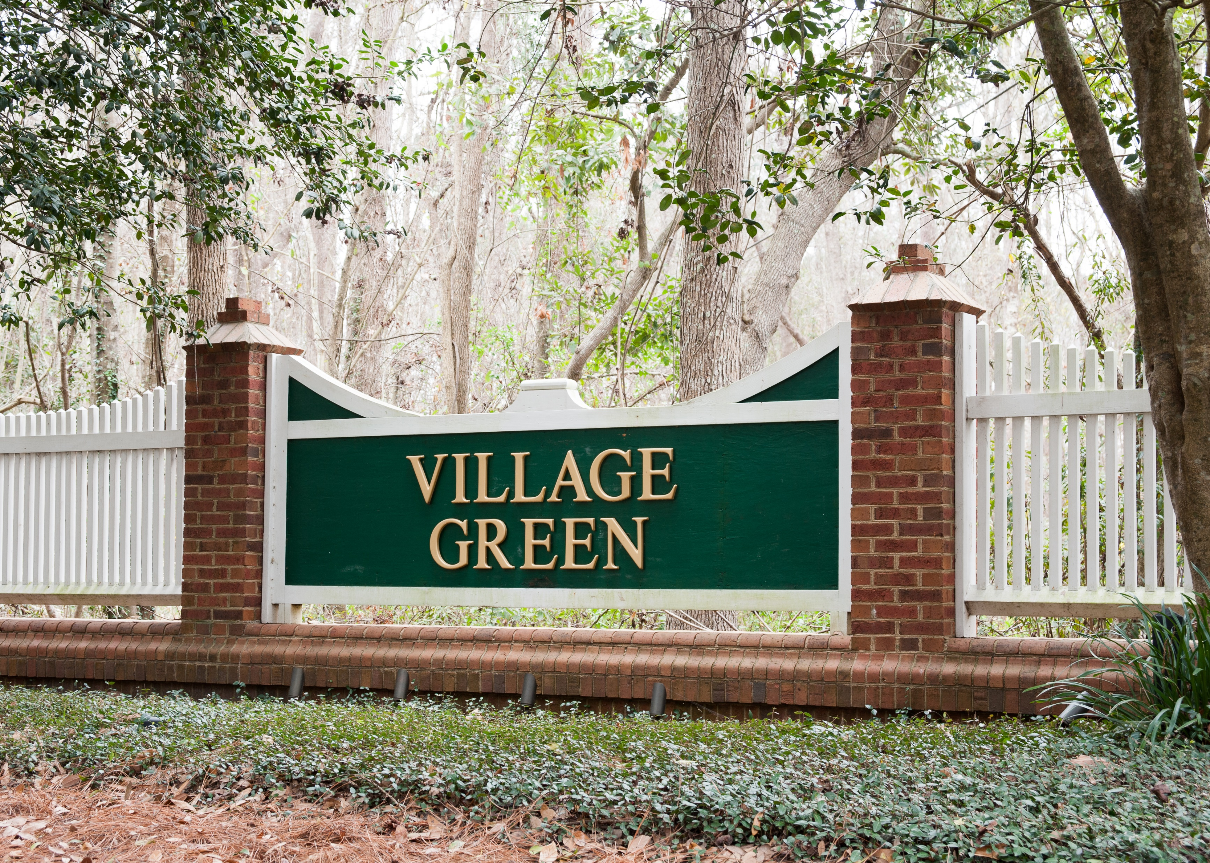

Open House ~ Saturday, March 3rd ~ 12-3
Starbucks card to first 10 agents
3321 Forest Glen Drive
Village Green ~ Charleston
MLS# 18003543 ~ $287,500
Beautiful home. A must to see. Very open floor plan with hardwood floors, in main living area. Formal Dining room and a Formal Living Room. Family Room includes a wood burning fireplace. Eat-in Kitchen with pantry and granite countertop. Laundry room and a Half bath are downstairs. Master Bedroom is upstairs with vaulted ceiling. Master Bath has a separate tub and shower. There are 2 additional bedrooms and bath upstairs. The screened in porch in the rear of home is perfect for entertaining your guest.
Geraldine Sands
(843) 224-1911
gw.sands67@gmail.com
AgentOwned Charleston Group | 902 Savannah Hwy | Charleston, SC 29407-7802

