Slide 1
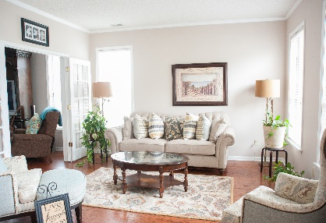
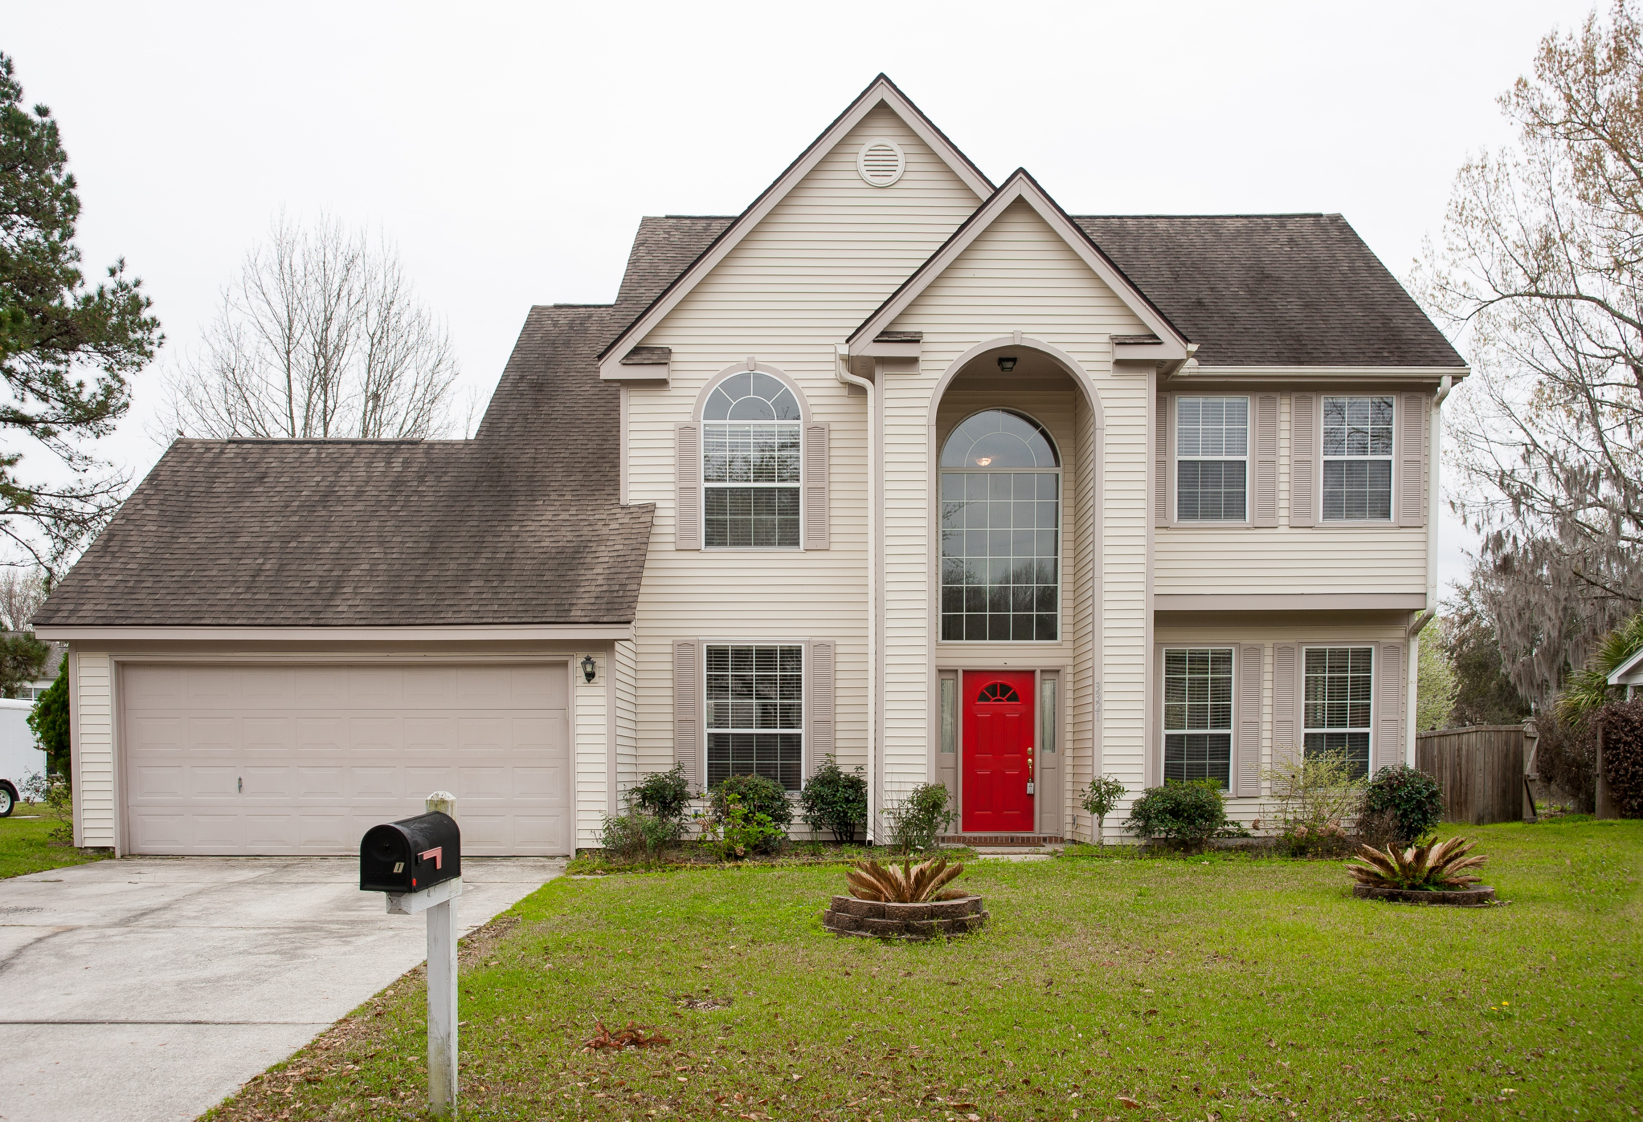
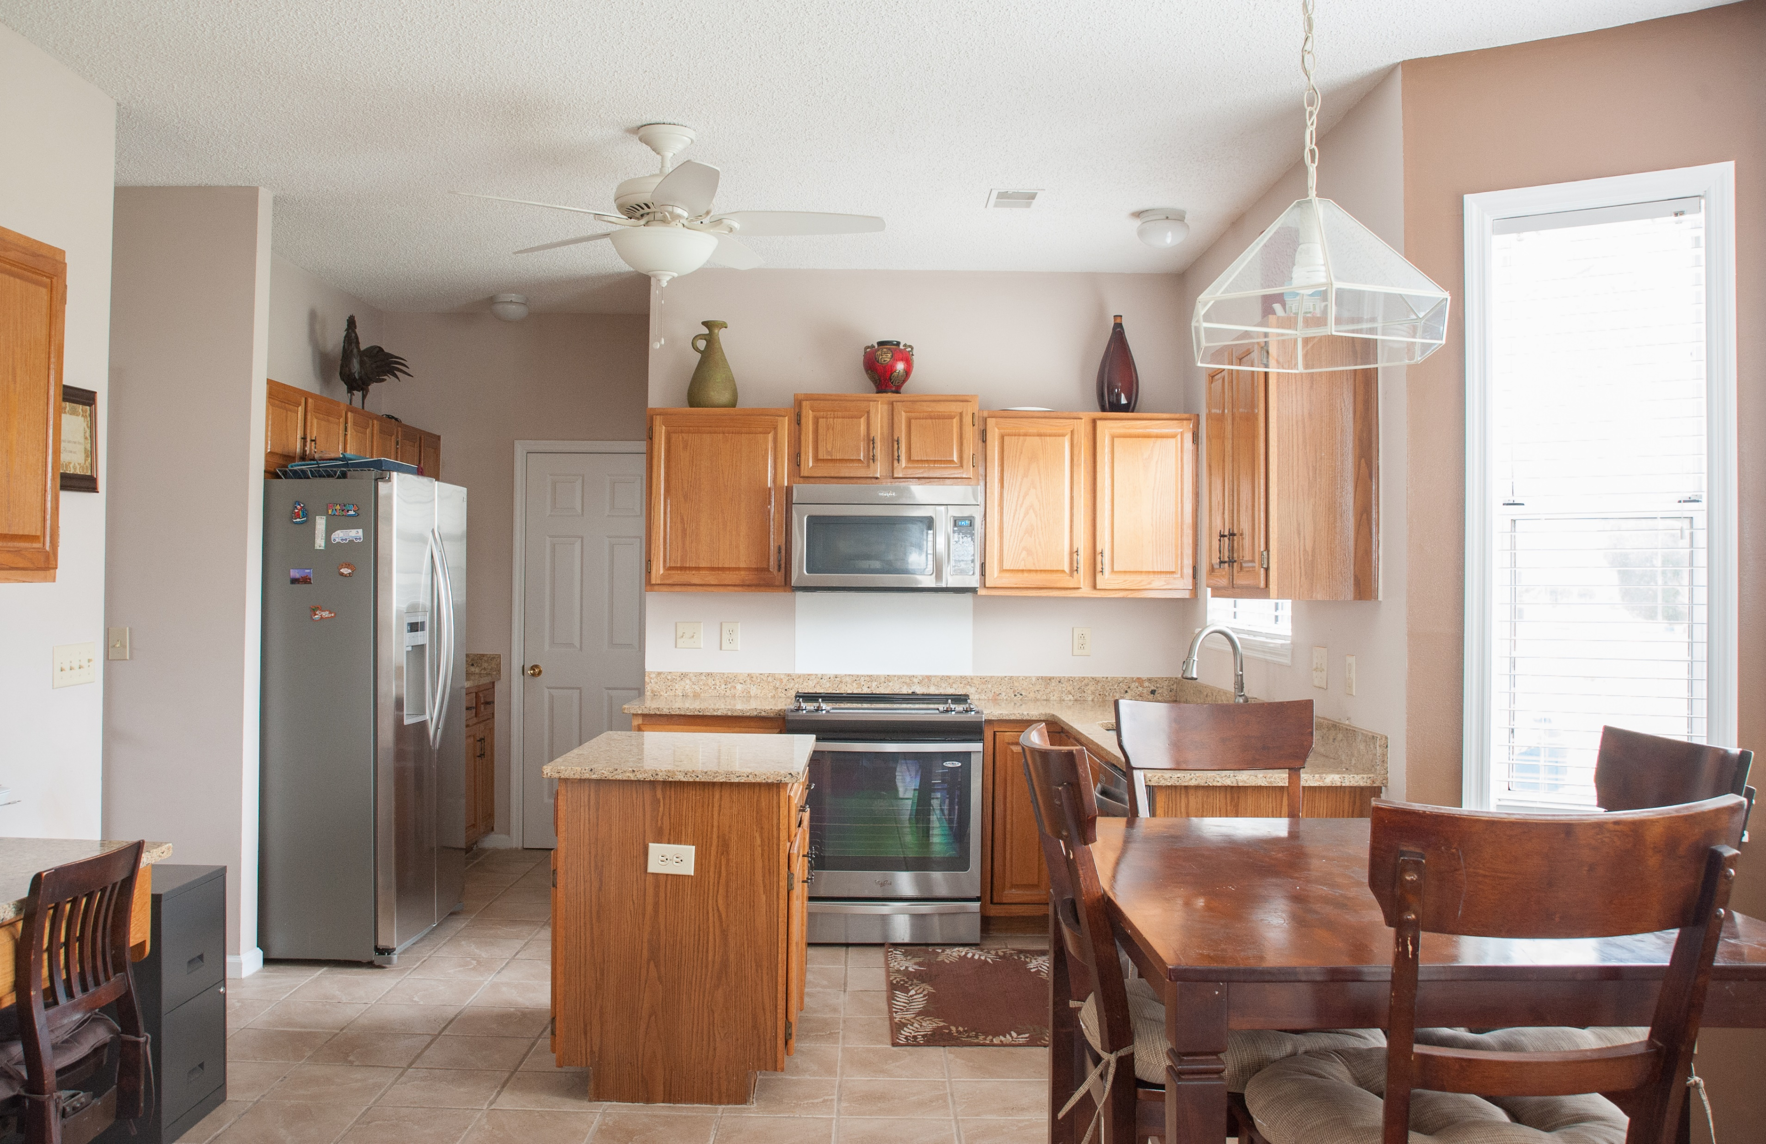
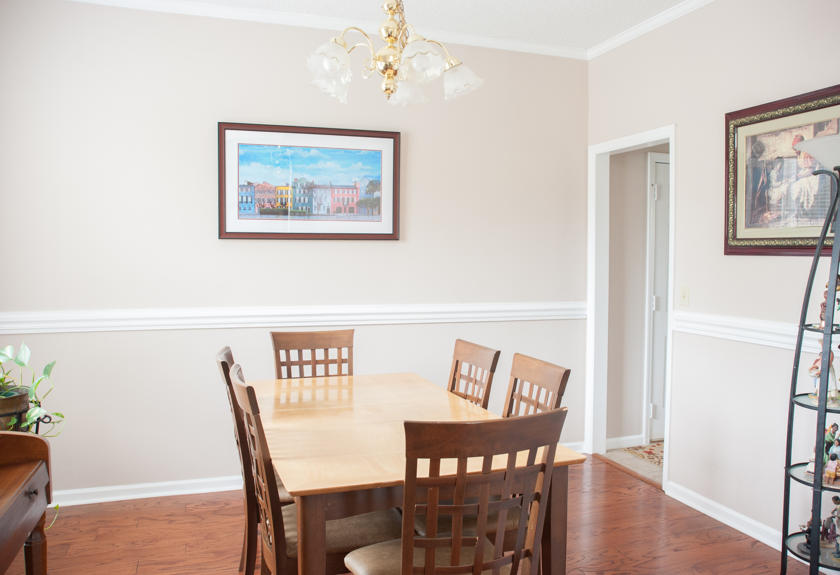
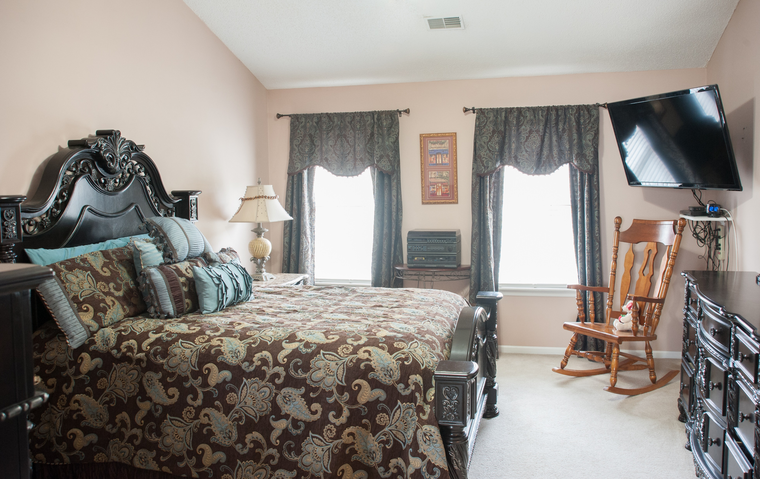
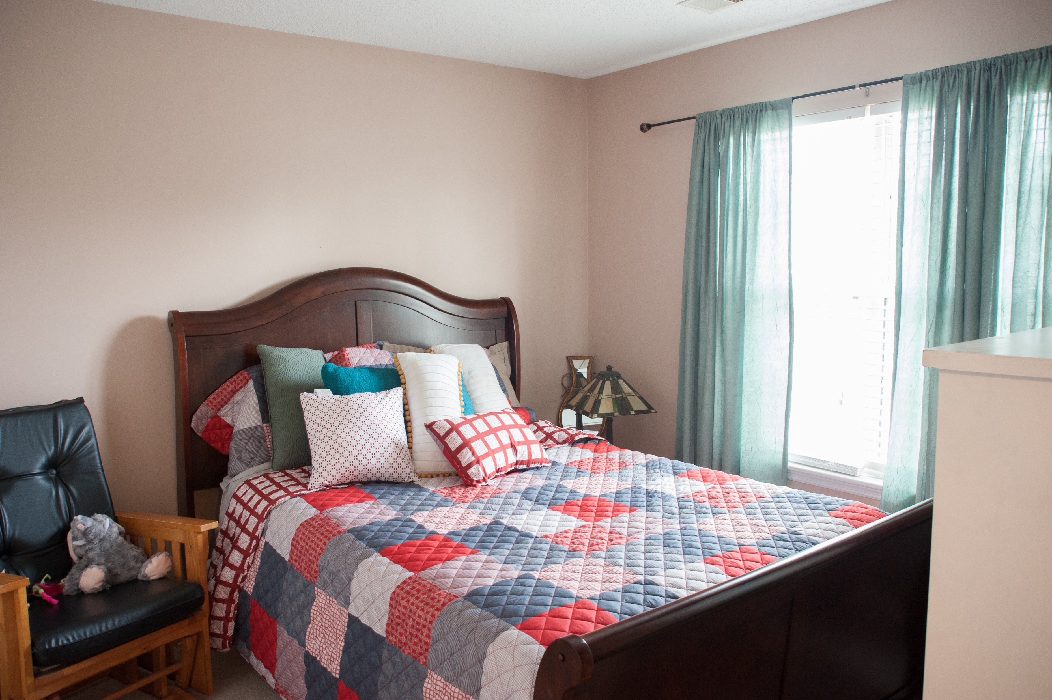
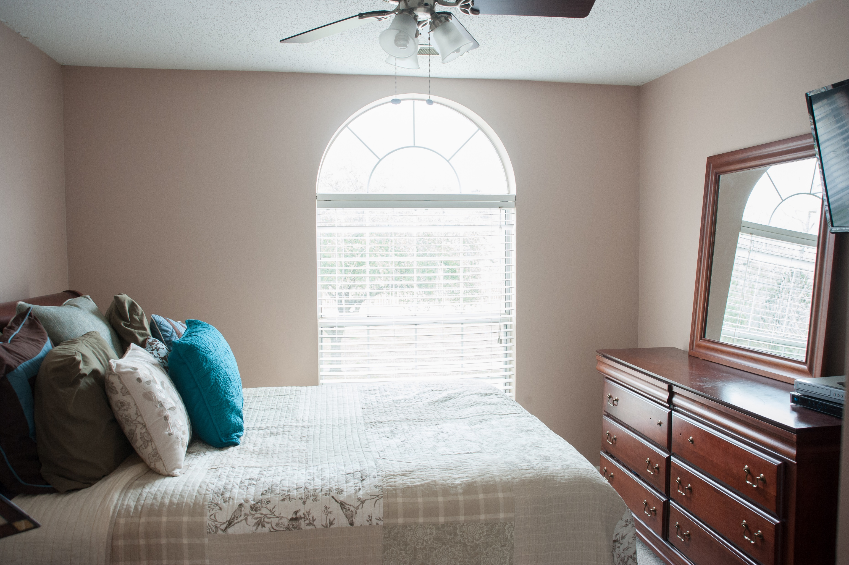
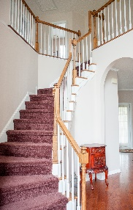
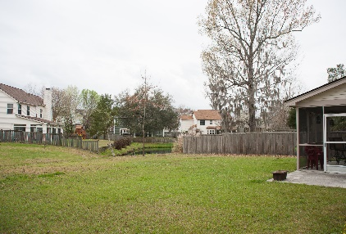
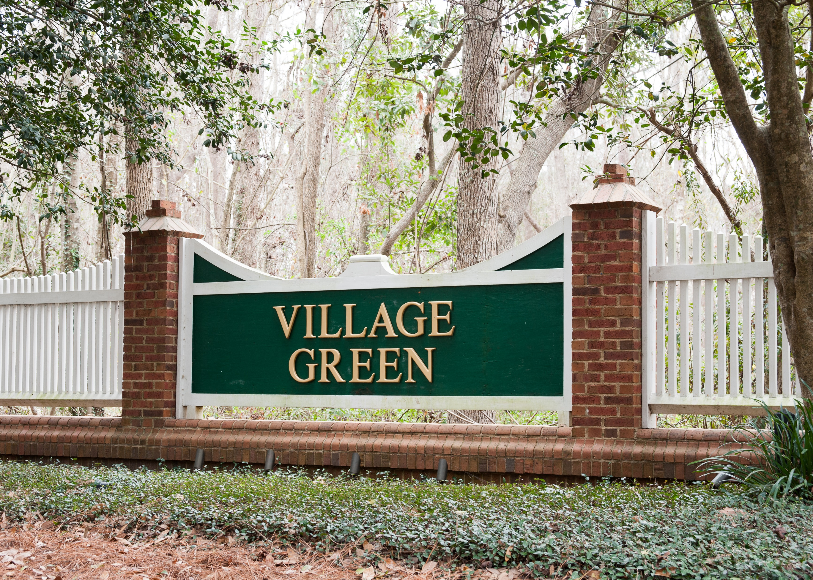

$5,000 Price Reduction In Village Green
Come Take Another Look At This Beautiful Home
Starbucks card to first 10 agents
3321 Forest Glen Drive
Village Green ~ Charleston
MLS# 18003543 ~ $274,500
BRING ALL OFFERS! OWNER VERY MOTIVATED. EASY TO SHOW!
Open floor plan with hardwoods through out first floor. Formal Dining room and also a flex room/office/formal living room on main floor. Family room includes a wood burning fireplace. Eat-in Kitchen with tons of storage. Stunning 2-story foyer with open railing and tons of natural light. Master bedroom is upstairs with vaulted ceiling and large master closet. Master Bath has a separate tub and shower. Two more bedrooms plus another full bath upstairs. Screened-in porch & grilling patio overlook beautiful lawn. Village Green amenities offers a neighborhood swimming pool & pool house and picnic park!
Geraldine Sands
(843) 224-1911
gw.sands67@gmail.com
AgentOwned Charleston Group | 902 Savannah Hwy | Charleston, SC 29407-7802

