Slide 1
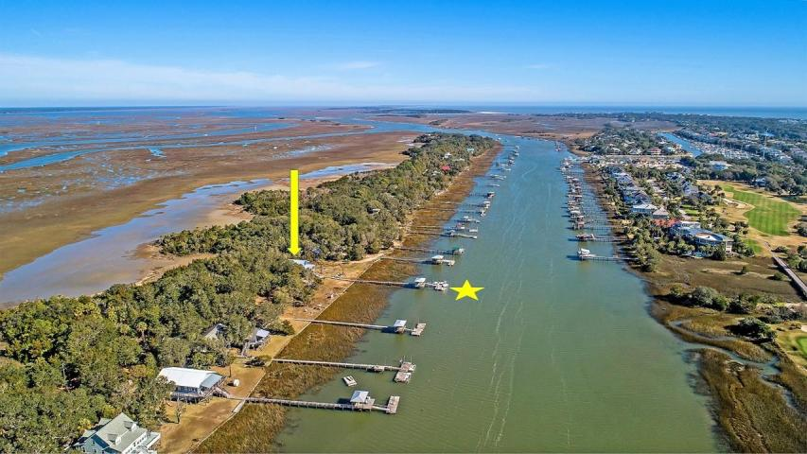
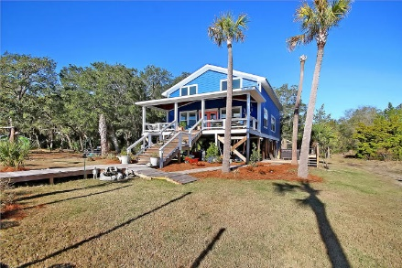
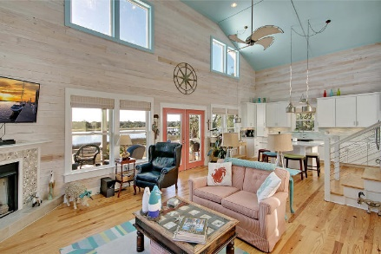
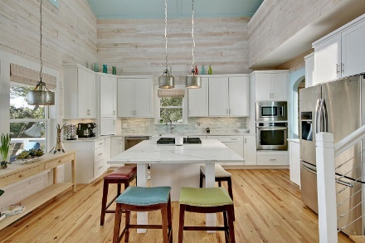
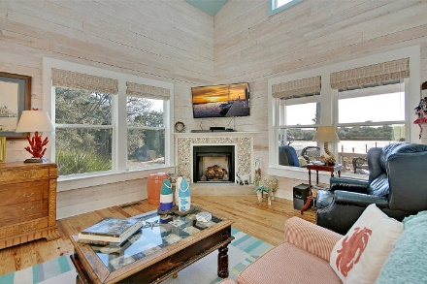
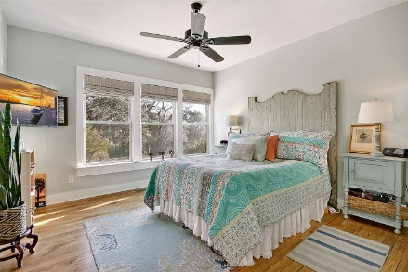
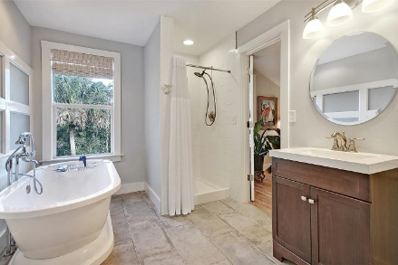
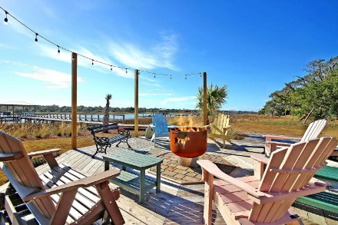
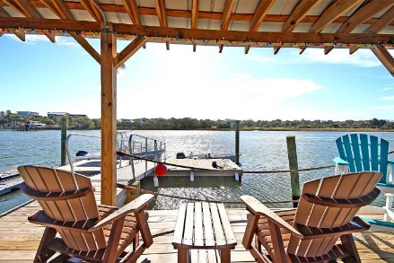
Private Island Getaway
Price Reduced!
3325 Buccaneer Road
Isle of Palms, SC 29451 ~ MLS# 19000911 ~ $799,500
The only way to access this private island just over the Intracoastal Waterway is by boat! Located on the other shores of the Isle of Palms Marina, this updated residence on Goat Island makes you feel like you've entered a whole other world. The dock is the metaphorical driveway for this island getaway where you can park your boats & there's also a drive on floating dock for an up to 20' boat. The fully redone home has been designed around enjoying the water views from the fire-pit/deck area, the swing & the full front porch. The depth of the front steps were increased just to accommodate extra seating to enjoy the sunset from. The square footage of this home has been maximized to provide 3 BRs, 3 BAs, an open concept living space w/fireplace, 2 story ceiling, formal dining room & a loft.
Come experience this for yourself!
Additional features include:
Completely redone, upgraded, and updated home
Fireplace in the living room has a seashell surround
Beautiful shiplap
Wainscotting in the dining room
Master bath has a tile, walk-in shower
Kitchen has center island, built-in wine rack, tile backsplash, stainless steel appliances and gas range
Permitted for a boat lift
Book your showing today!
Tyler Hawkins tyler@mattoneillteam.com (843) 908-2734

