Slide 1
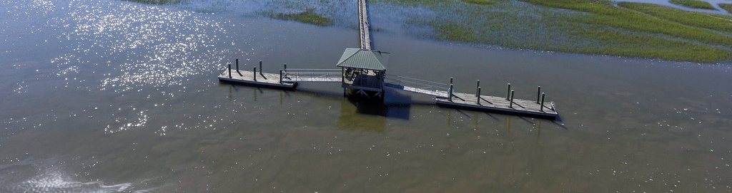
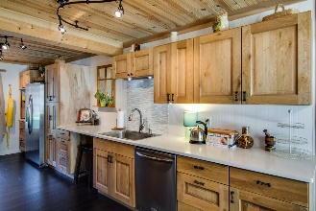
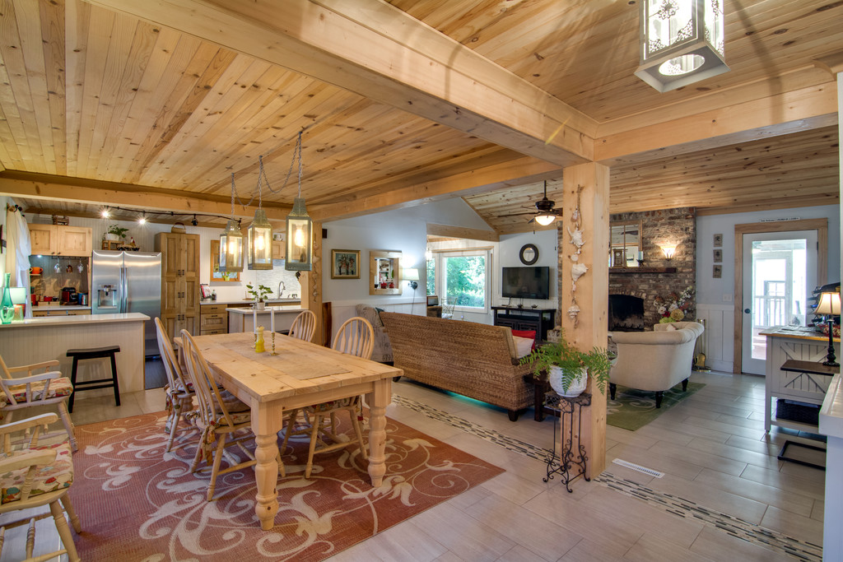
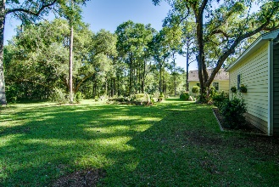
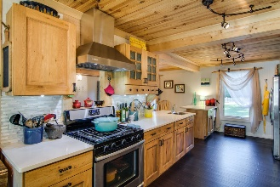
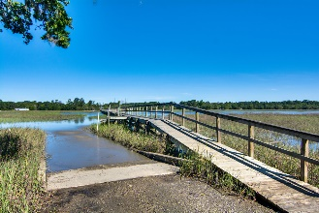
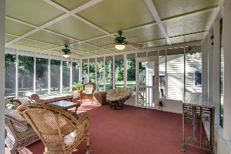
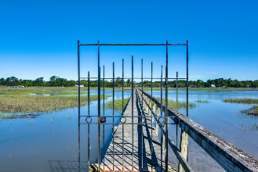


Open House Wednesday
June 21, from 11-1
3328 Cottage Plantation Road
Cottage Plantation ~ Johns Island
MLS# 17014882 ~ $450,000
Come enjoy 2 acres of quiet and beauty…and some lunch!
Over 2 acres! Close to Kiawah beach! Access to Bohicket River via boat ramp or Dock! This house will truly amaze you!! The owners have done extensive renovations. No HOA, but pride of neighborhood shows! When you drive up to the home, which is set off the road, you will feel the stress fade away. For the gardeners; you have a greenhouse! Already in place are plum, citrus and fig trees. Inside Open the front door to a beautiful foyer, formal dining to the left, ahead find family room with tongue in groove, knotty pine vaulted ceiling, fire place made of Old Charleston Brick, lots of light- So unique! Comfortable and great for entertaining! Community boat ramp and dock are available for scenic views and access to the river. If you are looking at road view online, it is more than decade old.
The kitchen is made for the gourmet cook; includes a gas stove, Silestone quartz counter tops, kitchen prep sink, lots of cabinets, under cabinet lighting, a space for a coffee bar, you must see for yourself! Bedrooms located off family room. Master has walk-in closet and updated double sinks.
Secondary bedroom area is spacious. Closet was removed from one bedroom to allow access to other bedroom and is being used as sitting area. Another full living area is on the other side of the home and has a separate entrance. This could be the 3 or 4th bedroom, but would work well as a second family room. A bonus room is over this room and could be an office or another bedroom. The screened porch is huge! The detached garage is being used as a workshop. There are a couple of out buildings if you wanted to raise chickens or have horses. The possibilities are endless! Community boat ramp is available to all, but access to the deep water dock requires an annual fee. Ask your agent for the full list of upgrades.
Laurie A Loparo, ABR
laurieloparo@gmail.com
lauriesellscharleston.com
Golden Bear Realty | 654 Coleman Blvd, Suite 100 | Mt Pleasant , SC 29464
Cell (843) 442-1290 | Office (855) 352-9088 | Fax (561) 721-3311

