Slide 1
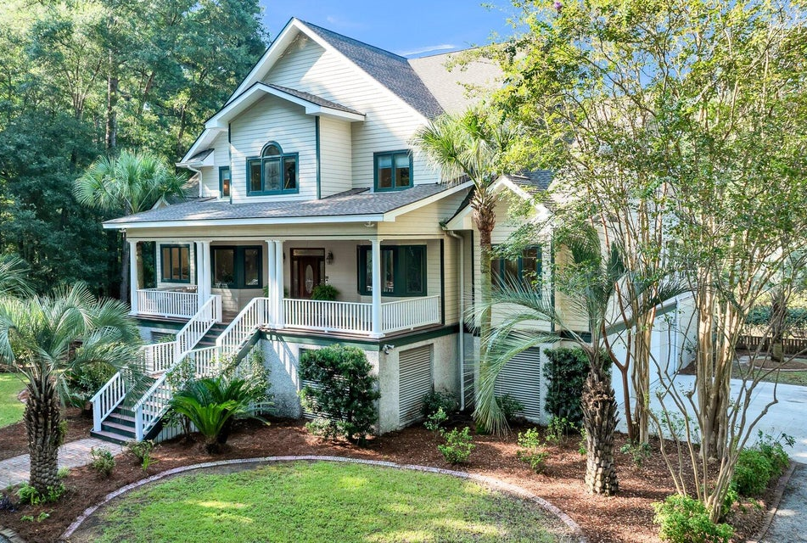
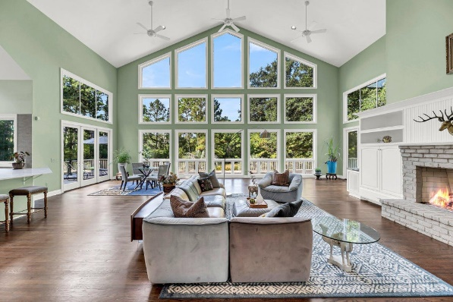
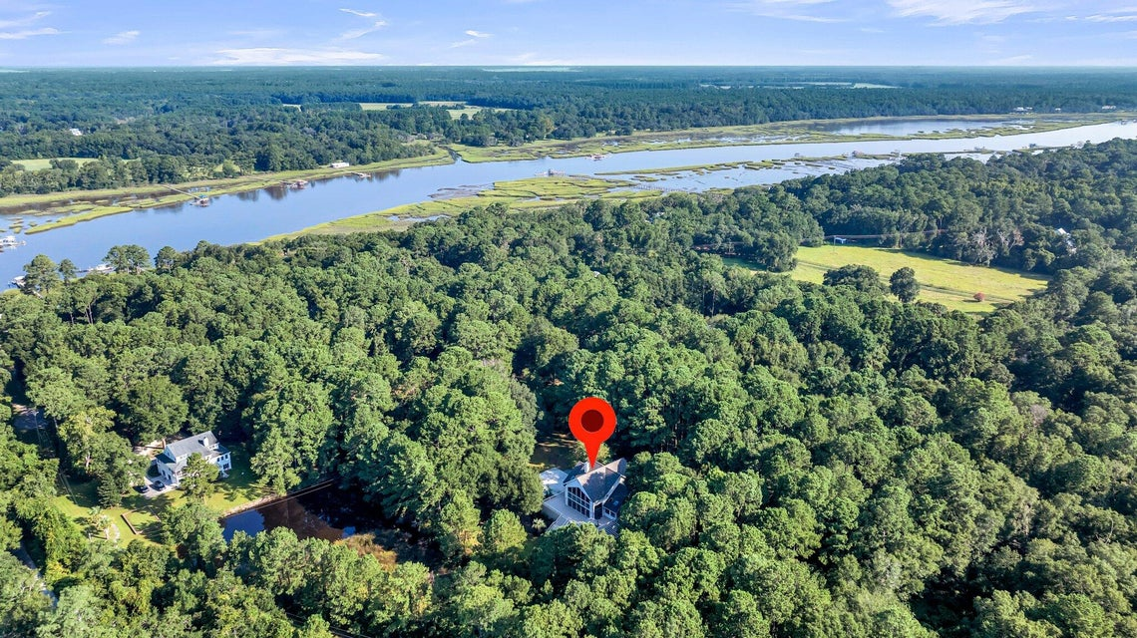
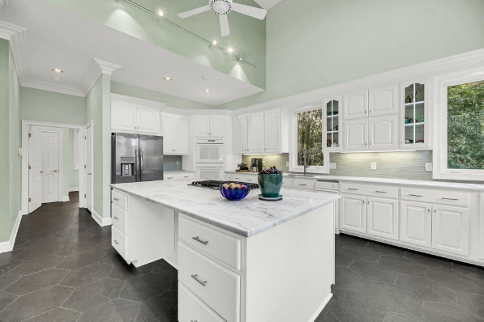



Agent Open House
Friday, Sept 6th ~ 12pm-2pm
Light Lunch Served !!
4.2 Acres
3329 River Landing Road
River Landing | Johns Island, SC 29455
MLS# 24020899 | $1,585,000
3 Bedrooms | 3½ Bathrooms
4,201 SF | Year Built 2000
Stephanie Howard
REALTOR
843-224-5912
stephanie@stephanie-howard.com
www.findyourcharleston.com
Elaine Brabham and Associates
1890 Sam Rittenberg Blvd. #217 · Charleston, SC 29407

