Slide 1
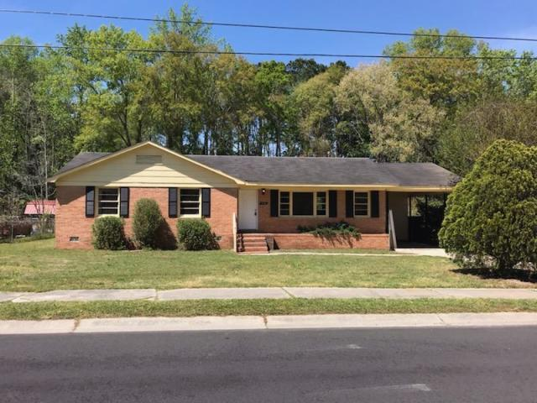
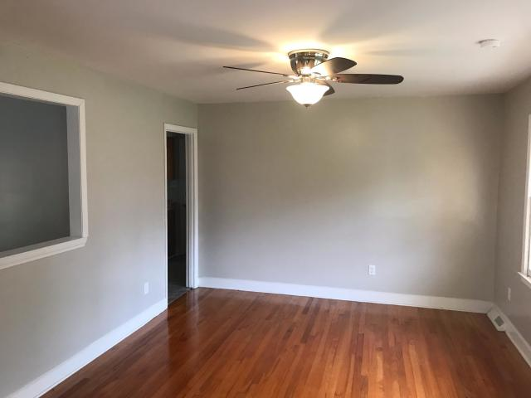
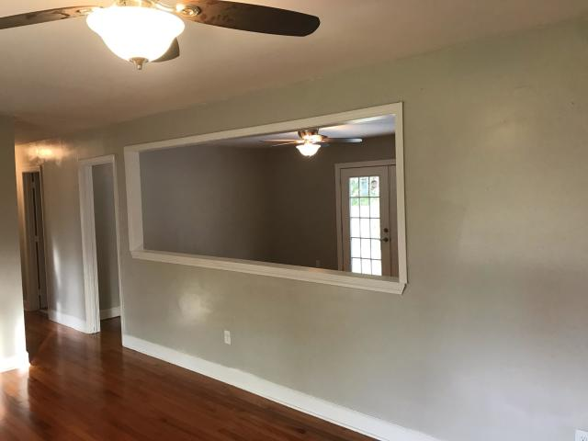
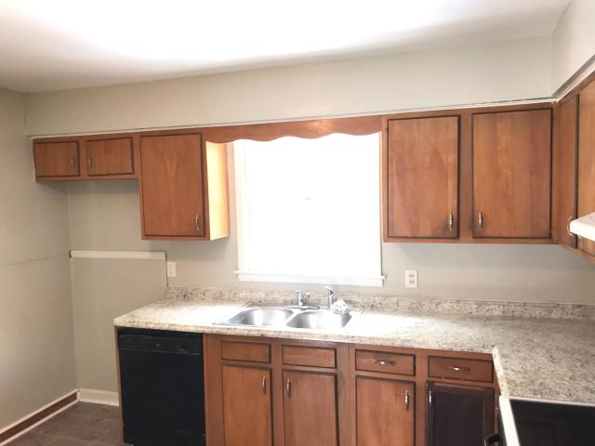
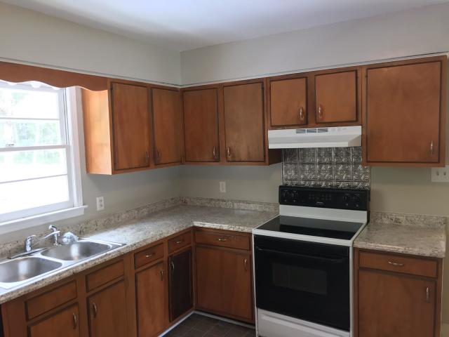
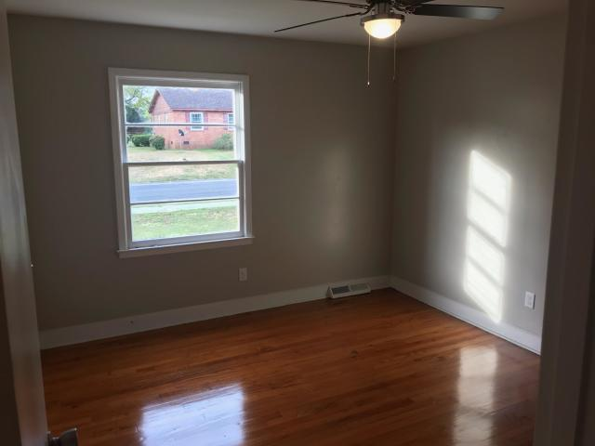
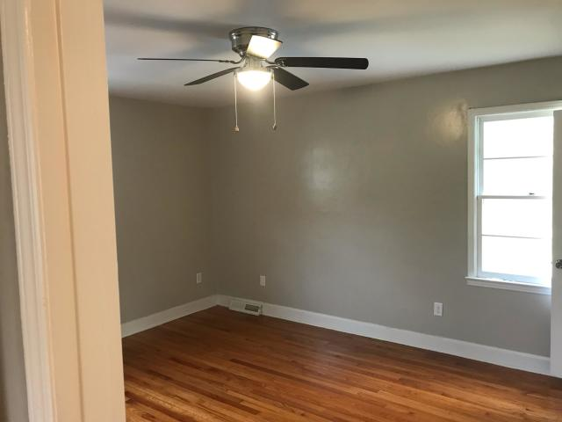
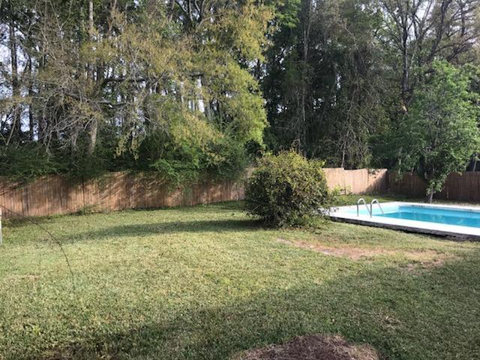
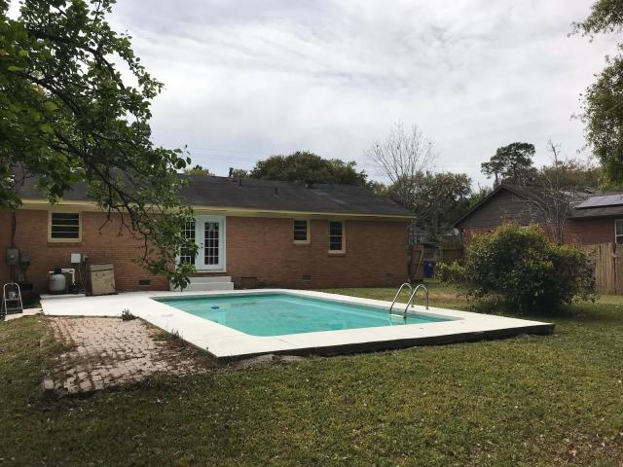



Big Yard + In-ground Pool 3334 Stoneybrook Road Pepperhill North Charleston, SC 29420 MLS# 19009232 $183,900
Recently Renovated!
Opportunity to live in central Charleston with a in-ground pool! This home is in the Pepperhill subdivision, right off of Ashley Phosphate. With easy access to the highway enjoy the convenience of being centrally located in the booming Charleston area. Right across from Pepperhill is a bowling alley for the family, or drive 15 minutes to get downtown and enjoy dinner/drinks with a significant other. Located near grocery stores, restaurants, and gas stations, everything you need is close by. Home features original hardwoods and has been completely renovated including: new 3 ton AC unit, freshly serviced pool, new sheetrock throughout, new countertops, new hot water heater, new fixtures throughout, smooth ceilings, fresh paint job (interior and exterior), new pool pump, new kitchen flooring.
Buyer to confirm square footage, schools, acreage, and all other pertinent information. Thank you!
Stephen Kugelman
(843) 330-0403
steve@agentowned.com
www.kugelmanrealestate.com
Robert Brandon Judy
(843) 330-2689
robert.judy@agentownedrealty.com
AgentOwned Preferred Group | 1400-G Palm Blvd | Isle Of Palms, SC 29451

