Slide 1
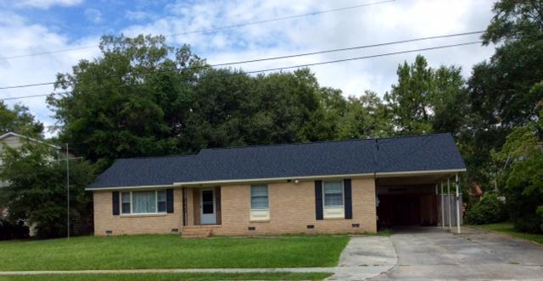
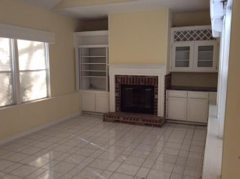
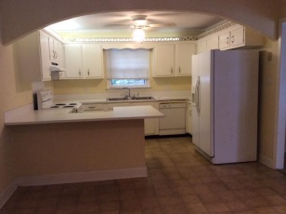
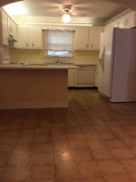
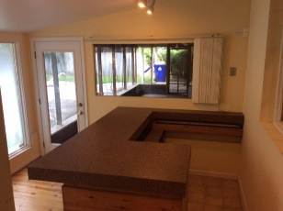
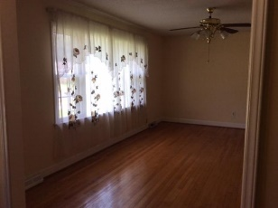


PRICE REDUCED BY $5,000 Motivated Seller!!!
3336 Dublin Road Pepperhill | North Charleston
MLS# 16021406 | $143,000
PRICE REDUCED BY $5,000! Motivate Seller Ready For All Offers!!!! The seller has already received an estimate cost to fill in the underground pool in the backyard, seller will cover the expense to have pool filled in. Once the pool is filled in it could be an excellent place for a flower garden or a veggie garden. This attractive 3 bedroom, 2.5 bathroom brick home with a large open eat-in kitchen area, original hardwood floors, with a gas burning fire place in the family room. Property being sold '' As Is '', the roof has been replaced with in the last three years. This spacious property just needs some TLC, the refrigerator, washer and dryer will convey with the property.
Betty Ellis
REALTOR
(843) 270-2948
betty217@bellsouth.net
www.agentownedrealty.com
AgentOwned Premiere Group
1800 Trolley Rd
Summerville, SC 29485

