Slide 1
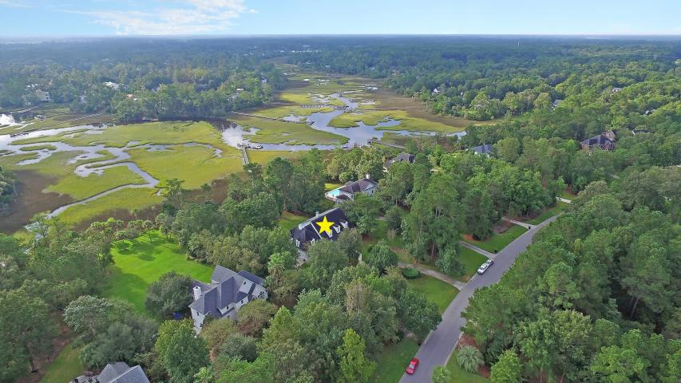
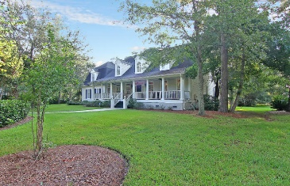
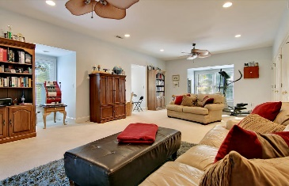
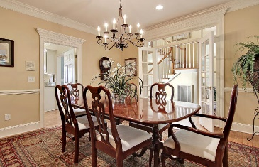
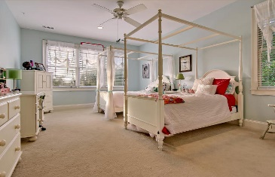
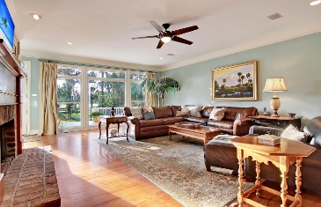
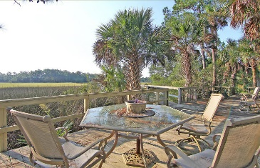
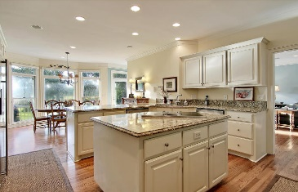
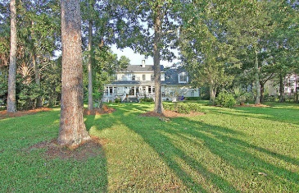
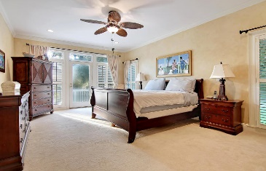
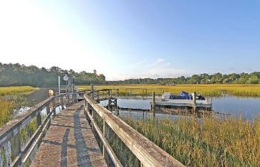

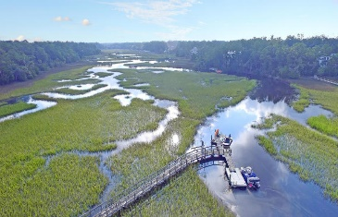

Only Mt Pleasant home with a dock under $900k!
Price Reduced!
3339 Cottonfield Drive
Dunes West ~ Mount Pleasant ~ MLS# 16026417 ~ $899,000
A dock with boat lift on Toomer Creek gets you access to the Wando River in just minutes! Huge back yard and 6 bedrooms. Fishing, crabbing, boating, or paddle board from your back yard. Enjoy the gated community of Dunes West and the excellent golf course community. A full front porch and back deck offer additional spaces to comfortably enjoy the outdoors. The inside of this home is gorgeous, sun-drenched, great for entertaining and cozy with its hardwood floors, many windows, a two story foyer, a giant FROG (6th bedroom) & the first floor owner’s retreat. The amenities found at this gated, golf course community are top of the line & make you feel like you live at a resort. At this price, with the water, dock, and very well-maintained home, this home should be at the top of your list!
Additional features include:
Kitchen features a center island, granite counters, SS appliances, breakfast bar, eat-in area and wine fridge
Dining room has french doors with transom windows and chair rail molding
Plantation shutters
Crown molding
Master bedroom has two walk-in closets and an en-suite full bath with dual vanity, jacuzzi tub and walk-in shower
Book your showing today!
Book your showing today!
Matt O’Neill matt@mattoneillteam.com 843-532-4220

