Slide 1

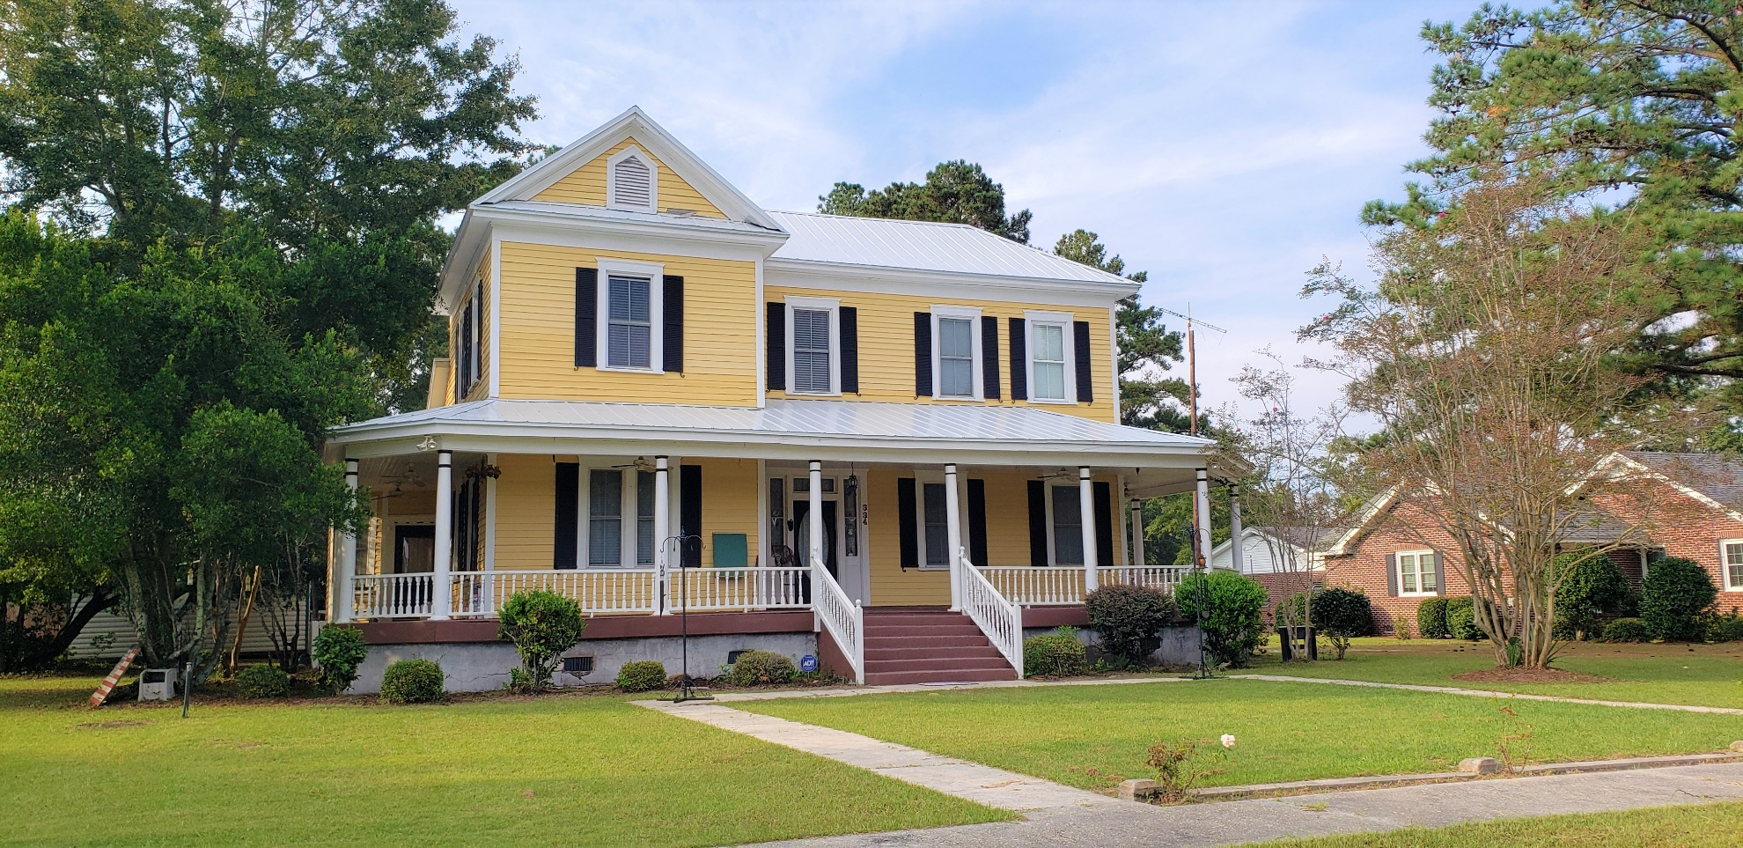
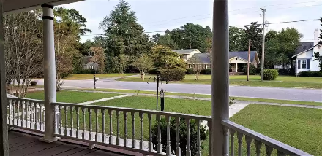
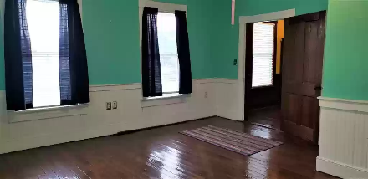
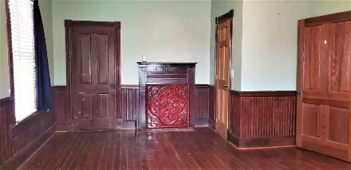
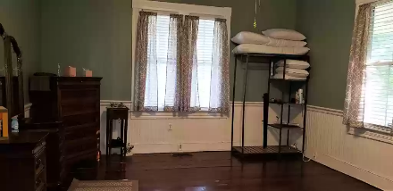
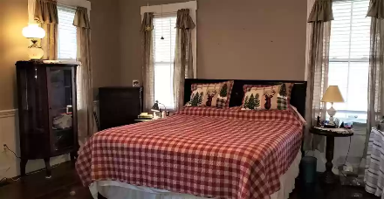
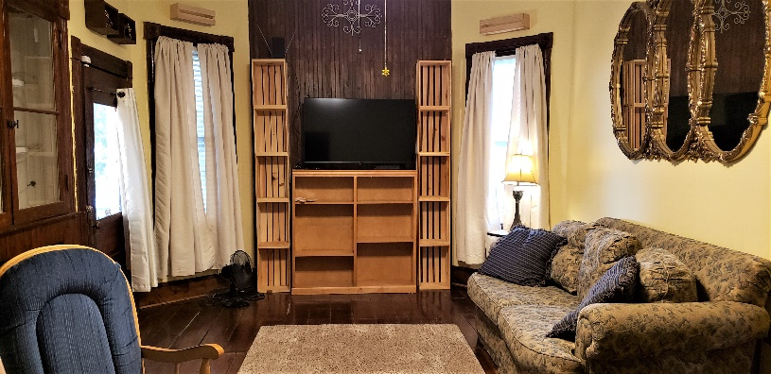
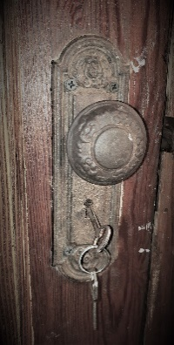
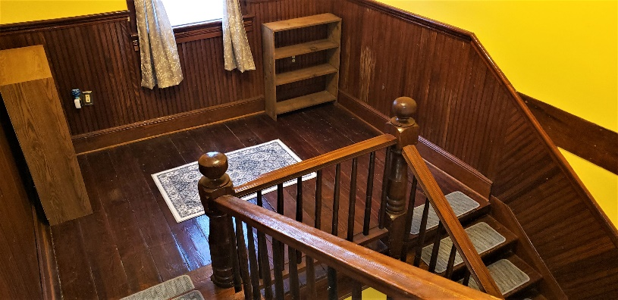
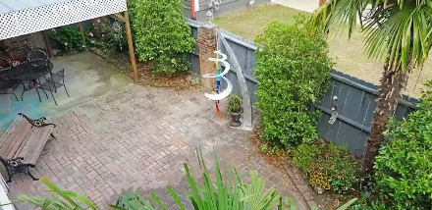

Own a Piece of History
334 Barkley St
Elloree, SC 29047 ~ MLS# 149139 ~ $250,000
This 1875 southern belle boast original plank hardwood floors, wainscotting, front door with working skeleton key and hand-hewn stair case. The updates include new roof in 2021, tankless water heater, dishwasher, and all new duck work. The home has 3 large attics for storage, Large 2nd, 3rd and 4th bedrooms, Master bedroom with jetted tub and walk in closet, den, full kitchen with large pantry, dinning room big enough for the farm table and mud room to catch the treasures you bring in, large screened in back porch, 2 sheds, garden area ( 30-50 area)and the best wrap around porch. Sitting 1 hour from Charleston and Columbia this little gem of a house could be your retreat from the hustle of the the urban area. Make this home yours today!
Lake Homes Realty, LLC
Elloree, SC 29047
www.SCLakeLife.com
Kristie Anderson
(803) 387-9459
kristie@sclakelife.com

