Slide 1

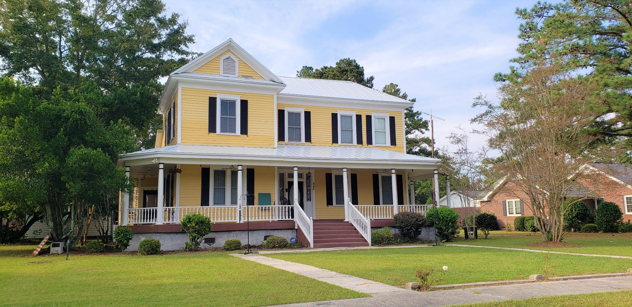
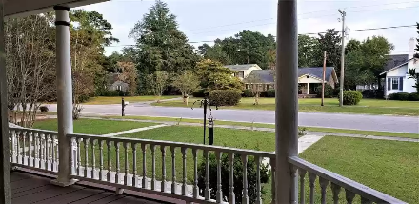
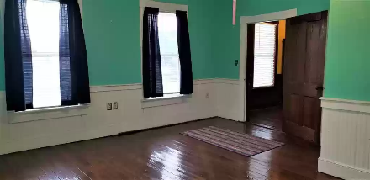
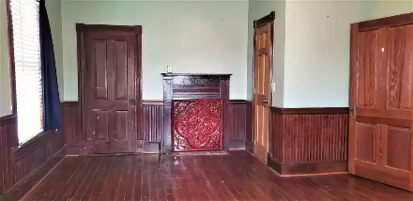
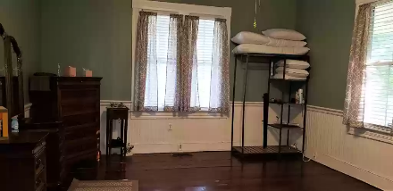
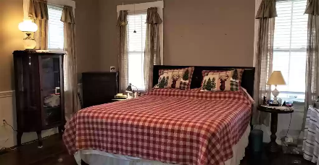
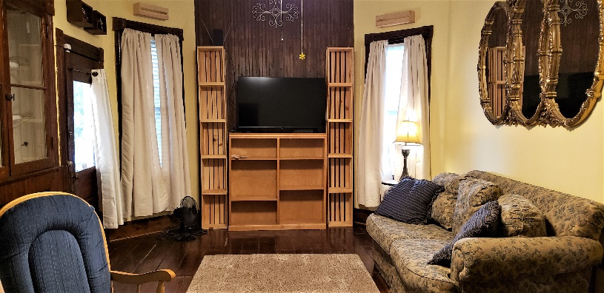
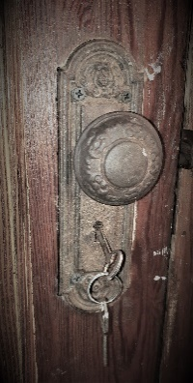
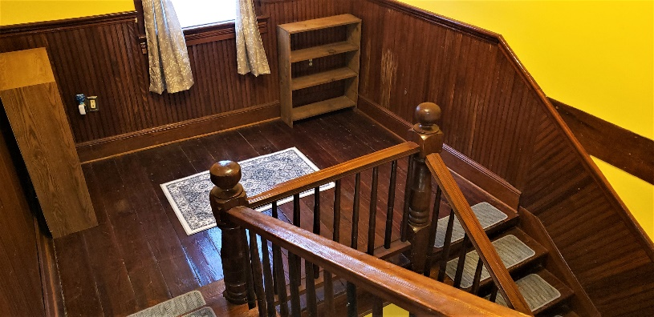
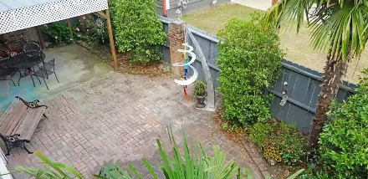

Own a Piece of History
334 Barkley St
Elloree, SC 29047 ~ MLS# 149139 ~ $275,000
Step back in time and Immerse yourself in Southern Charm in this century old home in town Elloree. Enter from the wrap around porch though into the foyer leading your way to the Master, Guest room, Den, Kitchen and Dinning rooms. The 2 story home offers a master suite on the main floor along with a guest room. Don't miss the many original custom built features of this home such as door knobs, custom trim, mantles, plank hardwood floors, front door with skeleton key, and much more. Roof was replaced in 2021. Sitting inside the Elloree Town limits it is only 1 hour to Charleston or Columbia. Elloree offers small boutique stores and antique stores. Come sit a while and enjoy the porch with a sweet tea.
Lake Homes Realty, LLC
Elloree, SC 29047
www.SCLakeLife.com
Kristie Anderson
(803) 387-9459
kristie@sclakelife.com

