Slide 1
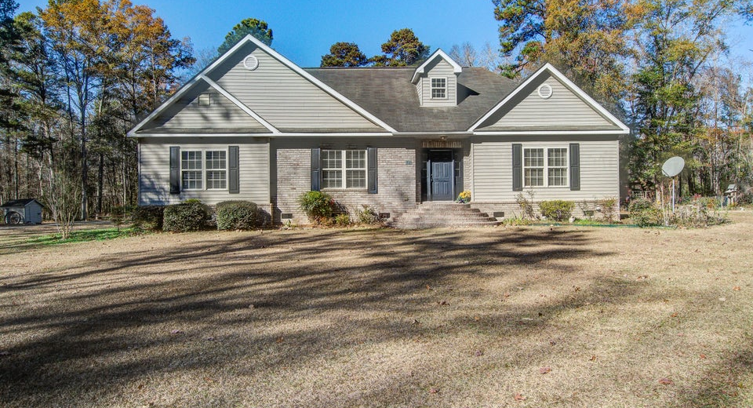
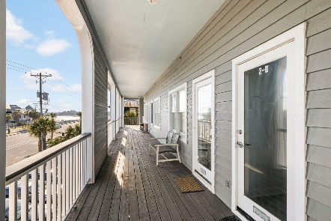
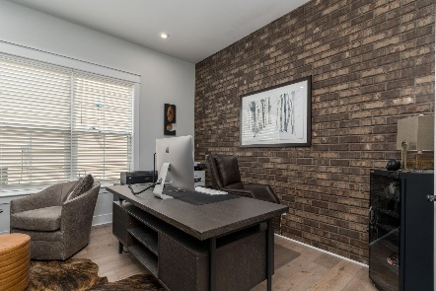
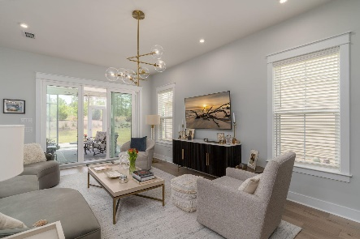

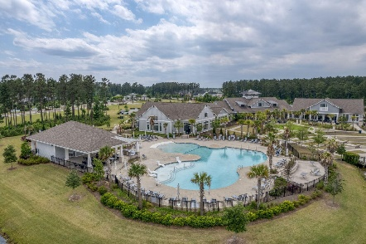
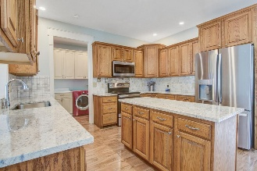
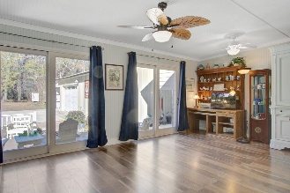
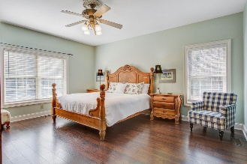
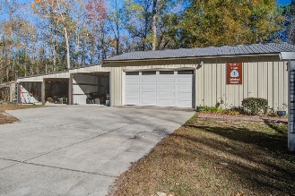
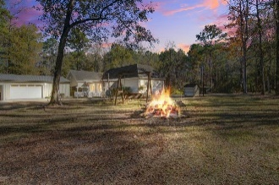
334 Shoptaw Road Holly Hill, SC 29059 | MLS# 25032145 | $785,800
Darrell Creek Elevated Home With Elevator & Salt Pool
Country Estate
Co-sponsored by
Welcome to your sprawling country estate, a beautifully renovated four-bedroom, two-and-a-half-bathroom ranch house situated on 14 pristine acres in the serene setting of Holly Hill. This property offers the perfect blend of classic charm and modern amenities, ideal for those seeking privacy and space. The heart of the home is the truly spacious remodeled kitchen, designed for both casual family life and entertaining. It boasts elegant granite countertops, custom wood 42'' cabinets offering abundant storage, and a full suite of new stainless-steel appliances. The oversize primary suite provides a peaceful sanctuary. The luxurious master bath is a highlight, featuring custom tiling throughout, a separate tiled shower and tub, and practical dual sinks. New tile flooring featured in the kitchen, bathrooms and utility space. Additional interior features include a utility room, spacious heated and cooled sunroom, newly refinished hardwood floors, new laminate flooring, smooth 9' ceilings throughout the main floor. The upstairs room could be the fourth bedroom, den or office and has a 1/2 bath. On either side of the upstairs room there is ample storage space that might be opened up and finished to add more space.
Outside, you'll find the tranquility of the acreage easily accessible from the large wooden deck, perfect for morning coffee or evening gatherings under the stars. There are fish in the creek that runs through the property, ample wildlife, a pond and space to hunt. Practical needs are fully covered with a detached 24x68 garage providing ample space for vehicles and hobbies or running a business from home. There is an additional tool room, a 12x24 covered bay, and a separate18x20 metal shed. This is a rare opportunity to own a move-in ready home offering exceptional space and modern comfort on a substantial piece of land. Bring you business, your toys, your family and friends!
Offering $3000
Lender Credit
Rochelle Rennert
843-847-9694 | rochellesellscharleston@gmail.com | www.theunlockingdreamsteam.com
AgentOwned Premiere Group, Inc. | 219 N Highway 52 Ste A | Moncks Corner, SC 29461-3926

