Slide 1
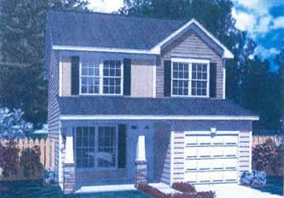
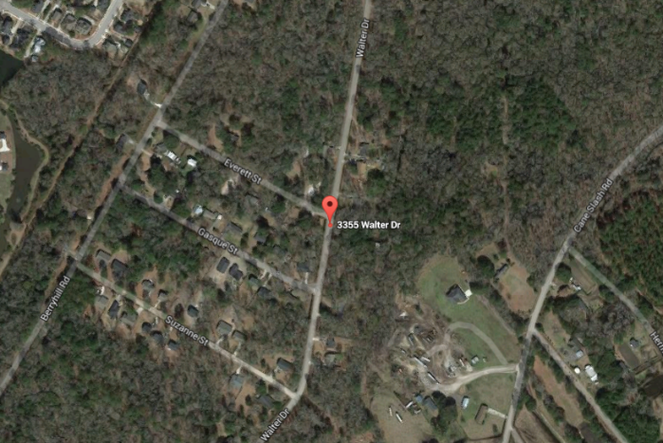


NEW CONSTRUCTION * NO HOA * READY IN 30 DAYS!
3355 Walter Drive
Cedar Springs * Johns Island, SC 29455 * MLS# 16006322 * $282,000
Own this NEW home with no neighborhood Rules & Fees*Your family will love this 2 Story BRAND NEW home on a LARGE BEAUTIFUL LOT (almost .4 ac)*NO HOA FEES or COVENANTS & RESTRICTIONS! Plenty of Room for a BOAT & outdoor hobbies AND in an ADVANCED STUDIES MAGNET MIDDLE SCHOOL ZONE*WOOD FLOORS throughout downstairs*OPEN CONCEPT FAMILY ROOM & KITCHEN w/granite, stainless steel appliance pkg, soft close drawers & separate Pantry*Upgraded oak treads on stairs*Must see to appreciate the spaciousness of ALL the Bedrooms*MASTER Bedroom HAS VAULTED CEILING*Master bath has separate tub & shower*Smooth ceilings throughout*2 CAR attached finished garage*Upgraded ''shaker shingle'' accent on exterior*Builder is including a privacy fence down the side lot lines as a bonus with acceptable offer.
Sheila Romanosky
(843) 224-0242
sromanosky@carolinaone.com

