Slide 1
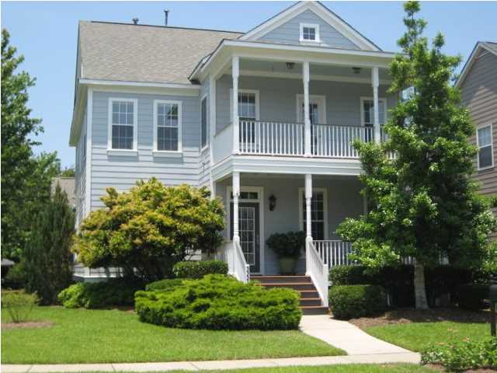
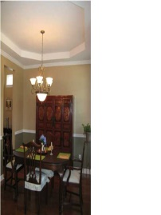
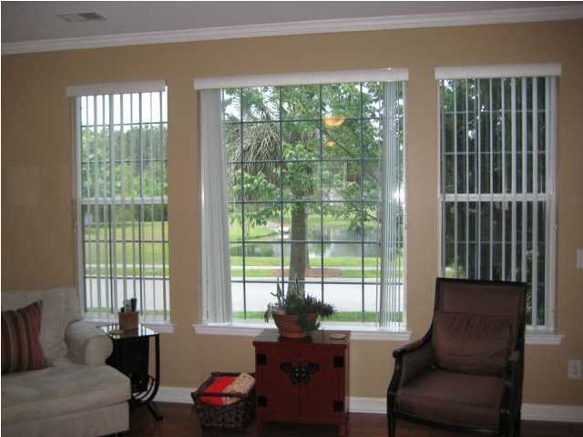
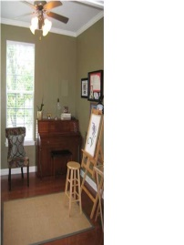
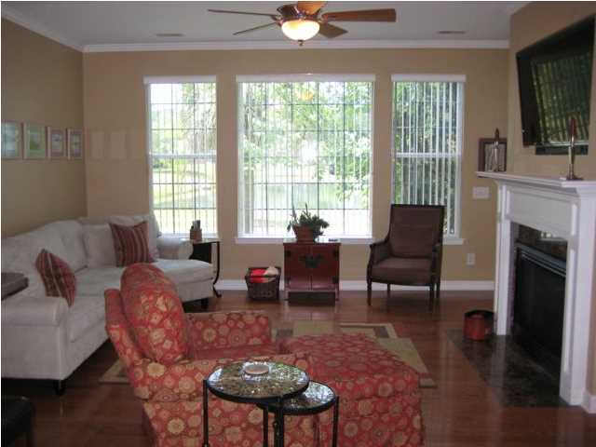
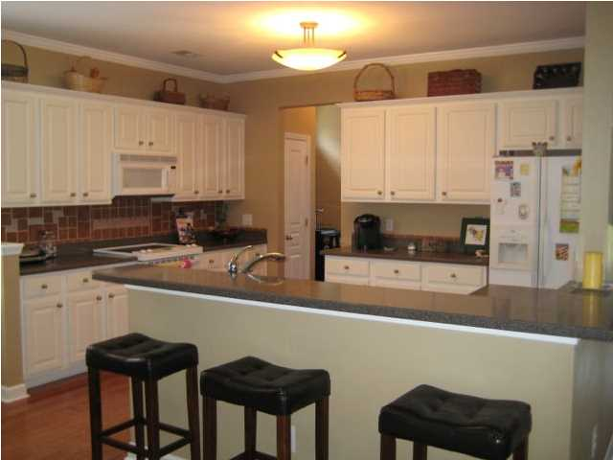
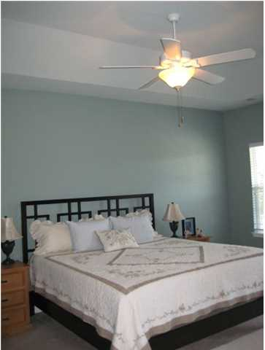
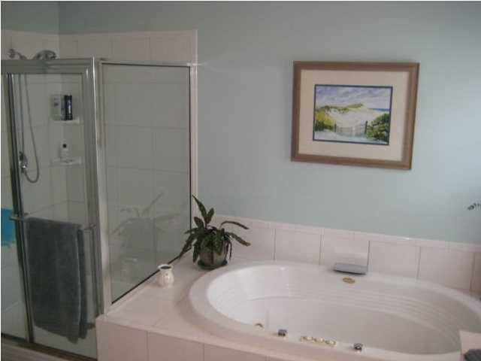
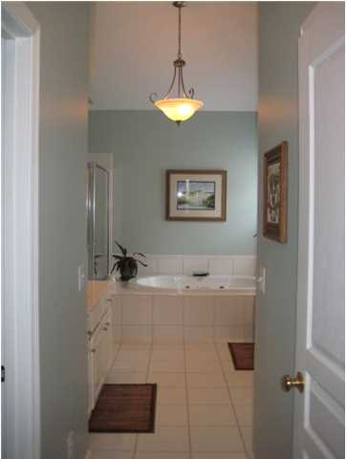
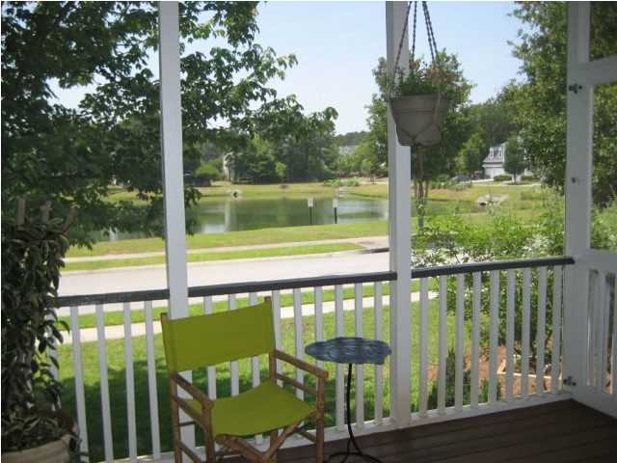
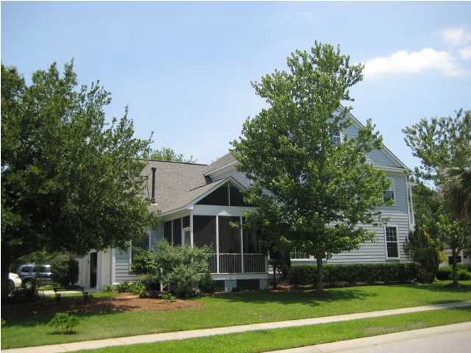
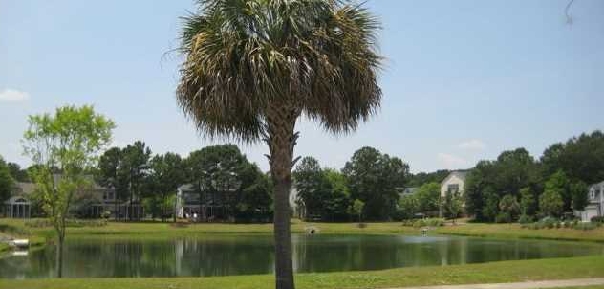

3357 Collier St
Hamlin Plantation
Mt Pleasant
MLS# 1416867
$460,000
4 Bedrooms | 2½ Baths
2,760 sf
Great home on large corner lot in Hamlin Plantation overlooking pond. This home is very well maintained inside and out. Exterior was painted June 2013. Downstairs includes hardwood flooring, formal dining room with tray ceiling, office and open kitchen and living area. Living area has natural gas fireplace and access to screen porch. Kitchen has tile backsplash and it is possible to convert to a gas range. Master bedroom has tray ceiling, a private porch and large walk in closets and 2 vanities and jacuzzi tub in master bath. The laundry room is located upstairs along with 2 more bedrooms and large room over the garage that could be used as a guest bedroom, 2nd living space, play room and much more. Sit on the screen porch or front decks and see views of the peaceful pond. This home has lawn irrigation, double car attached garage and is alley fed for out of way parking. Enjoy the neighborhood amenities of Hamlin Plantation including club house, pool, tennis and walking paths. Located only 10 minutes to Isle of Palms this home is in a great location!!
Well Maintained Home on corner lot!
Kendra Boozer
843.834.5089
kendrafboozer@gmail.com

