Slide 1
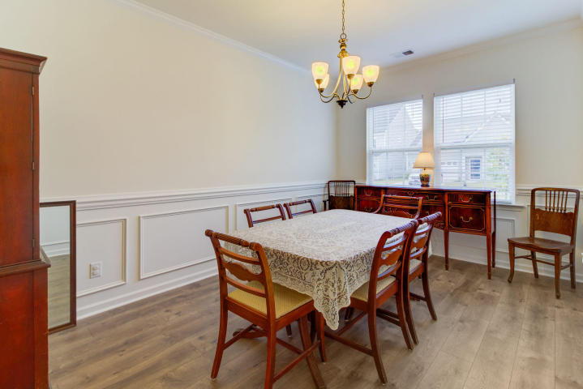
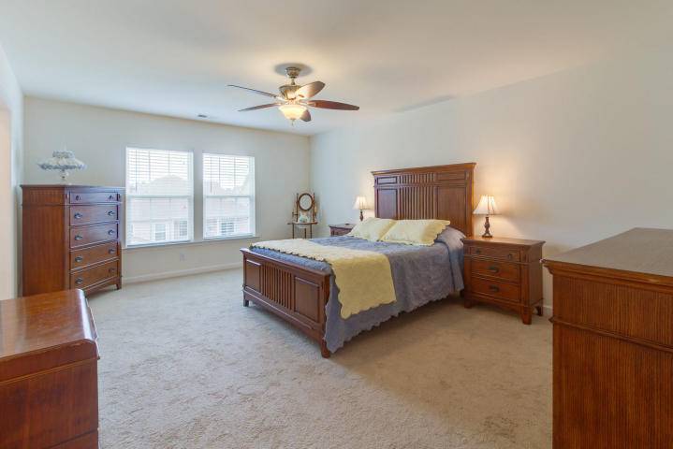
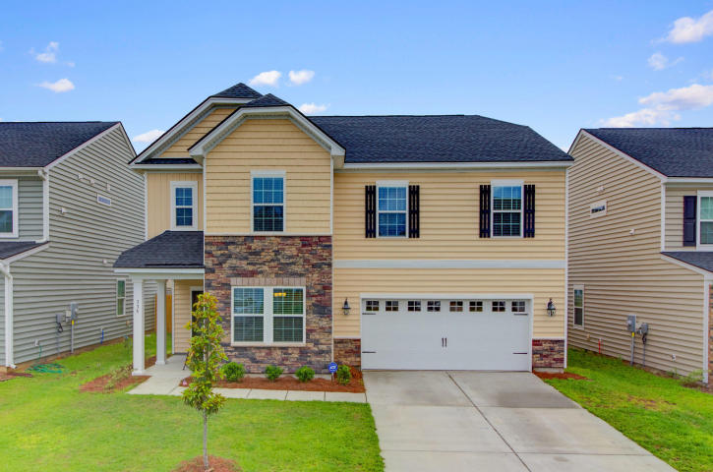
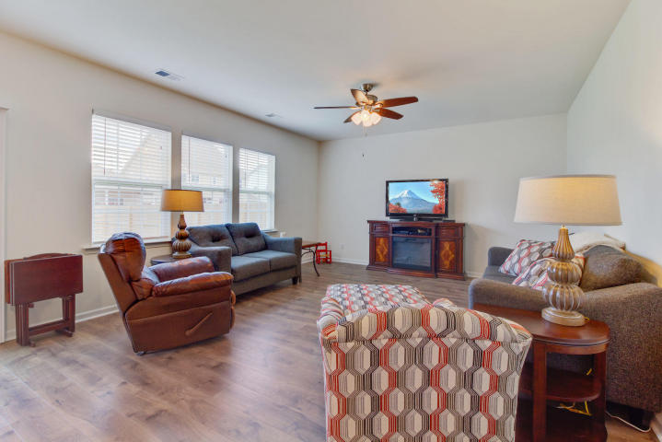
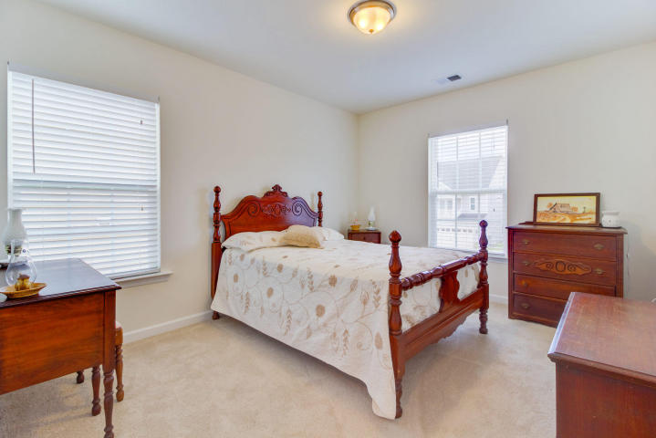
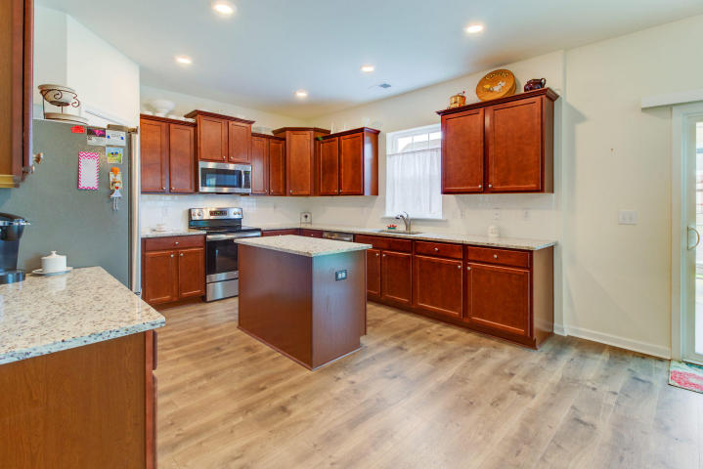
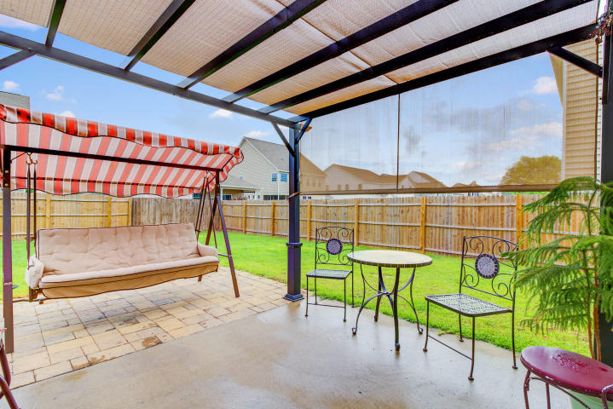
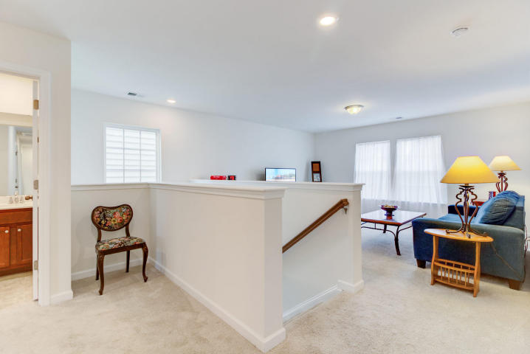
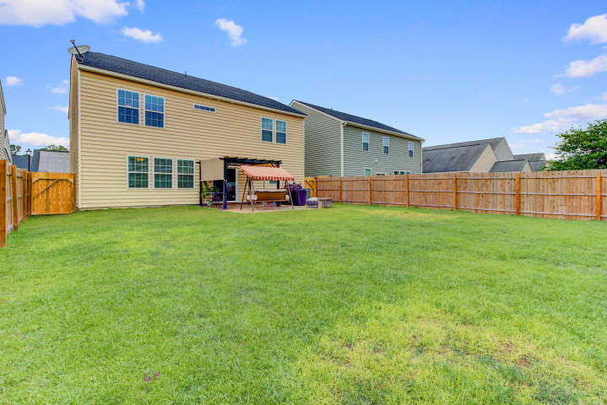


BETTER THAN NEW!! Priced below the new homes and has numerous upgrades
335 Bradley Bend Dr
Moss Grove Plantation
Moncks Corner, SC 29461
MLS# 18014288 ~ $249,900
This beautifully appointed and upgraded 4 bedroom Hanover has been lovingly enhanced making it the SMART CHOICE for buyers! The home was built with several desirable finishes including gorgeous granite counters and subway tile backsplash in the kitchen, which is complete with an island. Beautiful stainless steel GE appliances grace this large kitchen with an abundance of cabinets and counter space for meal preparation. The lovely wainscoting and trim package in the formal dining room adds a sense of elegance for holidays and special gatherings with family and friends. Throughout the main level you will love the attractive wood laminate floors that are on point with today's style. Additional upgrades you will find upstairs include tile floors in the laundry room and bathrooms. Each full bathroom has double sinks and tall vanities and in the master you will love the 5 foot shower with bench. Since the construction of this well upgraded home, there have been NUMEROUS ENHANCEMENTS that make this house EXTRA SPECIAL! The large back yard has been fully enclosed with a beautiful wooden privacy fence. The patio has been enlarged with pavers making it a lovely outdoor living area complete with a brick bench and pretty pergola. This is a thoughtfully planned yard to ensure full enjoyment of your outdoor living space! Blinds have been installed throughout the home (with the exception of the bonus room which has lovely sheer curtains allowing abundant natural light to flood the room). Hunter ceiling fans have been installed in the family room and master bedroom as well as shelving installed in the front guest room closet. In the two car garage a work bench and extensive shelving have been installed for your convenience and smart storage solutions. All of these enhancements have been completed and will save the new owner a lot of money from the start! This home has a transferrable termite bond and in-wall system available for pest control. Moss Grove Plantation offers its residents a lovely neighborhood pool with a zero entry feature perfect for little swimmers. A picnic area overlooking a large lake and play area for the children are also a great benefit. Additionally, storage for boats, trailers and RV's is available in the community. 335 Bradley Bend, in popular Moss Grove Plantation is truly move in ready and the SMART CHOICE for buyers who want to simply unpack and start enjoying all that this lovely community, nearby beaches, and Historic City of Charleston have to offer!
3D Walk thru tour on MLS or go to
https://my.matterport.com/show/?m=CR7eHizEyEK
Ellen O'Neil
Broker/Owner, ABR, e-PRO, CNE
Charleston Realtor of Distinction
(843) 300-8530
www.EllenONeilProperties.com

