Slide 1
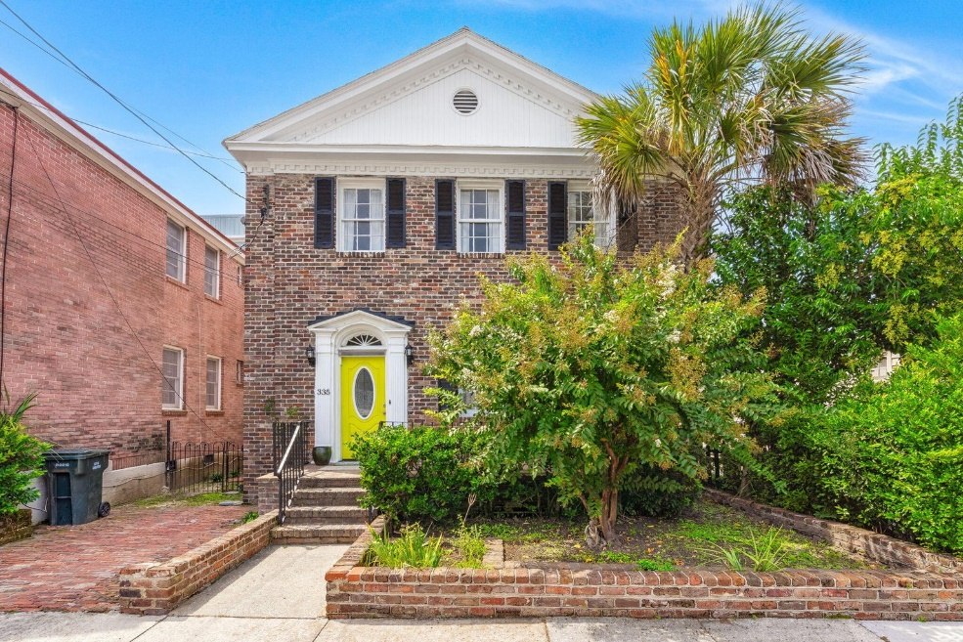
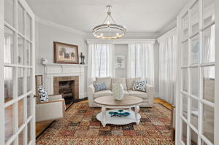
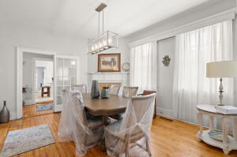
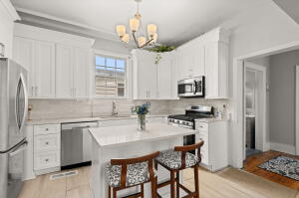
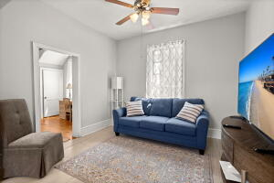
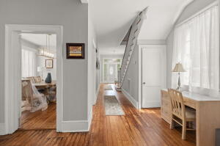
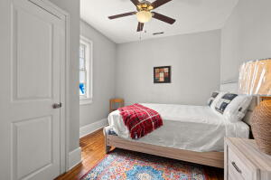
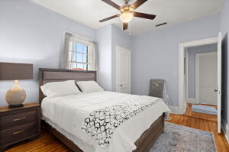
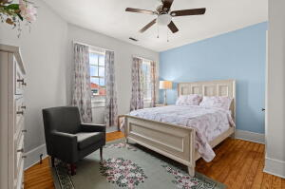
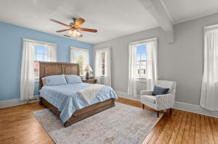
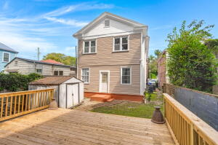



GORGEOUS DOWNTOWN CHARLESTON FUNRISHED RENTAL
335 Ashley Avenue
Westside
Charleston, SC 29403
MLS# 23022175
$8,000
4 Bed | 2½ Bath | 2,688 sf
Step into the epitome of Charleston living at the freshly renovated 335 Ashley Ave. Nestled in the heart of downtown Charleston, this exceptional property positions you at the crossroads of the city's vibrant culture and charm. This exquisite residence marries contemporary elegance with historic charm. Fresh off a full-scale renovation, every corner of this home radiates a sense of novelty and refinement. Forget about long commutes or searching for parking—Charleston's most beloved restaurants, bars, and recreational activities are within a leisurely stroll from your doorstep. Whether you're meeting friends for dinner, heading out for a night on the town, or needing access to nearby hospitals, convenience is a given.
This residence comes furnished with 4 expansive bedrooms, each adorned with brand new, sophisticated furniture from Haverty's. If your needs extend beyond, there's potential to convert spaces into a 5th or even 6th bedroom, ensuring ample room for guests, a home office, or whatever suits your lifestyle. One of the property's standout features is its enormous custom-built closet. Ideal for those with an extensive wardrobe or those who simply value expansive, organized storage, it's a space that effortlessly combines utility with luxury. The crowning glory of the renovation is the state-of-the-art 2023 kitchen and primary bathroom. Both designed with both aesthetics and functionality in mind, the kitchen offers the latest in culinary innovation. And the best part? The kitchen is brand new and has never been used, waiting for its first meal to be prepared. Don't forget! Enjoy time outside on the enormous deck in the generously sized backyard which has plenty of room for any outdoor activity or just relaxing. So, whether you're setting down roots or seeking the perfect temporary abode, 335 Ashley Ave is more than a residenceit's an experience. Dive deep into the heart of Charleston, wrapped in modern luxury, and schedule your tour today.
Nick Mazzilli
(843) 640-5575
nick@nickmcharleston.com
nickmavencharleston.com
Maven Realty
2180 McMillan Ave
#71672
Charleston, SC 29405

