Slide 1
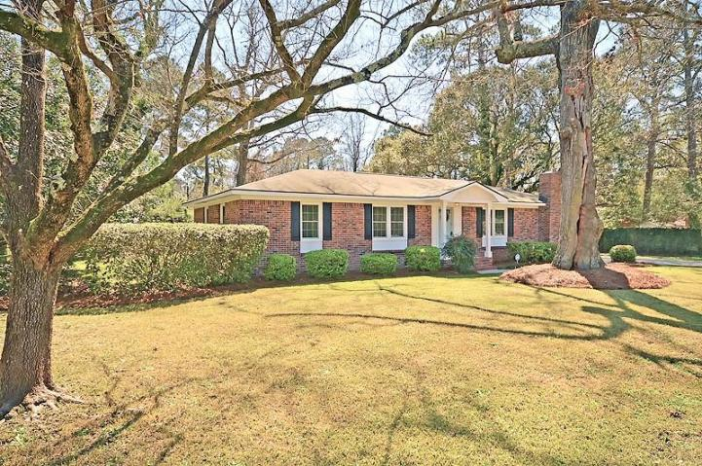
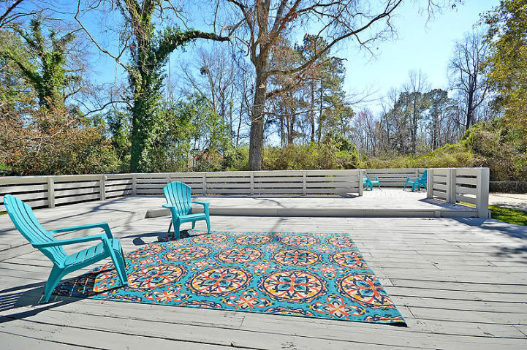
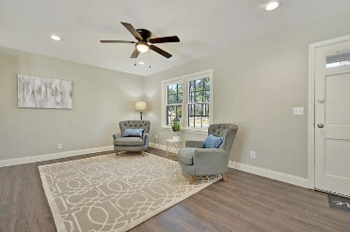
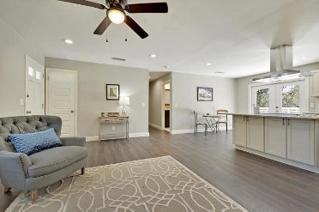
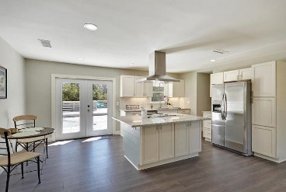
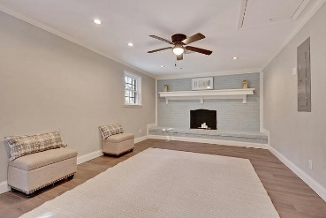
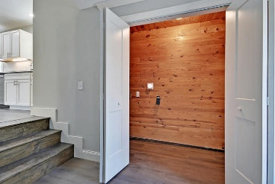
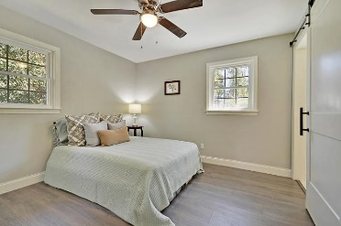
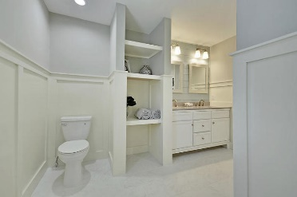
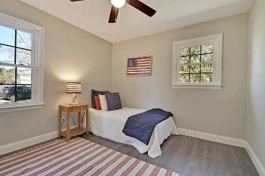
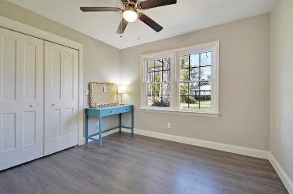
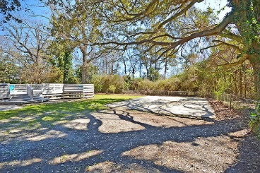



Back on the Market!
Don't miss this one a 2nd time!
A $2100 Lender Credit is available and will be applied towards the buyer's closing costs and pre-paids if the buyer chooses to use the seller's preferred lender. This credit is in addition to any negotiated seller concessions.
3361 Brenda Drive
Stafford Heights | Johns Island, SC 29455 | MLS# 20005616 | $300,000
Beautifully renovated and centrally located just off of Maybank Hwy, this charming all-brick home exceeds any builder upgrade list and everything is already included! You will love the open floor plan with high-end finishes including new stainless appliances, granite countertops, upgraded cabinets, large kitchen island, shiplap accent details, tiled showers & bathroom floors. Situated on a quiet dead-end street on a spacious .39 acre with a wooded view. No HOA. "X" flood zone (flood insurance is optional). Extensive outdoor entertaining space including a huge deck (1300sq ft+) and a 30'x40' concrete pad. NEW stainless steel refrigerator is INCLUDED! Only 15 minutes to downtown, a short drive to the beach and so many great restaurant options just around the corner. Don't miss this one!
A $1450 Lender Credit is available and will be applied towards the buyer's closing costs and pre-paids if the buyer chooses to use the seller's preferred lender. This credit is in addition to any negotiated seller concessions.
Whitley Boyd
(843) 324-4761
WBoyd@CarolinaOne.com
www.PropertiesofCHS.com
Carolina One Real Estate | 628 Long Point Rd. | Mt Pleasant, SC 29464-3032

