Slide 1
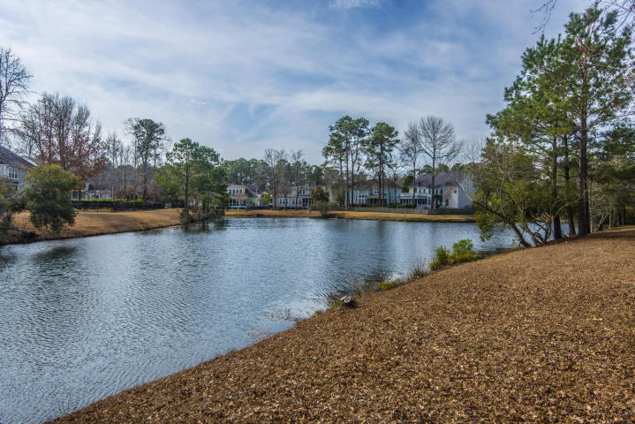
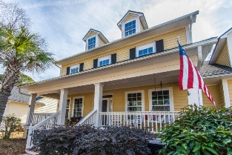
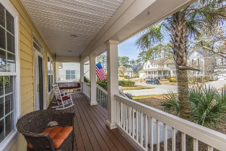
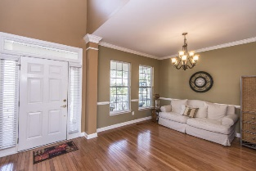
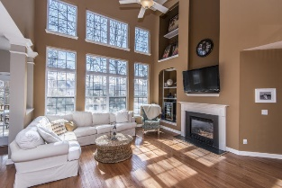
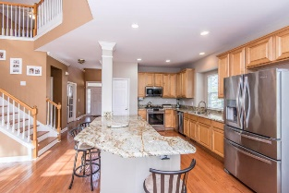
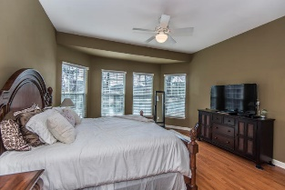
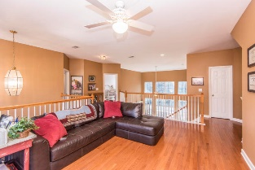
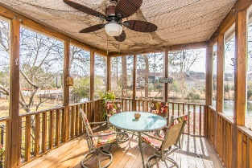
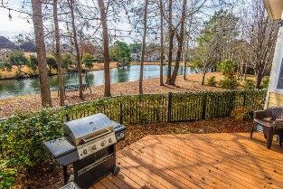
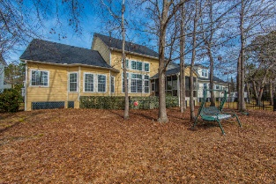


3361 Toomer Kiln Circle
Mount Pleasant, SC 29466
MLS# 18003568
Park West ~ Priced to Sell at $500,000!
Lots of Upgrades & Amazing Water Views!
Beautiful 4 bedroom, 3.5 bath executive-style home located in fashionable Coatbridge, Park West. Set against the neighborhood lagoon with dramatic water views from the floor to ceiling windows in the main living area and from the first floor master suite, this home features an updated kitchen with custom cabinetry, granite countertops, and new stainless appliances- including a gas stove. A spacious home office is located on the first floor across from the formal dining room, and there is a large open loft on the second floor with additional office space and built in desk. There are hardwood floors throughout the home and carpeted secondary bedrooms; other tasteful details include newer ceiling fans, UV tinted windows, and Venetian blinds. The home features a fully illuminated and screened back porch with extended exterior deck; and a new HVAC unit and new roof were added in 2017. $1,800 credit available toward buyer's closing costs and pre-paids with acceptable offer and use of preferred lender.
Kristin Schatmeyer
Cell - (843) 697-7370
kristin.schatmeyer@carolinaone.com
www.KristinSchatmeyer.com
Carolina One Real Estate
2713 Highway 17 North
Mt. Pleasant, SC 29466

