Slide 1
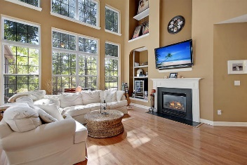
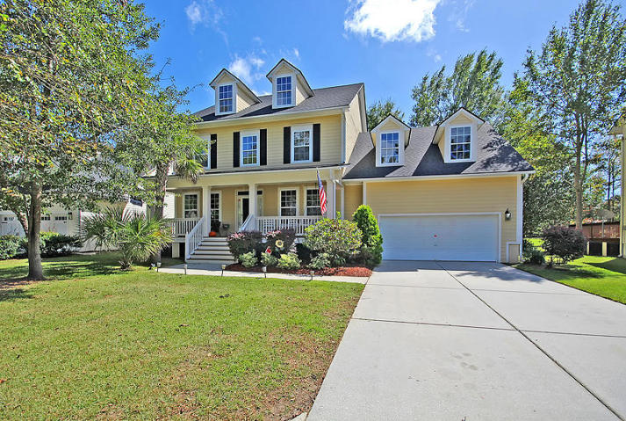
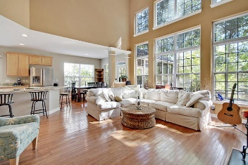
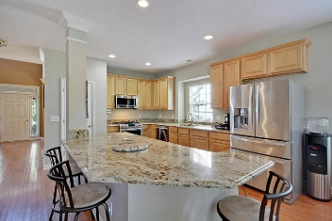
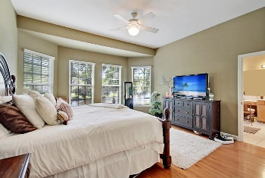
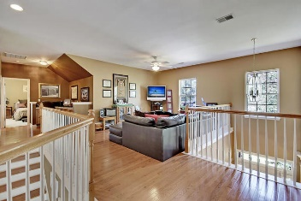
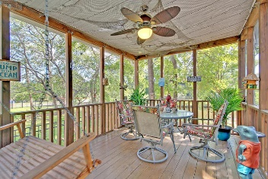
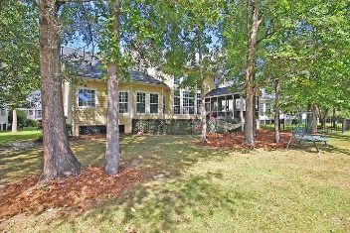
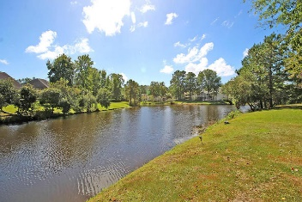

3361 Toomer Kiln Circle
Mount Pleasant, SC 29466 · MLS# 17027125 · $519,500
Just Listed in Park West
New Lower Price!
Beautiful 4 bedroom 3.5 bath executive home in Coatbridge section of Park West. This home sits on an amazing pond lot that is gorgeous. Walking up to the front door you are greeted with a full front porch large enough for multiple rocking chairs or bistro table with chairs. Once inside hardwood floors with an office/living room on the right and a dining room/flex-room on the left. Continuing into the home there is a huge 2 story family room with a wall of windows, built-ins, and fireplace that is open to the UPDATED GOURMET eat-in kitchen with custom cabinets, stainless steel appliances with gas stove, and granite counter tops. The master bedroom suite is on the main floor and has an abundance of natural light, over-sized walk-in closet, and a spa-like master bath with dual sinks, soaking tub, tile floors, and separate shower. The first floor also has a guest bath, laundry room, and mud-room area off the 2 car garage. The second floor boasts 3 large bedrooms and a loft area. Two of the bedrooms share a Jack-n-Jill bath and the loft and third bedroom share a full bath. Finally, the screen porch and patio grilling area overlooks a gorgeous backyard with pond and are perfect for relaxing with a cold beverage or entertaining family and friends. Park West amenities include 2 Pools, Play Park, Several Tennis Courts, Club House, Miles of Walking Trails, and Outstanding Schools and Recreation Fields. Park West is only 7 minutes to the High School, and 5 minutes to either a Harris Teeter, Publix, or Walmart, and is a short drive to downtown Charleston with 5-star restaurants, world class shopping and iconic history as well as a short drive to the beaches, the airport, Boeing and Daniel Island. Come take a look because you will not find another home that offers as much as this one! New Roof 2017!
Stan Huff
843-670-2835
stan.huff@agentowned.com
Jill Marcacci
843-297-5590
jill@agentowned.com
www.agentownedrealty.com
AgentOwned Realty Co. Preferred Group, Inc. | 824 Johnnie Dodds Blvd | Mt Pleasant, SC 29464

