Slide 1
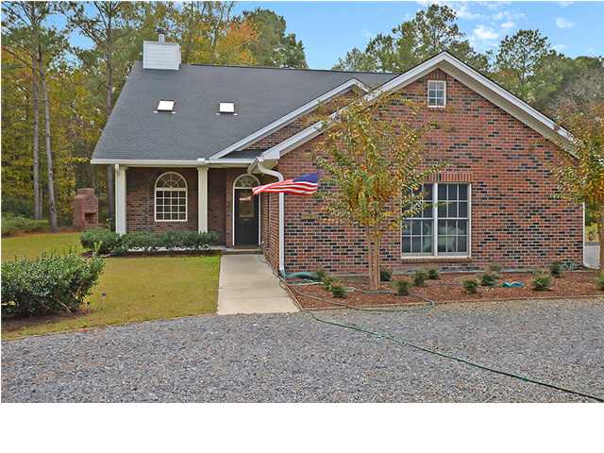
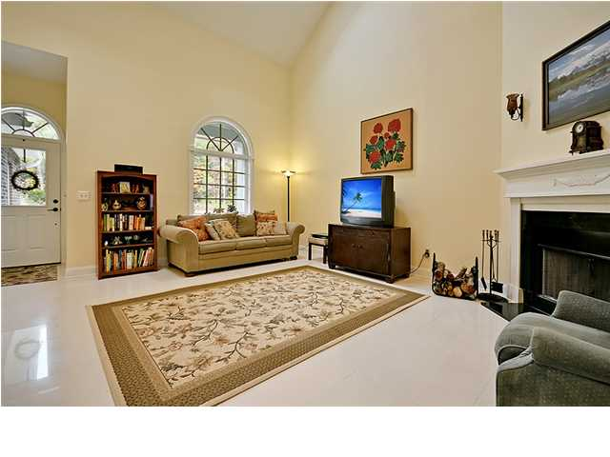
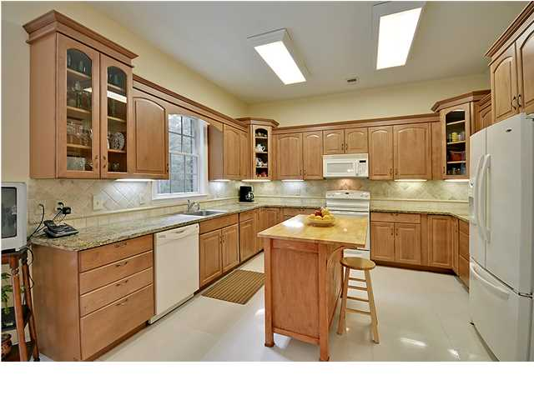
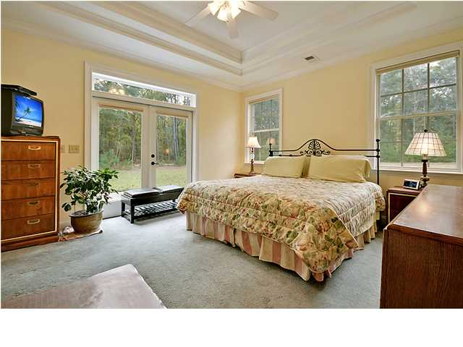
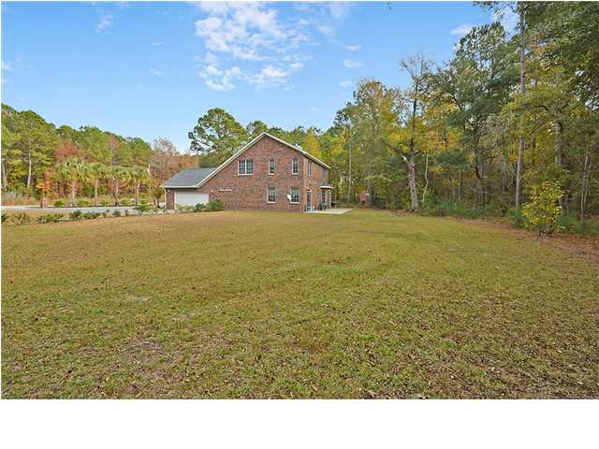


PRICE REDUCED - OPPORTUNITY KNOCKS!!!
3363 Kit Freeman Ln
Hickory Hill
Johns Island
MLS# 1329532
$389,000
This Exclusive fully detached brick 2 story home is situated on a quiet tree-lined street and is surrounded by a large private 1.7 acre landscaped lot. This fantastic home is located less than 3 miles from the world renowned resort islands of Kiawah Island and Seabrook Island and the new shops of Freshfield Village. This Distinctive home is appointed with many valuable features that will not disappoint the most discriminating buyer. Upstairs there is a large, perfectly positioned, hall bathroom that services the 2 spacious bedrooms, a large game room/den, and ample storage areas. There are several large rooms with 10 ft. smooth ceilings and stylish porcelain tile flooring on the main floor including a magnificent and bright great room, with a cozy fireplace, the stunning master bedroom suite that offers tray ceilings, a huge private walk-in closet, a glamorous bathroom with ceramic flooring, jetted tub, separate shower and his and her vanities, a fascinating and colorful formal dining room, a modern kitchen that offers upgraded built-in appliances, beautifully crafted wood cabinets and selected granite countertops, a French door opens to an oversized patio perfect for outside enjoyment, grilling, and relaxing. This awesome home is priced to sale and will not last! Opportunity knocks! Age, sqft, taxes, HOA, acreage and schools are approx. buyer to verify.
Bill Everett, Jr
Broker
Office 843-767-7777
Direct 843-693-8539
Fax 843-576-5352
RE/MAX Pro Realty, 9209 University Blvd, Charleston, SC 29406

