Slide 1
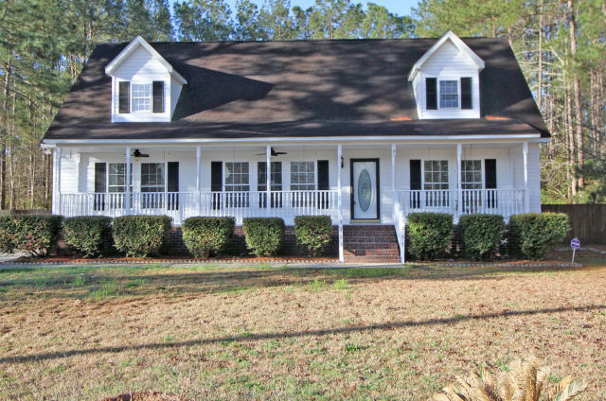
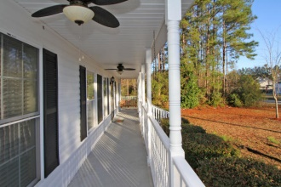
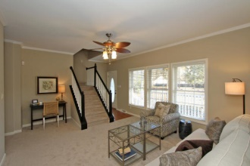
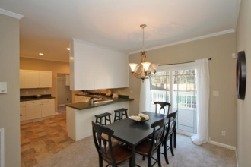
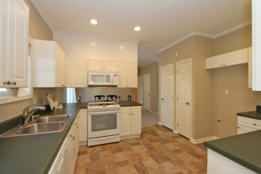
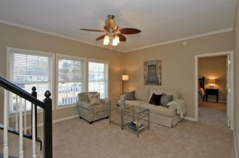
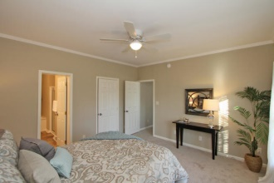
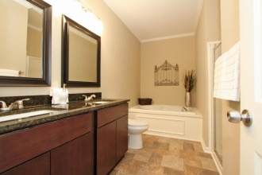
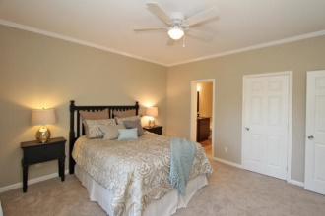
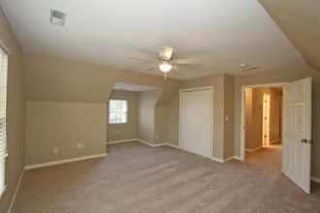
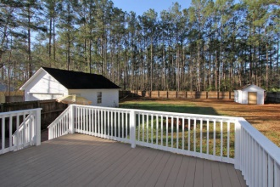

3363 Miller Drive Ridgewood :: Ladson :: MLS# 15007398 :: $225,000
Perfect home for a large family
Just Reduced!
Spacious 5 bedroom home just off Hwy 78 past the fairgrounds. Excellent location for Daimler, General Dynamics, Boeing, Trident Hospital, etc. Just renovated with new carpet in all bedrooms family areas. Kitchen and baths have vinyl tile flooring. The entire interior of the house has been freshly painted. The kitchen has a new stove and new dishwasher. The master bedroom is downstairs with its own bath with jetted tub and walk-in shower. There are two other bedrooms downstairs and two large bedrooms upstairs with office, and activity area. The house is situated on a large 1/2 acre fenced lot with a detached two car garage as well as a detached workshop. Large deck off the breakfast room at the back of the house. Easy to show!!!
Greg Hughes
843-884-1800 - O
843-708-4734 – C
ghughes@carolinaone.com
Carolina One Real Estate
Mt Pleasant Office 195 W Coleman Blvd Mt Pleasant, SC 29464

