Slide 1
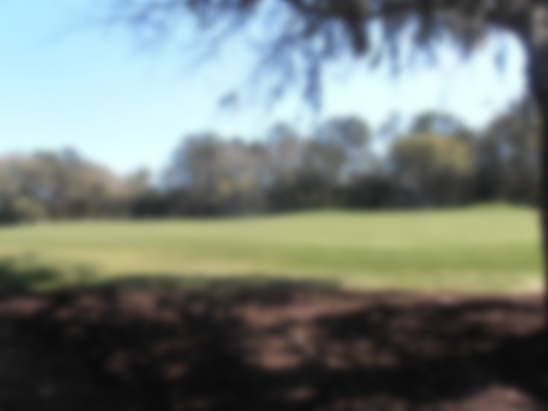
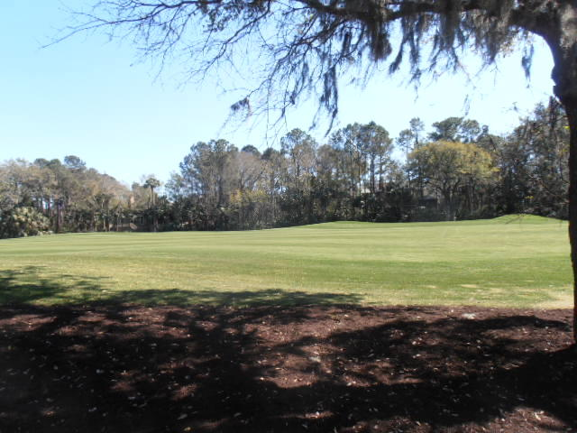
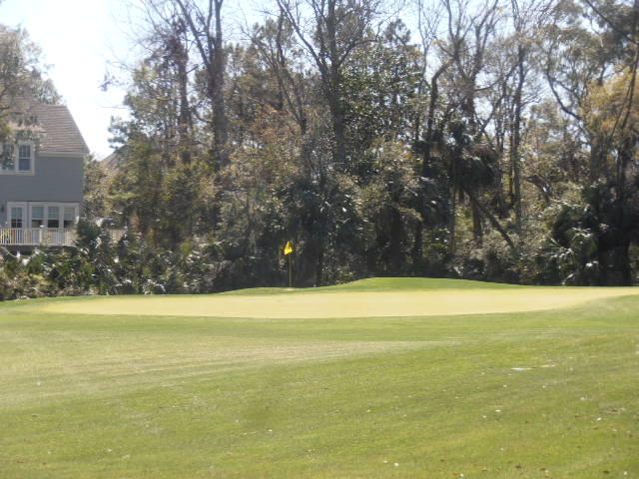
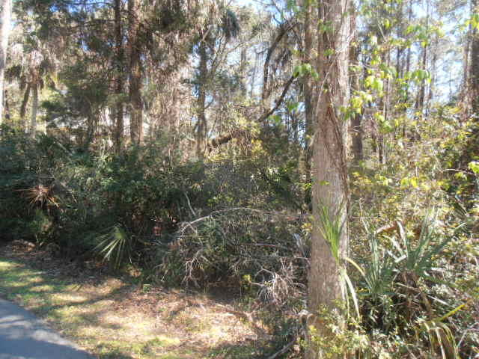
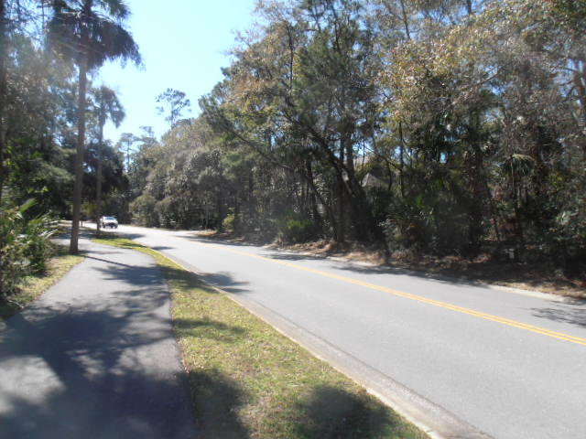
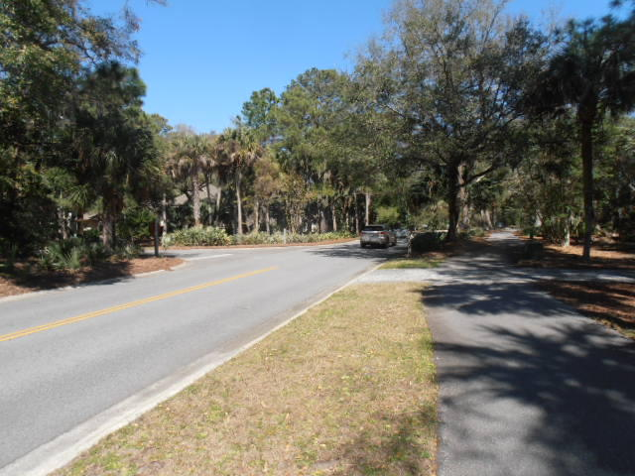
Vacant Land On The Golf Course!
336 Governors Drive
Kiawah Island | MLS# 17008111 | $282,500
Own a home site on the golf course behind the second gate on Kiawah Island!
This lot has great views of the 4th green on the golf course.
Charles Salmonsen
M (843) 224-0300 | O (843) 388-6613 | charles@salmonsen.com
Salmonsen Realty | 864 Lowcountry Blvd Ste B | Mt Pleasant, SC 29464

