Slide 1

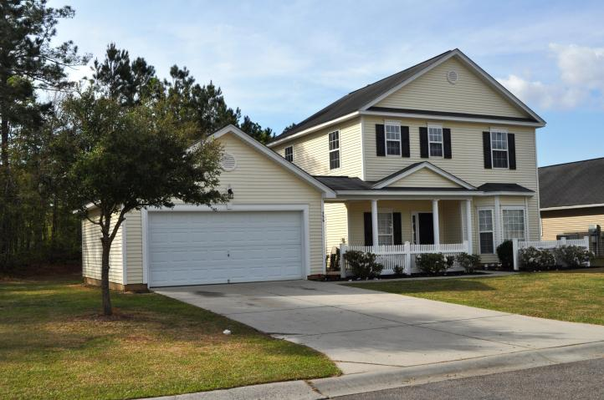
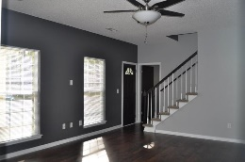
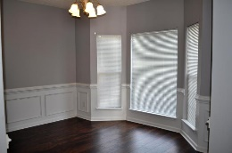
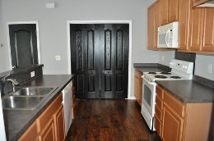
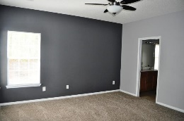
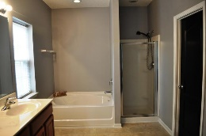
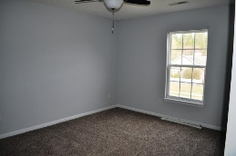
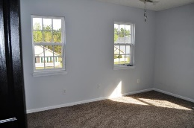
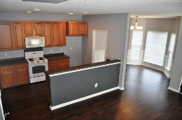
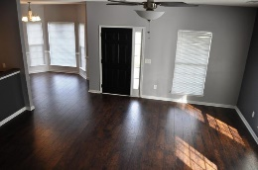
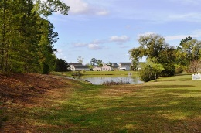


Move-in Ready
336 Savannah River Drive Lakes of Summerville • Summerville MLS# 17009276 • $214,900
Welcome to your new home! This spacious open floor plan home has been updated with all new laminate floors on the 1st floor common areas (with a 10 year warranty) all new carpeting, all freshly painted and cleaned. New ceiling fans, door hardware, new heat pump, and all new outdoor light fixtures. All with attention to detail! Home site sits next to a common area never to be built on and 2 ponds within view. The large master is located on the 1st floor w/awesome bath and walk-in closet. Upstairs has 3 more large bedrooms and large bath. The neighborhood is conveniently located near wonderful hospitals, great schools, shopping and close interstate access. It also has a wonderful neighborhood pool, boat/RV storage available and club house (available to rent). Move-in ready!!
Lisa Stine, REALTOR
(843) 364-5359 lisastine61@gmail.com
Elaine Brabham and Associates, LLC • 1890 Sam Rittenberg Boulevard, Suite 217 • Charleston, SC 29407

