Slide 1
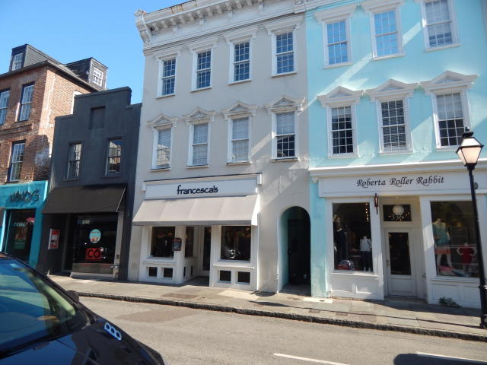
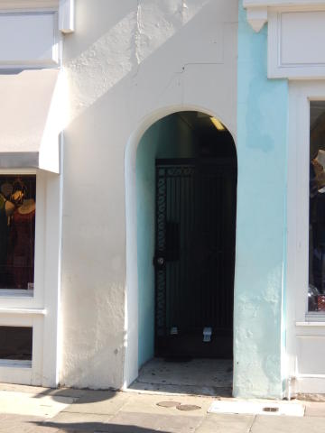
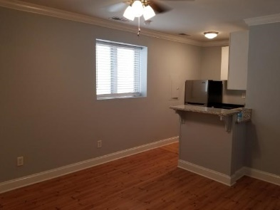
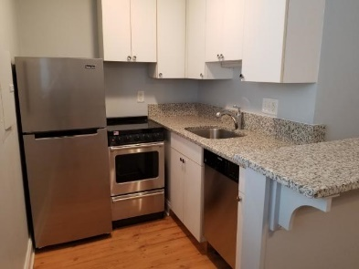
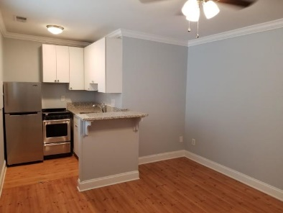
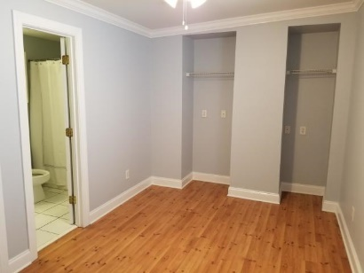
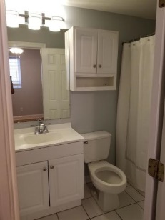
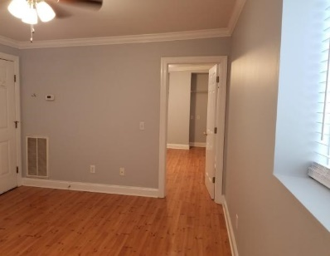
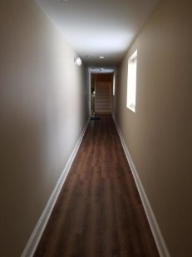
SELLER SAYS SELL NOW!! BEST PRICE IN TOWN!
338 King Street C
Downtown
Charleston, SC 29401
MLS# 19019851
$204,900
1 Bedroom | 1 Baths
Absolutely adorable little 1BR condo located in the heart of historic Charleston. Condo has been beautifully updated with gorgeous granite counters in the kitchen, brand new stainless appliances, new deep kitchen sink & faucet, new vanity, faucet & shower head in bath and a new toilet, new faux wood blinds, and a new ceiling fan in the bedroom. Floors are laminate wood and tile in bath. The interior has been freshly painted throughout in a soft grey that lends itself to loads of decorating options. This is the perfect little get-away place, super convenient walking distance to shops, restaurants, College of Charleston, parks and much more! There are laundry facilities onsite. The building next door is permitted to be boutique hotel.
Darlene Bollettino
Miler Properties
Office: 843-821-1111
Cell: 843-209-8955
dbollo84@yahoo.com www.milerproperties.com

