Slide 1
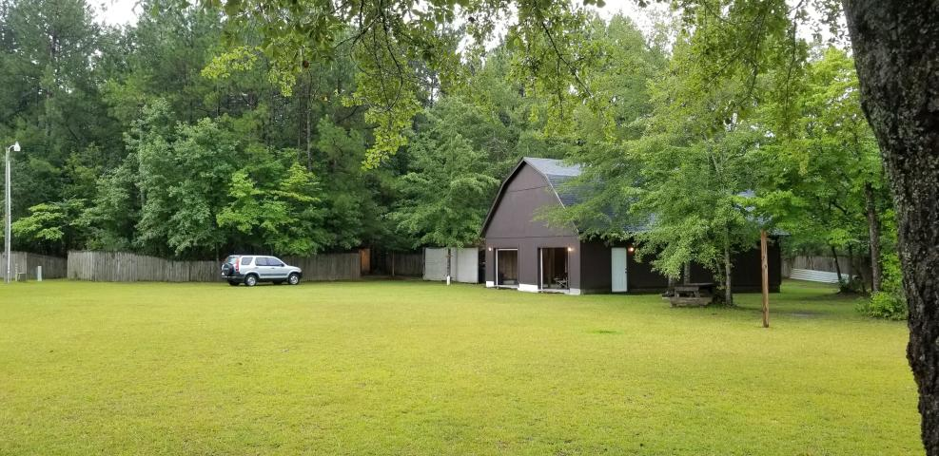
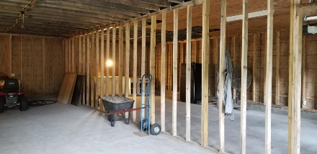
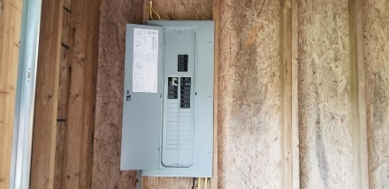
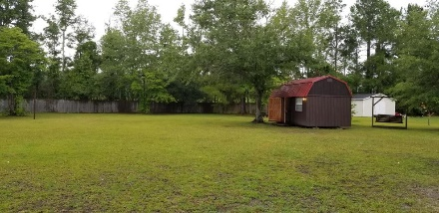
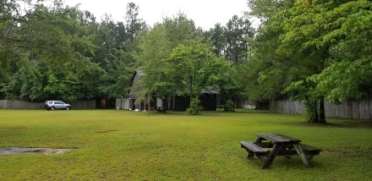


339 Red Briar Lane
Loyal Acres :: Cross, SC 29436
MLS# 18023379 :: $89,000
Ready For Your Dream Home!
3+ Acres!
Own 1.84 acres cleared land to build your new home!
Briar Bend is a quiet charming street and this property offers more than just the land. There is a 30x40 two story garage with a room above the garage and back deck. 2 large doors and one has an electric opener.
Second shed is 10x10 and has plumbing connected to well and spectic. Third shed is 12x12 with electric and there is a metal carport.
Great opportunity to add a home to existing features.
Connie White, Broker
843-532-3356
connie@chrepros.com · conniewhiterealestate.com
Charleston Homes · 597 Old Mt. Holly Road · Suite 301 · Goose Creek, SC 29445

