Slide 1
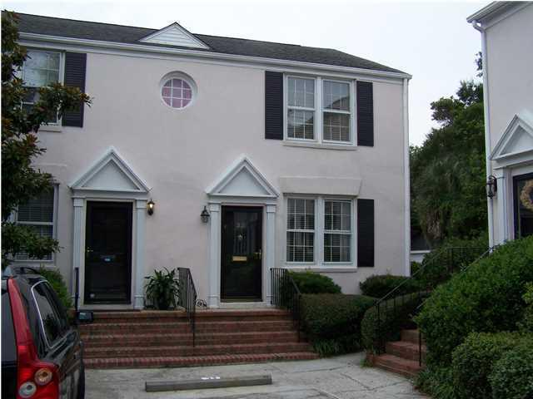
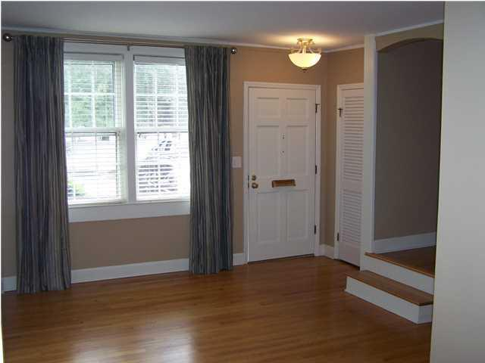
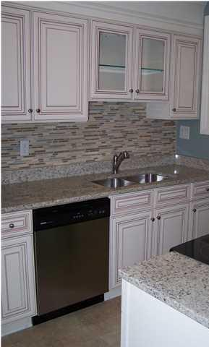
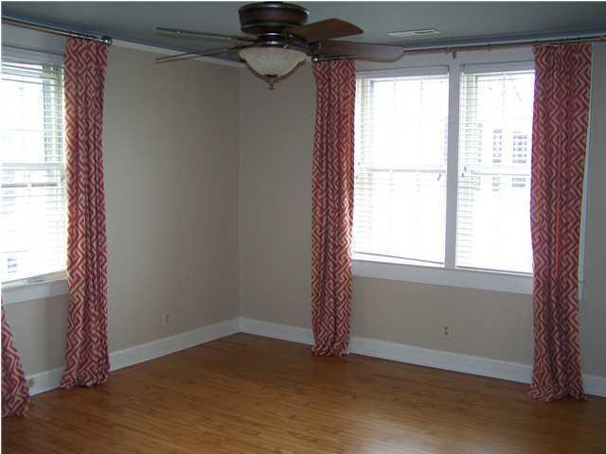
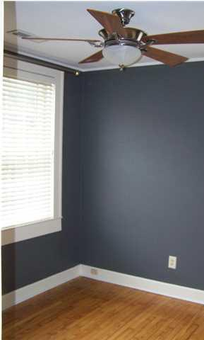
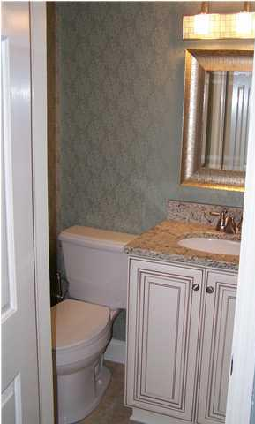
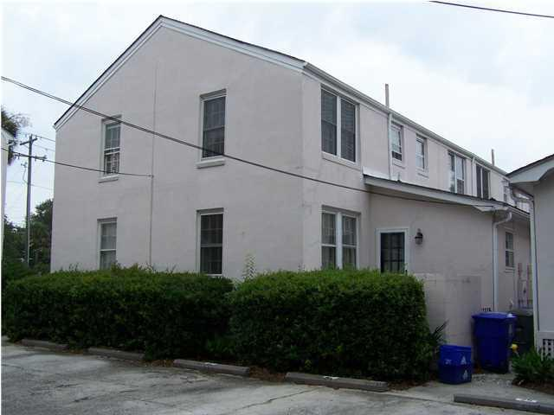
Major Price Reduction
33 Ashley Avenue
South of Broad
Charleston, SC 29401
$525,000
MLS# 1421480
2 Bed | 1½ Bath | 1,333 sf
Lovely two bedroom townhouse/condo located South of Broad at the intersection of Broad Street and Ashley Avenue. Park at your front door. This home comes with two (2) deeded off street parking places. Home has recently undergone remodeling and upgrades. The upgrades include: new kitchen cabinets, counters and floors, updated bathrooms and laundry room. Hardwood floors are located throughout the home with ceramic tile found in the kitchen, laundry room and bathrooms. First floor rooms include: living room, dining room, kitchen, half bath, laundry room and a pantry. The second floor has two (2) bedrooms and a full bathroom. There is a drop stair attic with plenty of storage space. This home is a must see.
Thomas Hartnett, Jr
Hartnett Realty Co., Inc.
134 Meeting St, Chas, SC 29401
tom@hartnettrealty.com
(843) 723-7222 Office | (843) 270-2915 Mobile

